Slide 1
Workshop for Post-Primary Mathematics
Workshop 3 - Geometry and Trigonometry

Slide 2
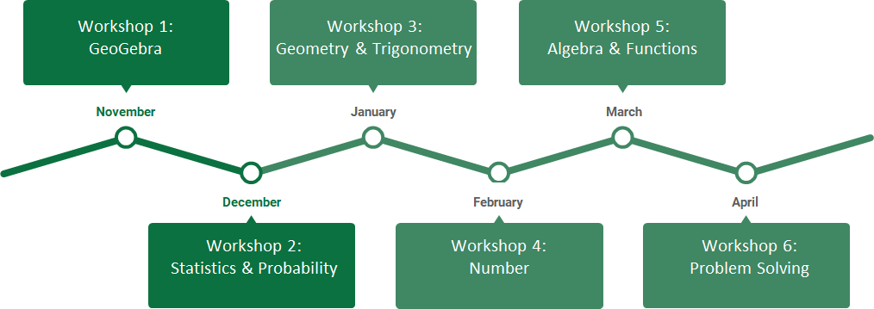
Rationale

Slide 3
Timetable
19.00 - 19.05 Overview
19.05 - 19.15 Review of Workshop 2 HW Task
19.15 - 19.45 Task 1 - The Van Hiele Theory of Geometric Thinking
19.45 - 20.15 Task 2 - Good Practice in Geometry
20.15 - 20.25 Break
20.25 - 21.00 Task 3 - Going in Circles with Pythagoras
21.00 - 21.15 Homework Task - Making Connections
21.15 - 21.30 Summary

Slide 4
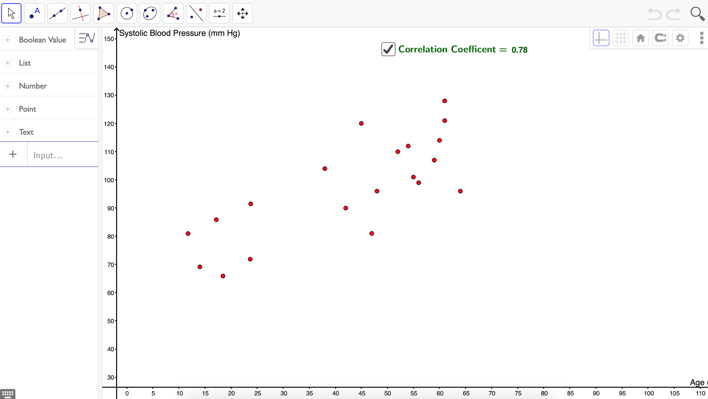
Review of Workshop 2
Booklet Task: Bivariate Date
https://tinyurl.com/WS2HW

Slide 5
Your expectations
What do you hope to gain from this workshop?
https://tinyurl.com/GeoTrigHopes
Password: GeoTrigHopes

Slide 6
Key messages
Geometry and Trigonometry offers a rich opportunity for students to engage with mathematics and to develop their mathematical thinking
It is important to consider the implications of the Van Hiele Theory of Geometric Thinking when teaching Geometry and Trigonometry

Slide 7
Task 1 - The Van Hiele Theory of Geometrical Thinking
Learning outcomes
Recognise the importance of improving students’ geometric thinking
Understand the key tenets of the Van Hiele Theory of Geometric Thinking and how this informs our approach to teaching Geometry
Apply an understanding of the Van Hiele Theory to the teaching of Geometry Concepts
Recognise how the Van Hiele Theory complements the pedagogies promoted in key policy

Slide 8
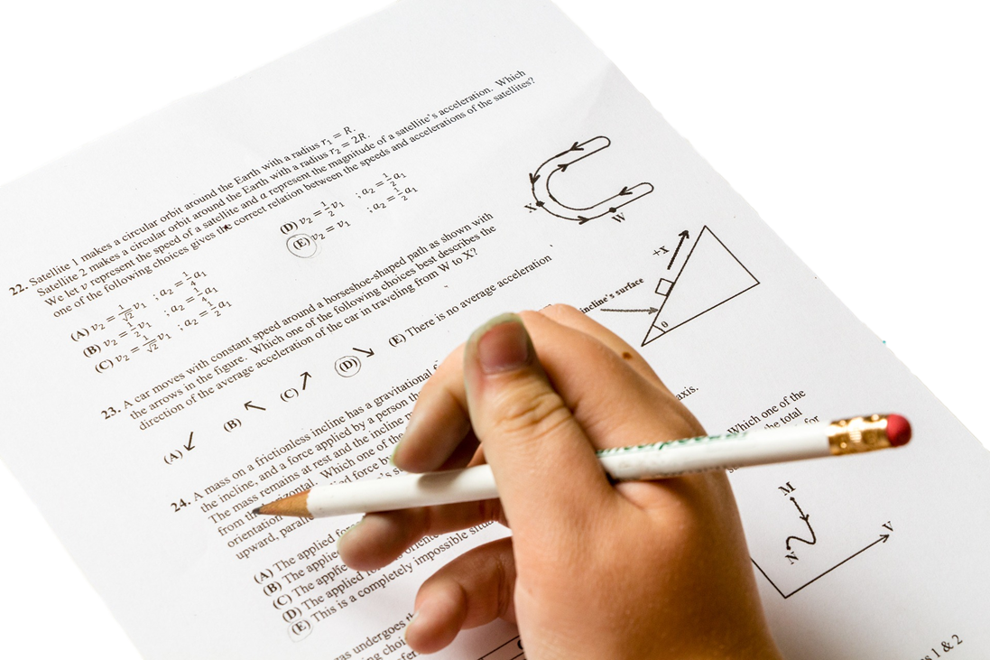
Chief Inspectorate Report 2015
“The underperformance of higher-achieving students in Ireland in Mathematics is a matter of concern”.
“The effective consolidation of student learning also remains a key challenge”.
“In incidental inspectors, the use of appropriate teaching approaches was less than satisfactory in 15% of lessons”.
Recommendations:
“Differentiated teaching strategies should be further developed to ensure the effective inclusion of students of all abilities”.
“The potential of ICT to enable enriched learning experiences is not being exploited sufficiently in post-primary schools.”

Slide 9
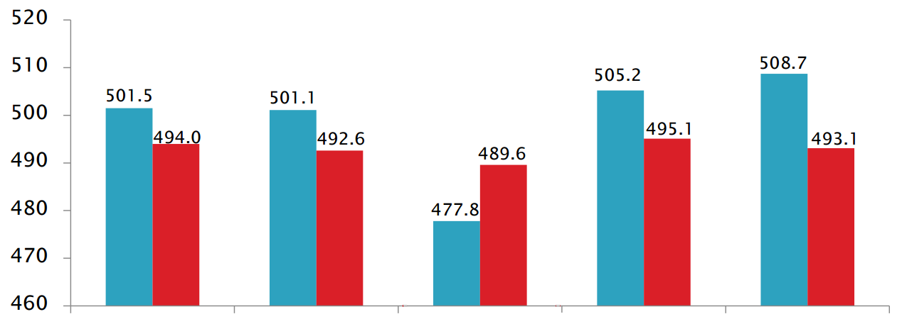
Overall
Change & Relationships
Space & Shape
Quantity
Uncertainty & Data
9

Slide 10
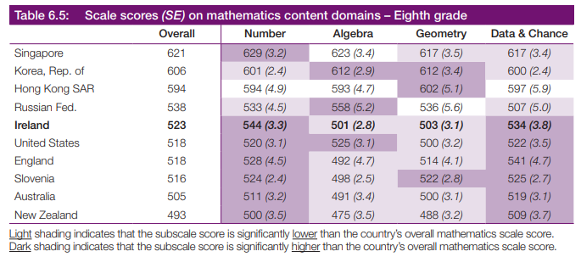
In Ireland, Second Year students displayed relative strengths on the Number (+21 pts.) and Data & Chance (+10 pts.) content domains, and relative weaknesses on Algebra (-22 pts.) and Geometry(-20 pts.)
10

Slide 12
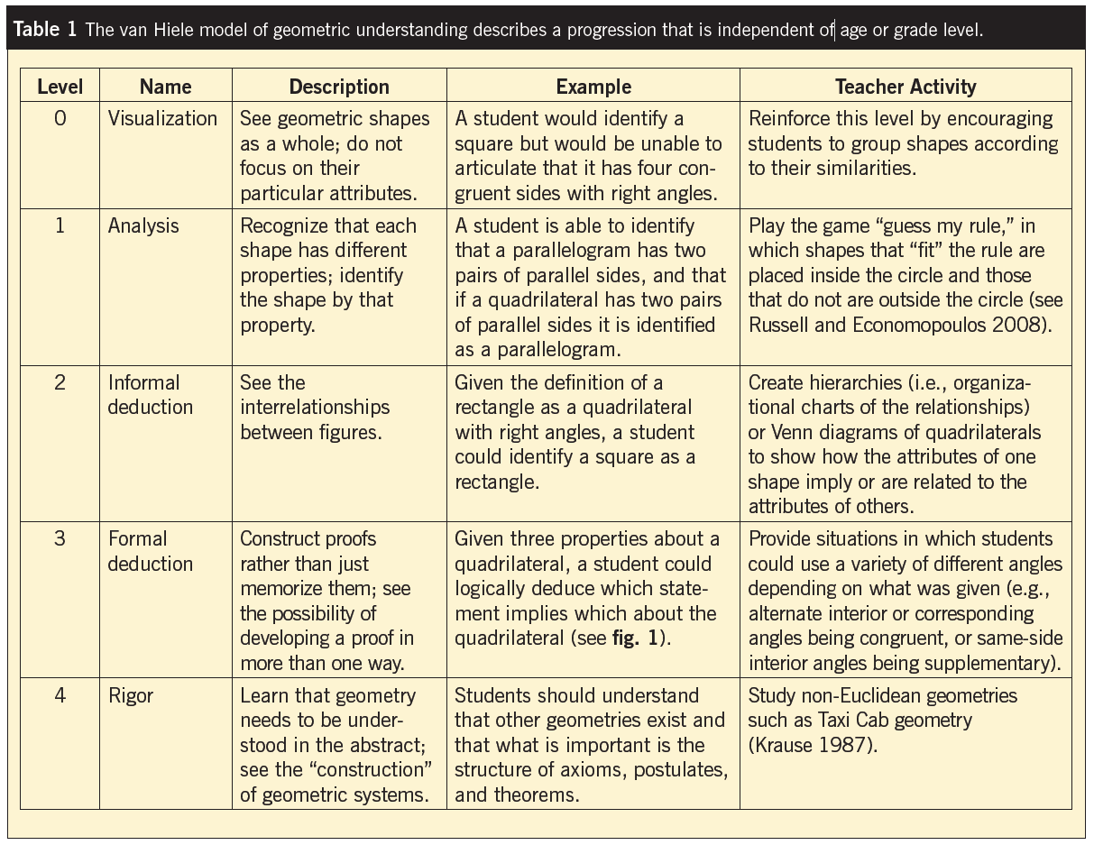
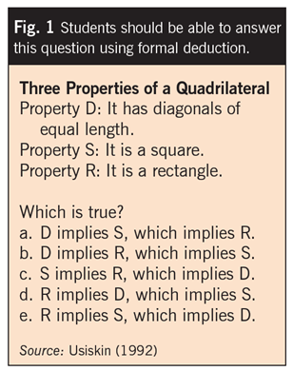

Slide 13
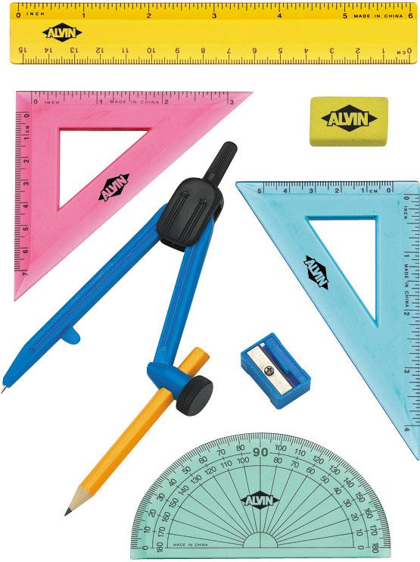
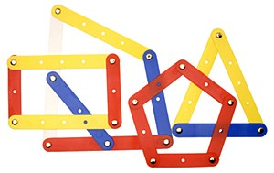
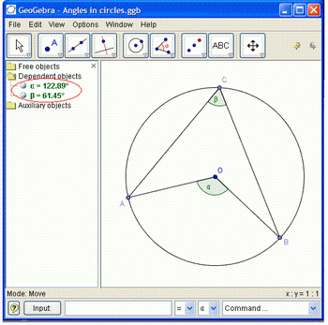
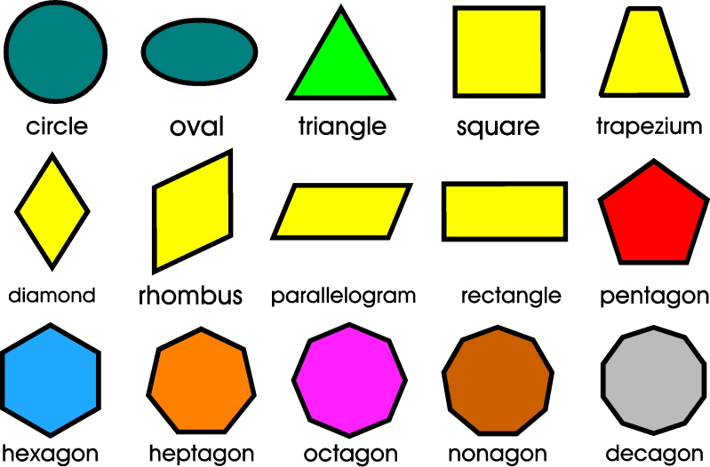
Resources used in a Geometry Lesson

Slide 14
You are now standing vertically opposite Van Hiele
How do you normally teach vertically opposite angles?

Slide 15
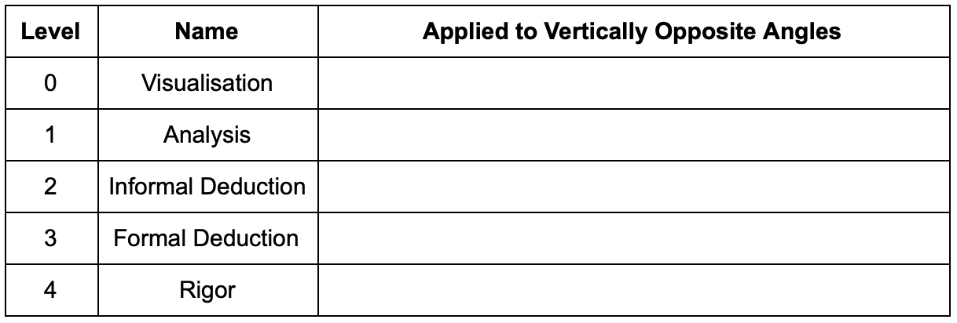
Task 1 - Catering for students at different van Hiele levels

Slide 16
Task 1 - The Van Hiele Theory of Geometrical Thinking
Learning outcomes
Recognise the importance of improving students’ geometric thinking
Understand the key tenets of the Van Hiele Theory of Geometric Thinking and how this informs our approach to teaching Geometry
Apply an understanding of the Van Hiele Theory to the teaching of Geometry Concepts
Recognise how the Van Hiele Theory complements the pedagogies promoted in key policy

Slide 17
Task 2 - Good Practice in Geometry
Learning outcomes
Understand a number of basic practices which may help students better develop their Geometric Thinking.
Understand the benefits of exploring relationships in a logical way to lead students to prove deductively.
Theorems, constructions, axioms and definitions are all connected and knowledge is needed in all areas in order to build upon each concept.

Slide 18
Resources to assist planning

Slide 19
Axioms, Theorems and Constructions are connected

Slide 20
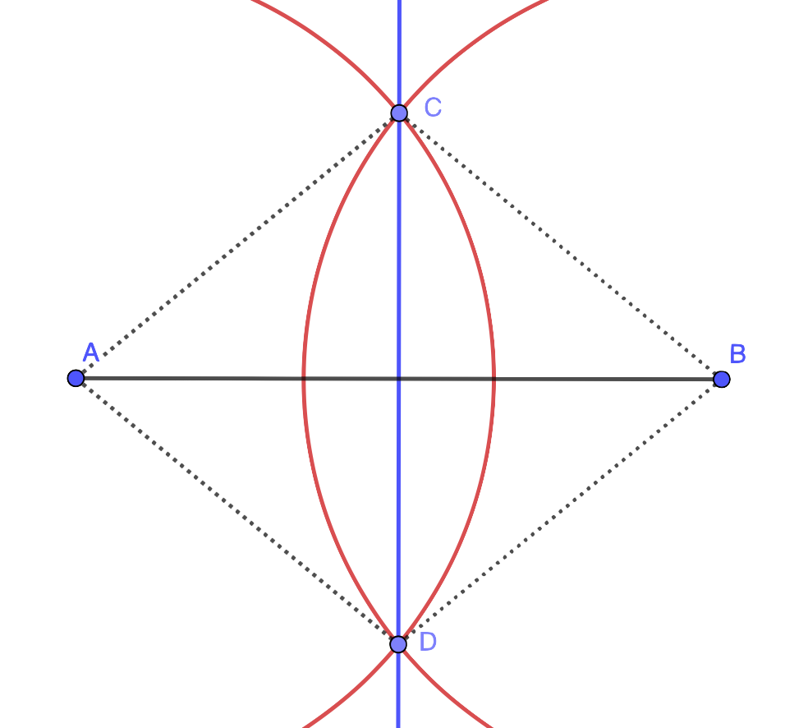
Task 2:
How many relationships can you see in this Diagram?

Slide 21
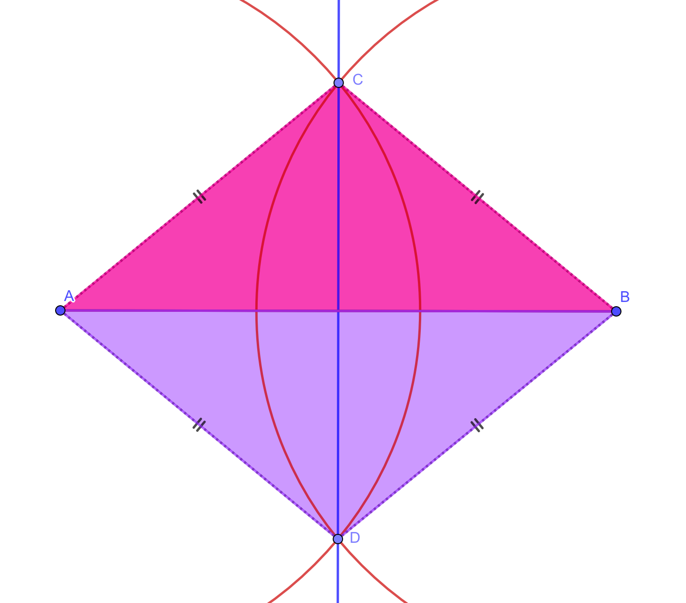
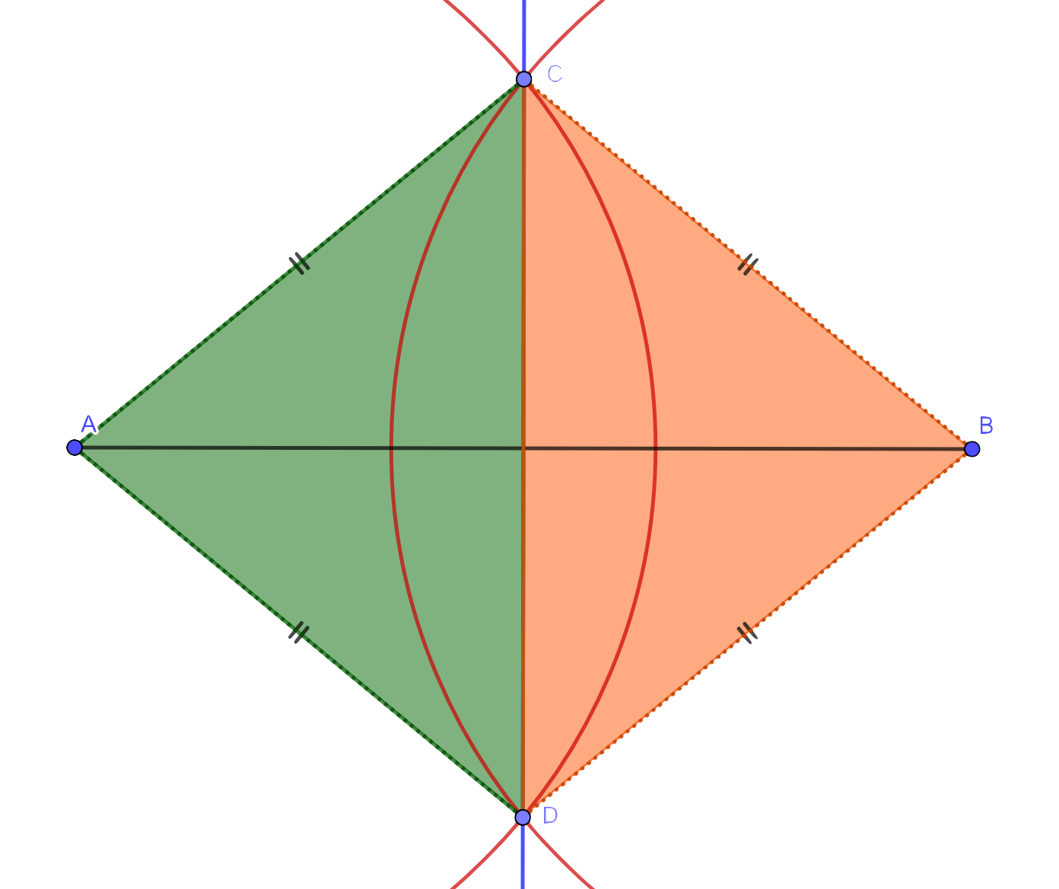
Some Relationships
2 Isosceles Triangles - Congruent (SSS)
Side
Side
Side
Side
Side
Side
Side
Side
Side
Side
Side Side
Side

Slide 22
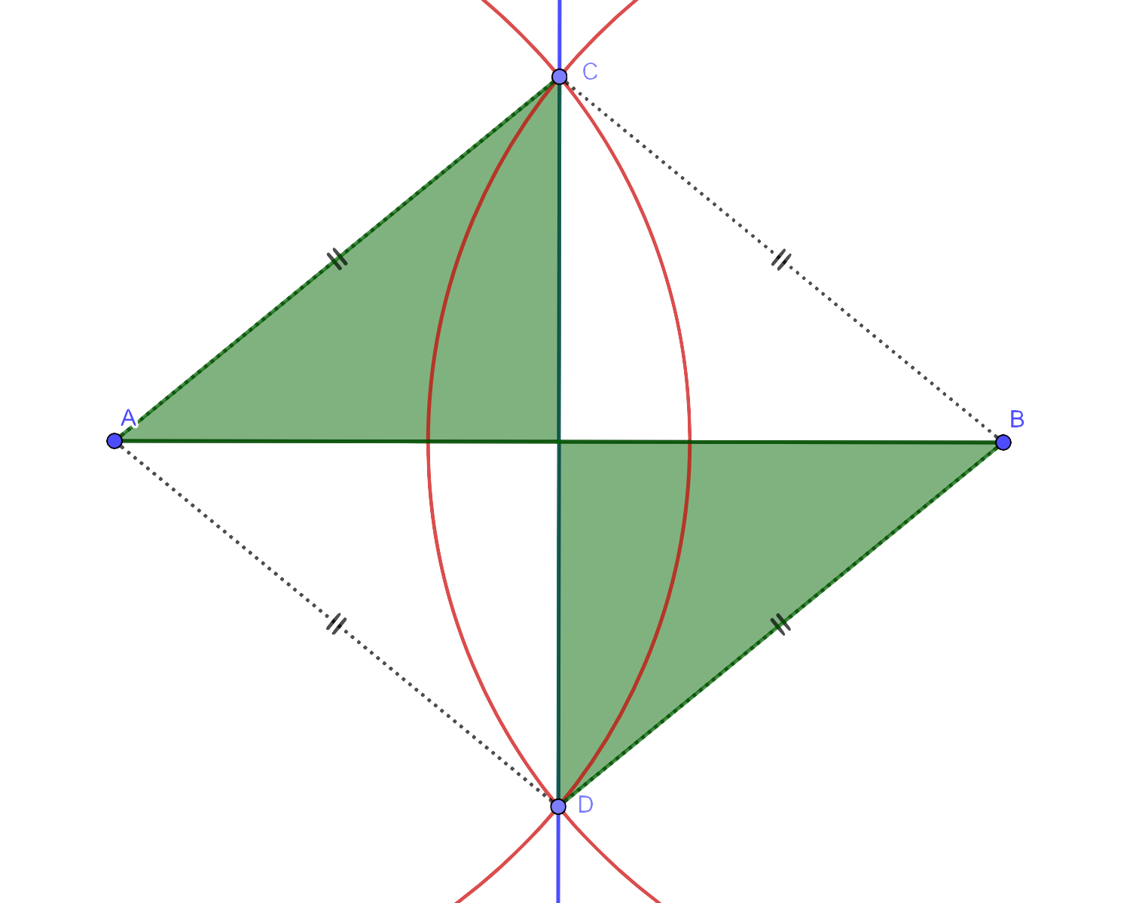
4 small congruent triangles

Slide 23
Connections to other Constructions:
Construction 3: Perpendicular line through a point not on the line
Construction 4: Perpendicular through a point on a line.

Slide 24
Future Learning of Constructions
The perpendicular bisector of a line segment is also related to the construction of root 3 and required for both the construction of the circumcentre and the centroid of a triangle.

Slide 25
Task 2 - Good Practice in Geometry
Learning outcomes revisited
Understand a number of basic practices which may help students better develop their Geometric Thinking.
Understand the benefits of exploring relationships in a logical way to lead students to prove deductively.
Theorems, constructions, axioms and definitions are all connected and knowledge is needed in all areas in order to build upon each concept.

Slide 27
Task 3 - Going in circles with Pythagoras
Learning Outcomes
Recognise the importance of Pythagoras’ Theorem in making sense of the equation of a circle.
Understand that often new mathematical knowledge may be developed using knowledge students already have.

Slide 28
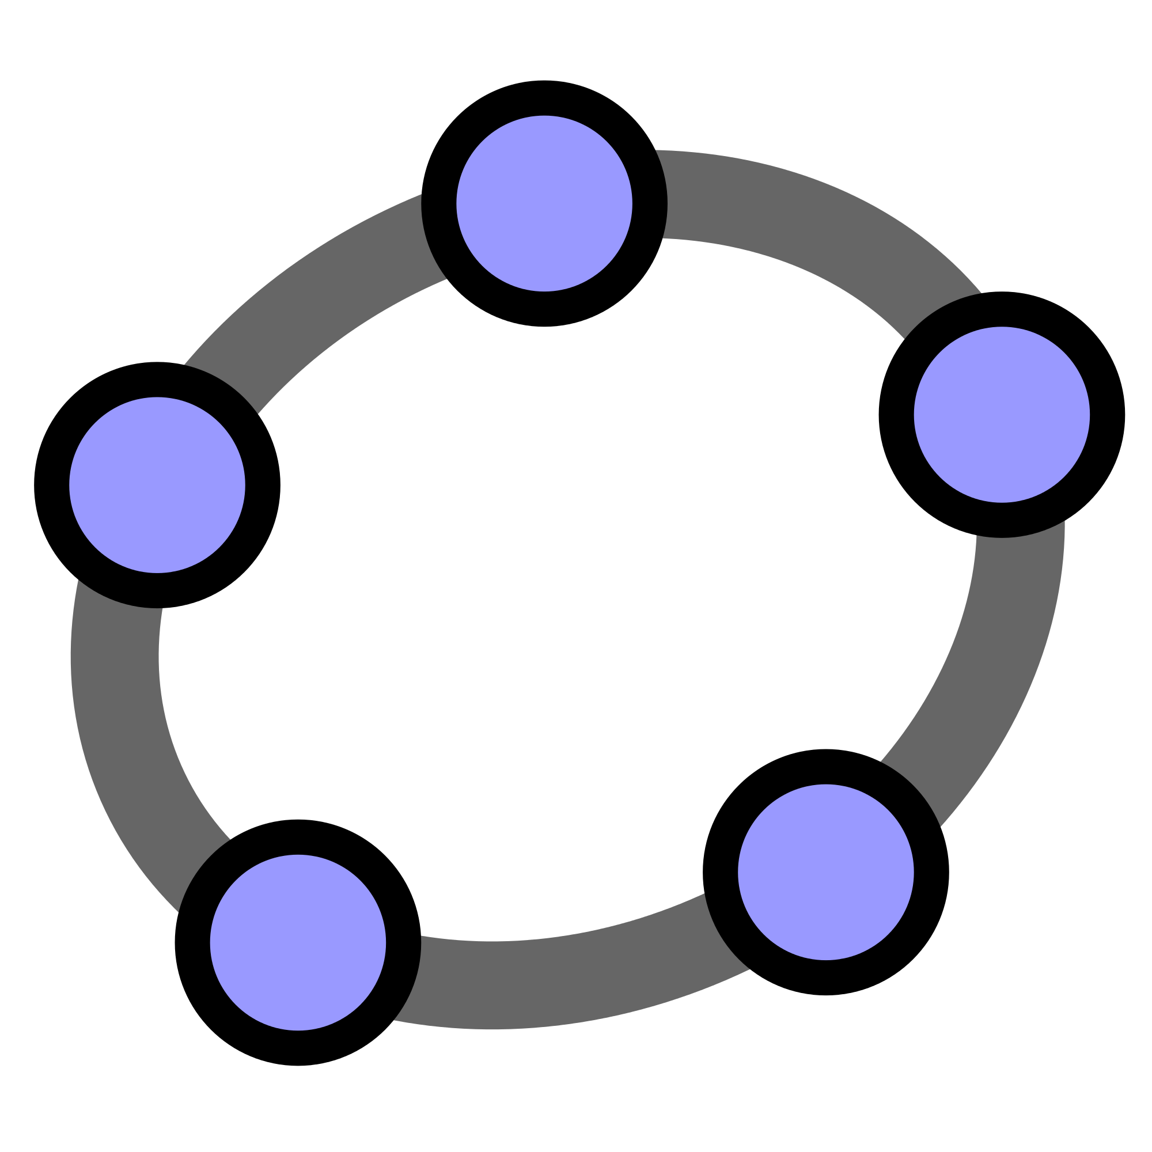
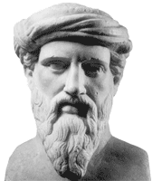
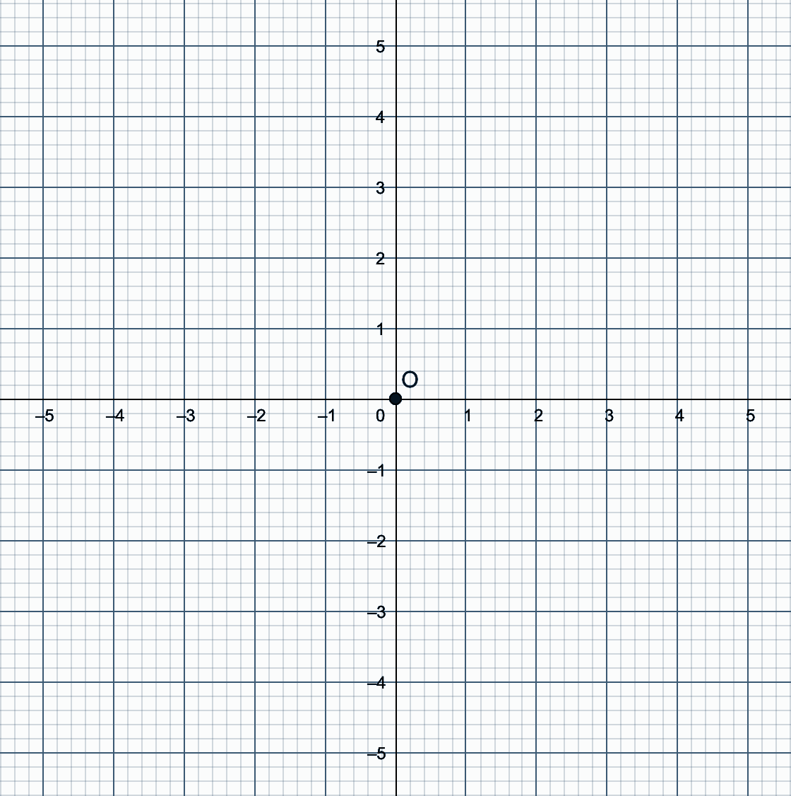
Task 3 - Going in circles with Pythagoras
Write down the coordinates of as many points as possible that are equidistant from the origin?

Slide 29
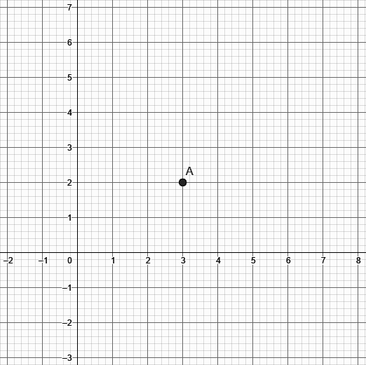
Task 3 - Going in circles with Pythagoras
Write down the coordinates of as many points as possible that are equidistant from the point (3, 2)?

Slide 30
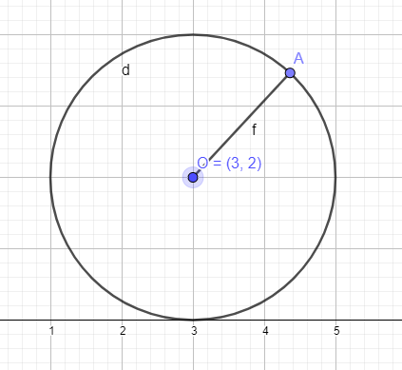
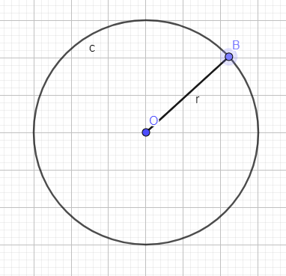
(x - 3)² + (y - 2)² = 2²
(x - h)² + (y - k)² = r²
2
r
y - 2
x - k
x - 3
x - h

Slide 31
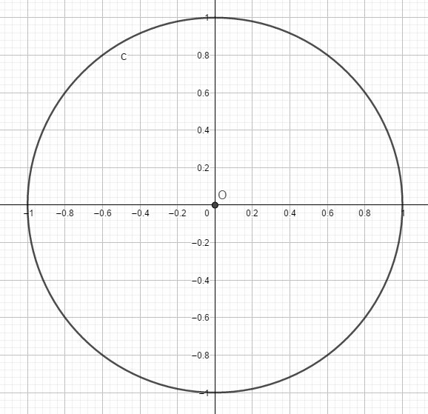
Trigonometry - Pythagoras, The Unit Circle and Trigonometric Identities
Cos𝜭 = a / h, where h = 1
a = 1 x Cos𝜭
a = Cos𝜭
(Cos𝜭, Sin𝜭)
h
Sin𝜭 = o / h, where h = 1
o = 1 x Sin𝜭
o = Sin𝜭
o
Sin𝜭
𝜭
a
Cos𝜭
Cos²𝜭 + Sin²𝜭 = 1

Slide 32
Task 3 - Going in circles with Pythagoras
Learning Outcomes
Recognise the importance of Pythagoras’ Theorem in making sense of the equation of a circle.
Understand that often new mathematical knowledge may be developed using knowledge students already have.

Slide 33
Homework Task
Learning Outcomes
Recognising that axioms, theorems and constructions are deeply connected.
Understand the benefits of making these connections to extend and complement our geometrical thinking.
Recognise the impact on our teaching practice of making connections
Realise the time efficiency of making connections.

Slide 34
Construction 2 Connections
Theorem 9
Theorem 5
Corollary 1
Definitions
30-34
Theorem 3
Definitions
24-25
Axiom 5
Construction 5
Construction 2
Axiom 4

Slide 35
Construction 2 Connections
Theorem 21
Theorem 20
Construction 19
Definition 27
Construction 2
Definition 40-42

Slide 36
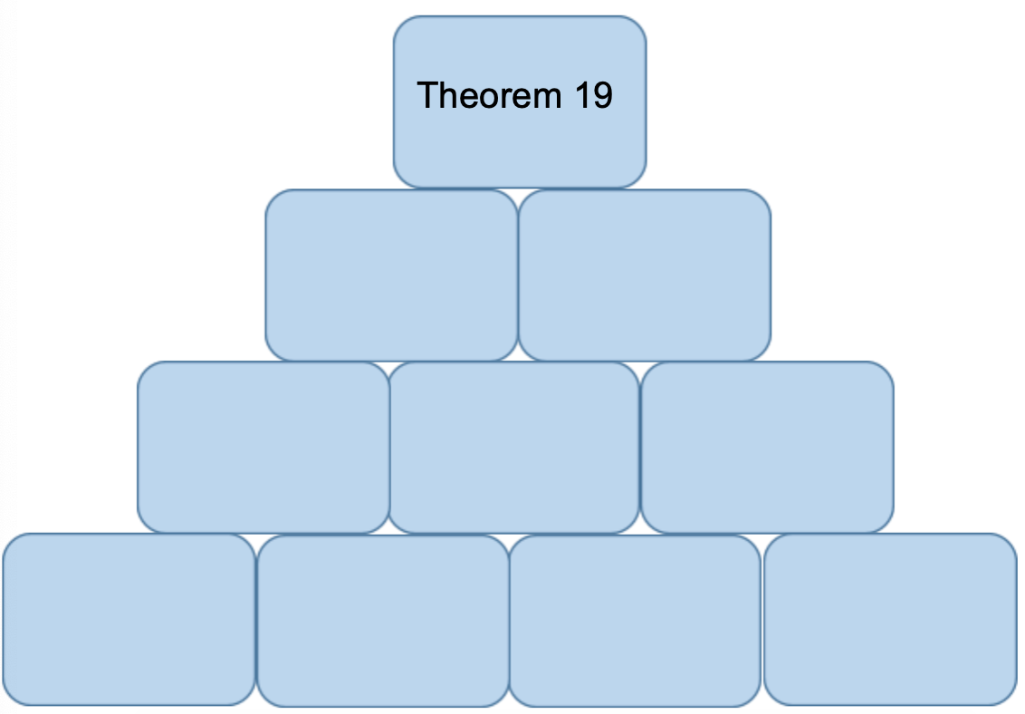
Homework Task - Using connections in the planning process
Using Theorem 19
Make meaningful connections to other axioms, theorems and constructions
Include these connections in your planning
Collaborate with your colleagues on using this planning process.

Slide 37
Summary
Evaluation Form
https://tinyurl.com/WS3Evaluation
warrenmcintyre@pdst.ie

