Slide 1
Workshop for Post-Primary Mathematics
Workshop 5 - Algebra & Functions

Slide 3
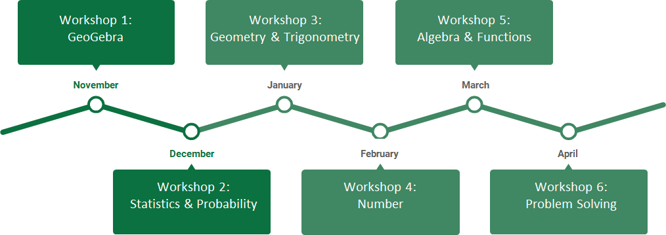
Rationale

Slide 4
Timetable
19.00 - 19.05 Overview
19.05 - 19.10 Review of Workshop 4 HW Task
19.10 - 19.50 Task 1 - Functions
19.50 - 20.30 Task 2 - Introduction to Calculus
20.30 - 20.40 Break
20.40 - 21.20 Task 3 - Rates of Change & Visualising Derivatives
21.20 - 21.25 Homework task - Visualising Derivatives
21.25 - 21.30 Summary

Slide 5
Review of Workshop 4 Homework Task
Modelling Investments
Jenny invests €20 at the start of each month for three years in a savings account which offers a monthly rate of 0.5%. She then reduces her investment to €15 for the remaining two years. What will the value of this investment be at the end of five years?

Slide 6
Solution
20
20(1.005)⁶⁰
20 x 1.005⁶⁰
20 x 1.005⁵⁹
…
…
20 x 1.005²⁵
15 x 1.005²⁴
…
…
15 x 1.005²
15 x 1.005¹
20
20(1.005)⁵⁹
36 months
20
20(1.005)²⁵
15
15(1.005)²⁴
24 months
15
15(1.005)²
15
15(1.005)¹
If we model the investment for 60 periods we see the following sum:
20 x 1.005²⁵ + 20 x 1.005²⁶ + ... + 20 x 1.005⁶⁰ + 15 x 1.005¹ + 15 x 1.005² +...+ 15 x 1.005²⁴

Slide 7
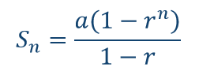
Using the Sum of a Geometric Series
20 x 1.005²⁵ + 20 x 1.005²⁶ + ... + 20 x 1.005⁶⁰ + 15 x 1.005¹ + 15 x 1.005² +...+ 15 x 1.005²⁴

Slide 8
Key Messages
It is important to build on students’ knowledge from Junior Cycle to extend their understanding of functions at Senior Cycle.
It is important to understand the difference between a relationship and a function.
It is important for students to understand the origins and purpose of differential calculus and its role in analysing functions.

Slide 9
Task 1 - Functions
Learning Outcomes
During the course of this task we will:
Explore the definition of a function and recognise that the set of functions is a subset of the set of relations
Explore the multi-representations of functions and relations and use these to understand the difference between a function and a relation
Explore the concept of inverse and investigate the idea that the inverse of a function is not always a function
Recognise the criteria that apply in order for a function to have an inverse which is also function.

Slide 10
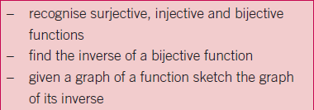
Relationship to Syllabus

Slide 11
Task 1.1: Mapping Representations
Functions and Relations matching activity
Considering each of the mapping diagrams, distinguish which diagram represents a function and which represents a relation only.
Explore the differences between a relation and a function.
Describe the conditions necessary to define a function.

Slide 12
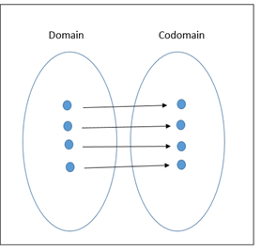
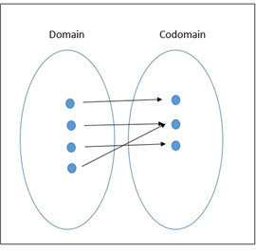
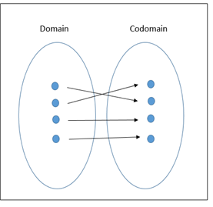
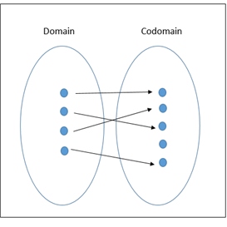
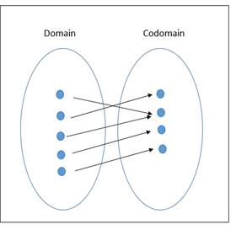
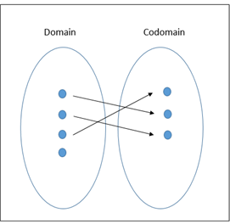
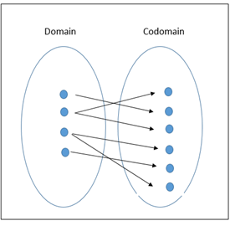
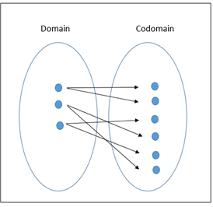
Functions
Relation only

Slide 13
Task 1.2: Matching graphs, couples and algebraic notation
From the set of functions and relations, match the appropriate graph with its algebraic equation and set of couples.
Identify which group of representations are functions and which are relations only. Explain your reasoning.

Slide 14
Solutions

Slide 15
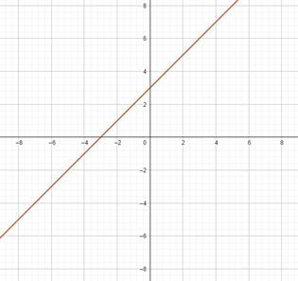
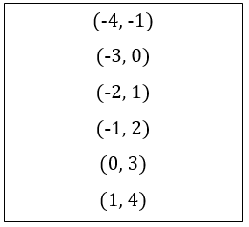
Task 1.2 Solutions - Functions

Slide 16
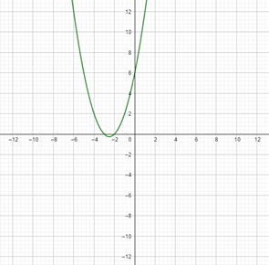
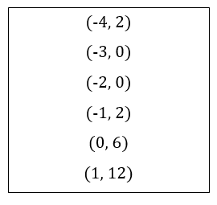

Slide 17
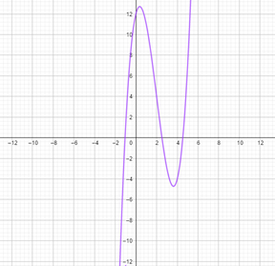
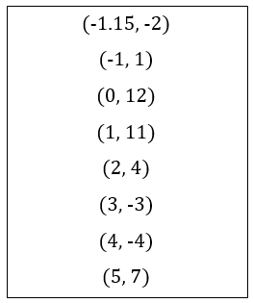

Slide 18
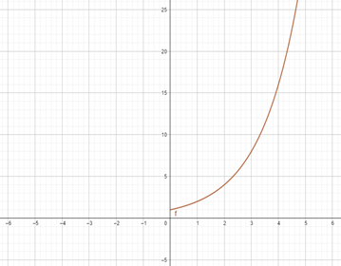
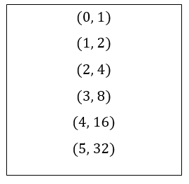

Slide 19
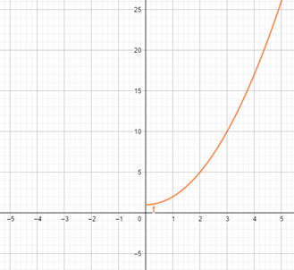
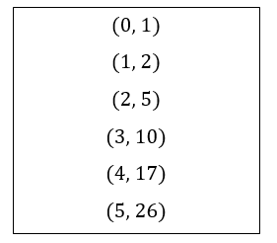

Slide 20
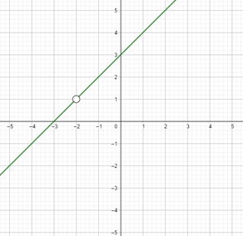
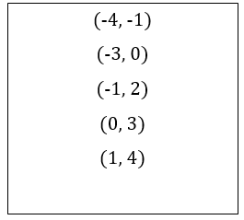

Slide 21
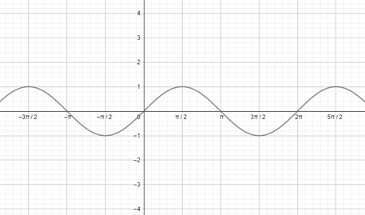
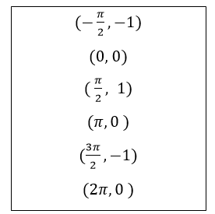

Slide 22
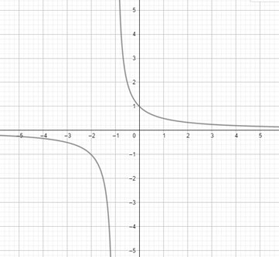
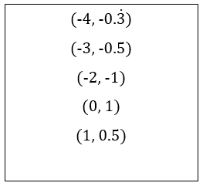

Slide 23
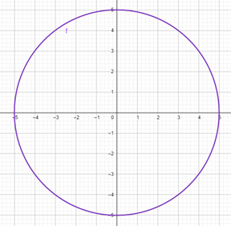
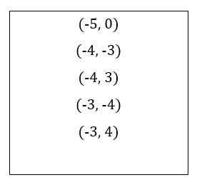
Task 1.2 Solutions - Relations

Slide 24
Discussion
Why do we undo?
Why is it important for us to be able to go backwards?

Slide 25
Task 1.3 Functions and their inverses
Relations

Slide 26
Task 1.3 Functions and their inverses
Which functions in Task 1.2 have inverses that are functions?

Slide 27
Summary

Slide 28
Task 1 - Functions
Learning Outcomes
During the course of this task we will:
Explore the definition of a function and recognise that the set of functions is a subset of the set of relations
Explore the multi-representations of functions and relations and use these to understand the difference between a function and a relation
Explore the concept of inverse and investigate the idea that the inverse of a function is not always a function
Recognise the criteria that apply in order for a function to have an inverse which is also function.

Slide 29
Task 2 - Introduction to Calculus
Learning Outcomes
During the course of this task we will:
Recognise the importance of building on students’ prior knowledge of rates of change to introduce calculus
Identify the slope of a secant on a curve as the average rate of change
Understand the, origin of, and the need for calculus
Understand the difference between average rate of change and instantaneous rate of change
Identify the slope of a tangent to a curve as the instantaneous rate of change.

Slide 30
Discuss
What do you want your students to understand from calculus?

Slide 31
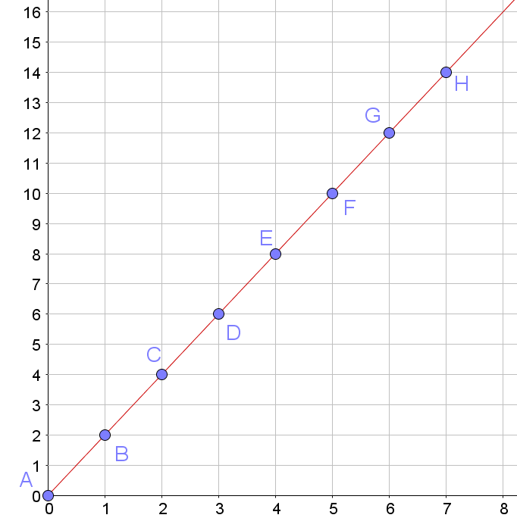
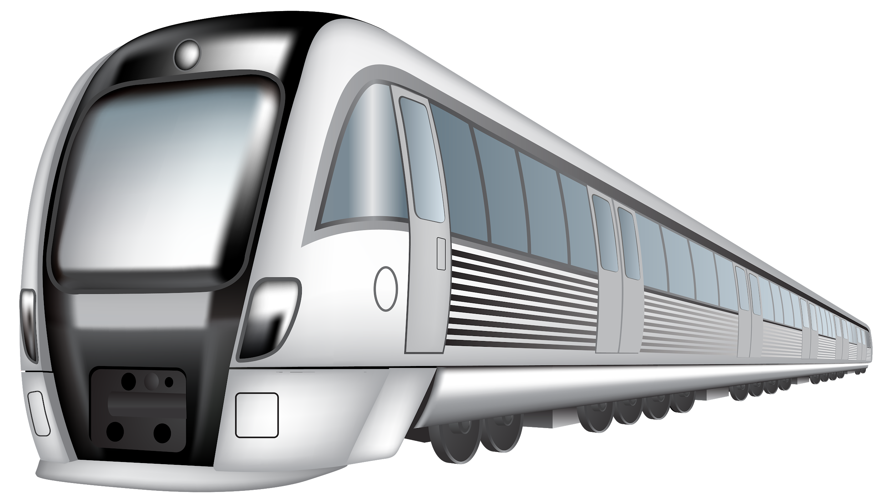
Rates of Change at Junior Cycle
Distance (km)
Time (minutes)

Slide 32
Task 2 – You sayin’ I’m fast?
In 2009 Usain Bolt broke the world record for the 100m sprint with a time of 9.58s.

Slide 33
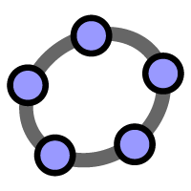
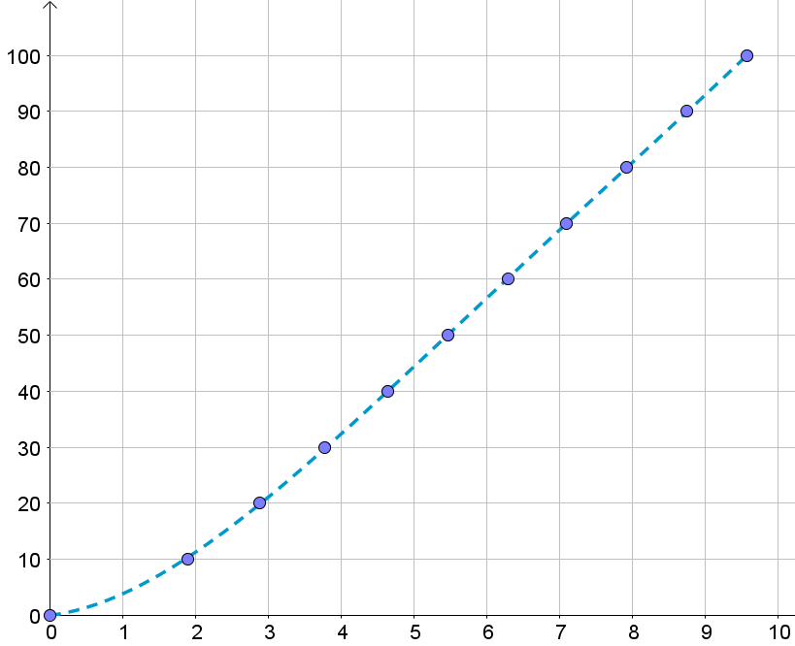
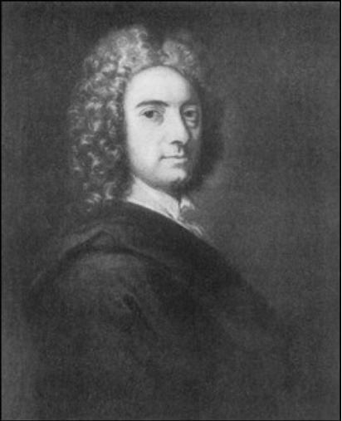
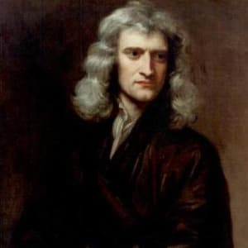
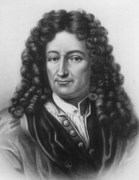
Task 2 - Are you saying I’m fast?
Distance (m)
Time (s)

Slide 34
Origin of Calculus
Newton
Berkeley
Von Leibniz

Slide 35
Task 2 - Introduction to Calculus
Learning Outcomes
During the course of this task we will:
Recognise the importance of building on students’ prior knowledge of rates of change to introduce calculus
Identify the slope of a secant on a curve as the average rate of change
Understand the, origin of, and the need for calculus
Understand the difference between average rate of change and instantaneous rate of change
Identify the slope of a tangent to a curve as the instantaneous rate of change.

Slide 37
Task 3 - Rates of Change
Learning Outcomes
During the course of this task we will:
Investigate the rates of change at different points on a curve as the slope of the tangent to the curve at those points
Explore the relationship between a function and the derivative of that function
Recognise the importance of using a constructivist approach to allow students to discover the rates of change / the slopes of tangents to a curve
See the benefits in using Digital Technologies to further enhance students’ understanding of this concept.

Slide 38
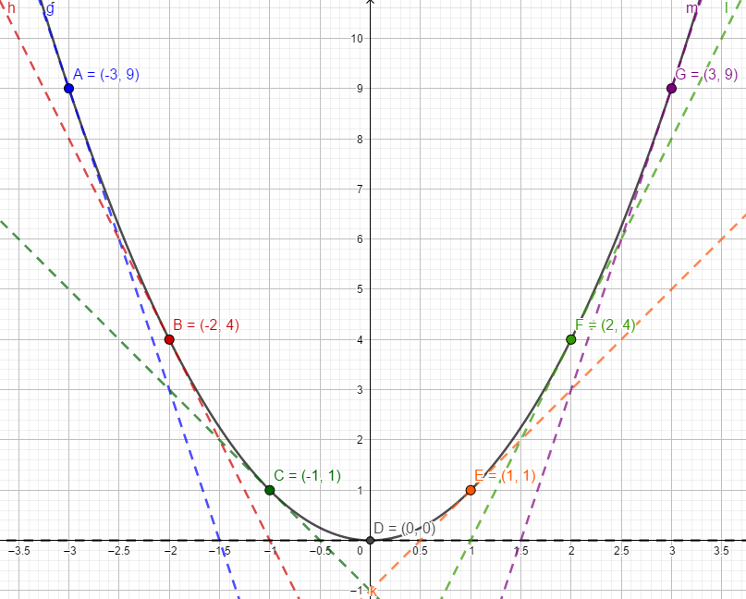
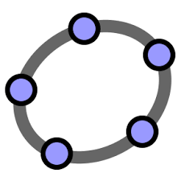
Task 3: Constructing a Lesson

Slide 39
Exploring the derivative of functions

Slide 40
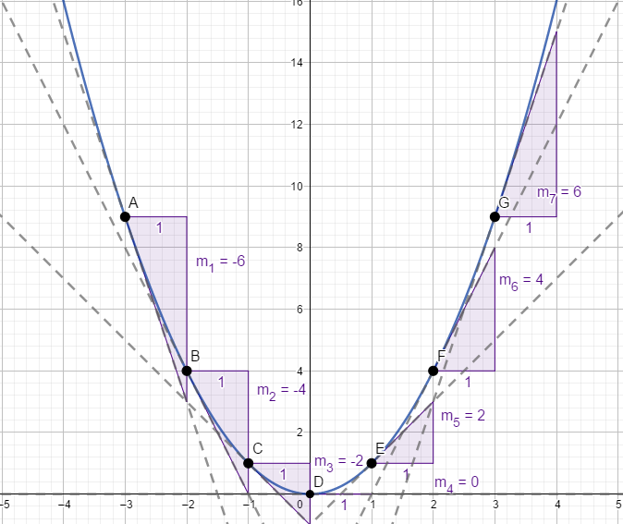
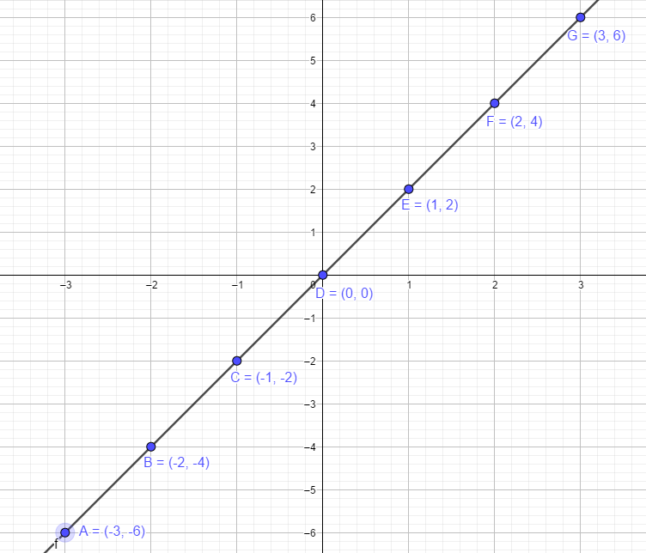
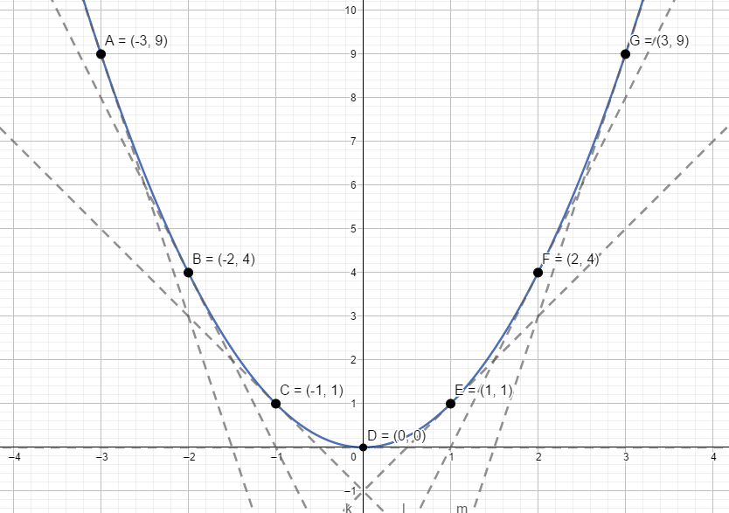
Use the slopes of these tangents to create another function
 | Slope of tangent
-3 | -6
-2 | -4
-1 | -2
0 | 0
1 | 2
2 | 4
3 | 6
Describe the relationship between the x values and the slopes of the tangents to the curve.

Slide 41
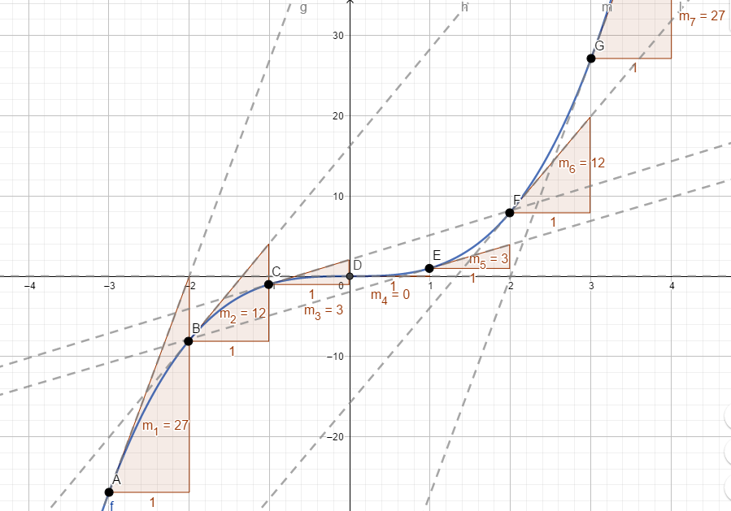
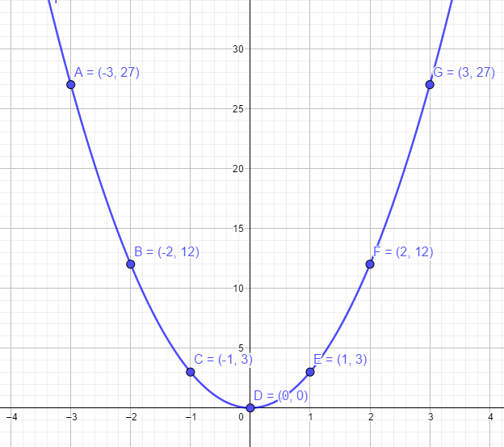
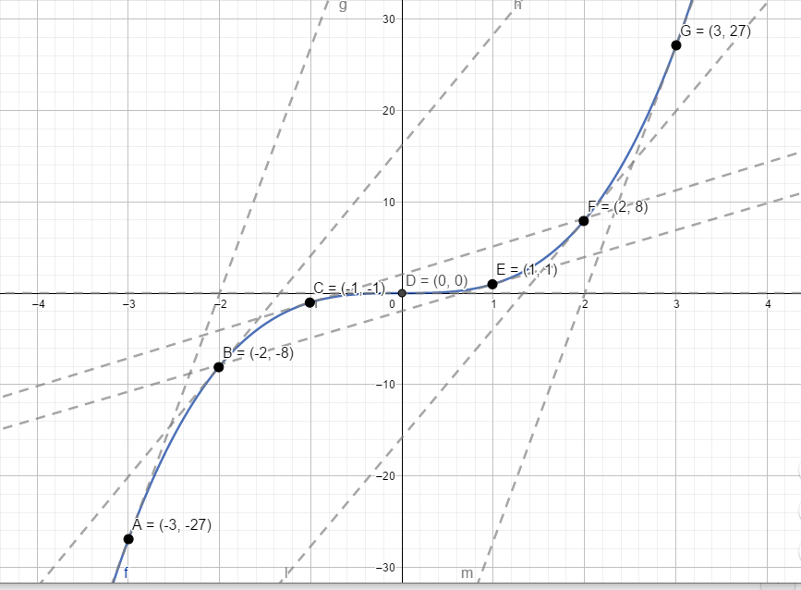
Use the slopes of these tangents to create another function
 | Slope of tangent
-3 | 27
-2 | 12
-1 | 3
0 | 0
1 | 3
2 | 12
3 | 27
Describe the relationship between the x values and the slopes of the tangents to the curve.

Slide 42
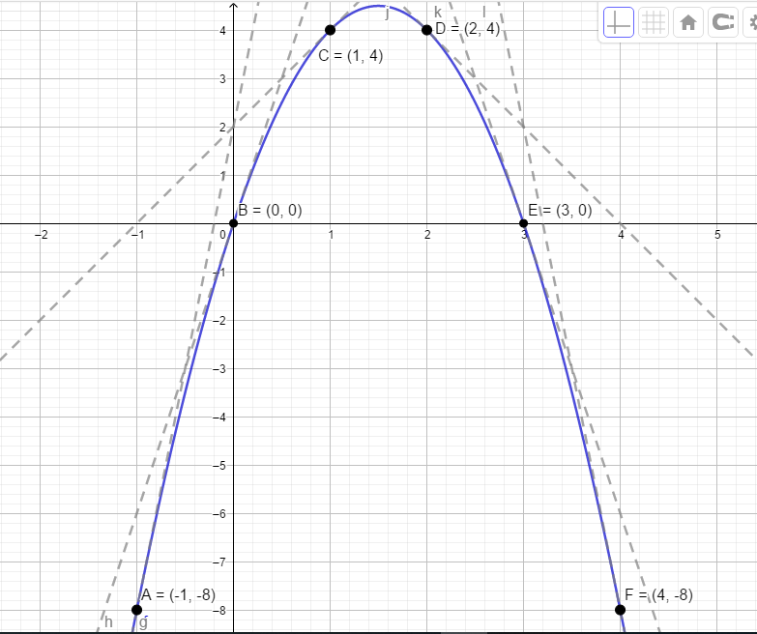
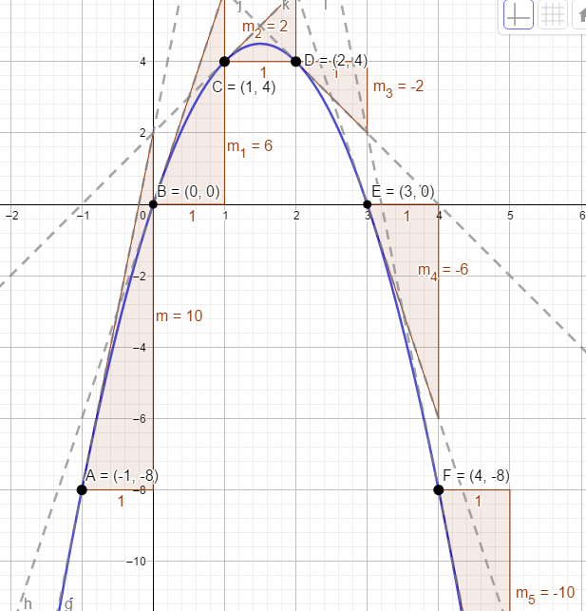
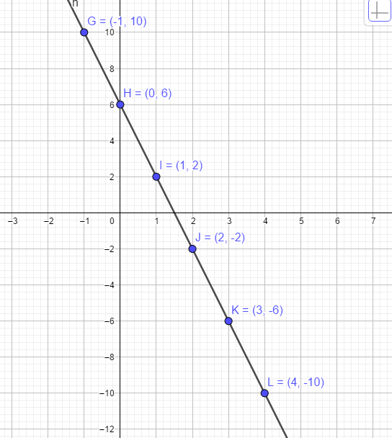
Use the slopes of these tangents to create another function
 | Slope of tangent
-1 | 10
0 | 6
1 | 2
2 | -2
3 | -6
4 | -10
Describe the relationship between the x values and the slopes of the tangents to the curve.

Slide 43
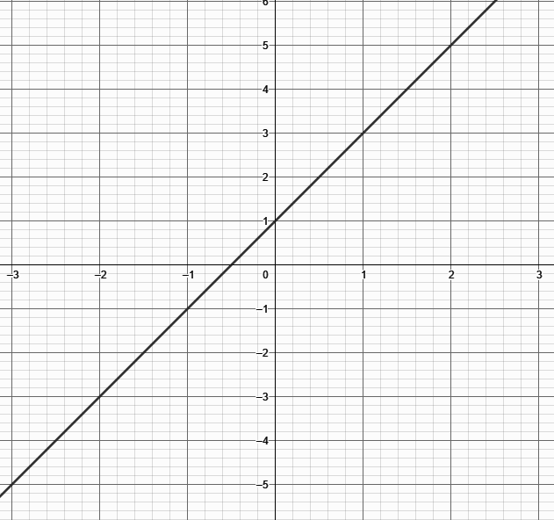
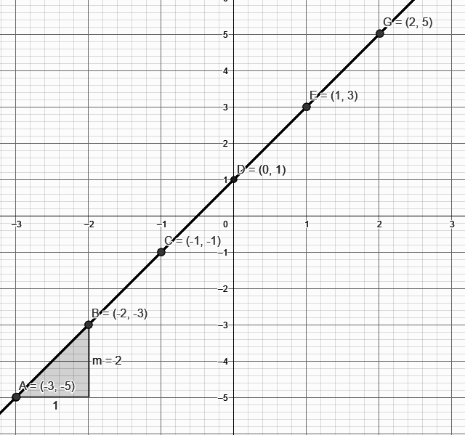
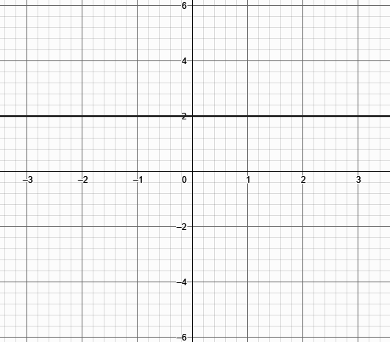
Use the slopes of these tangents to create another function
 | Slope of tangent
-3 | 2
-2 | 2
-1 | 2
0 | 2
1 | 2
2 | 2
Describe the relationship between the x values and the slopes of the tangents to the curve.

Slide 44
Use the slopes of these tangents to create another function
 | Slope of tangent
-𝝅/2 | 0
0 | 1
𝝅/2 | 0
𝝅 | -1
3𝝅/2 | 0
2𝝅 | 1
5𝝅/2 | 0
Describe the relationship between the x values and the slopes of the tangents to the curve.

Slide 45
What opportunities exist in other STEM subjects to demonstrate the importance of Calculus?

Slide 46
Task 3 - Rates of Change
Learning Outcomes
During the course of this task we will:
Investigate the rates of change at different points on a curve as the slope of the tangent to the curve at those points
Explore the relationship between a function and the derivative of that function
Recognise the importance of using a constructivist approach to allow students to discover the rates of change / the slopes of tangents to a curve
See the benefits in using Digital Technologies to further enhance students’ understanding of this concept.

Slide 47
Take Home Task: Visualising Derivatives
Learning Outcomes
Understand the importance of visualising derivatives
Use a matching exercise to further develop their understanding of different derivatives
Use appropriate vocabulary to describe the shapes of curves and to describe the relationships between graphs of derivatives.

Slide 48
Describe the shape of this curve and the slope of the tangent as it moves along the function

Slide 49
Matching Activity

Slide 50
Matching Activity: Solutions

Slide 51
Take Home Task: Visualising Derivatives
Learning Outcomes
Understand the importance of visualising derivatives
Use a matching exercise to further develop their understanding of different derivatives
Use appropriate vocabulary to describe the shapes of curves and to describe the relationships between graphs of derivatives.

Slide 52
Key Messages
It is important to build on students’ knowledge from Junior Cycle to extend their understanding of Functions at Senior Cycle.
It is important to understand the difference between a relationship and a function.
It is important for students to understand the origins and purpose of differential calculus and its use for analysing functions.

