Slide 1
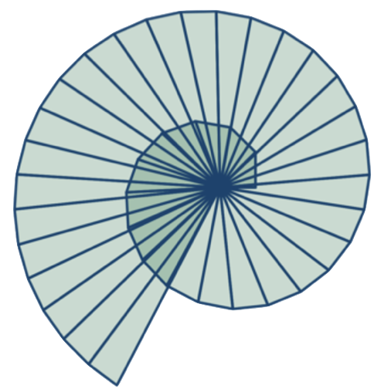
Workshop - Full Day:
Teaching Geometry for Understanding
Through the lens of The Van Hiele Theory of Geometric Thought
@ProjectMaths_ie

Slide 2
Schedule
09:30 – 09:35 Welcome & Updates
09:35 – 09.55 Snacking on Geometry
09.55 – 10.50 The Van Hiele Theory of Geometric Thought
10:50 – 11:05 Tea & Coffee
11:05 – 12.05 Applying Van Hiele to the Teaching of Theorems
12.05 – 13.00 Applying Theory to Our Teaching of Geometry
13:00 – 14:00 Lunch
14:00 – 15:15 Constructions Through the Lens of Van Hiele
15.15 – 15.30 Administration and Evaluations

Slide 3
Key Messages
Consider the need for a Geometry-through-Understanding Classroom
Understand how the van Hiele theory applies to the learning of geometry

Slide 4
Geometry as problem solving
How would your students fare with this problem?
A point inside a square is connected to each of it’s four vertices.
What fraction of the square is shaded?
Source: More Geometry Snacks by Ed Southall, Vincent Pantaloni

Slide 5
Solutions
Geometry Snacks
More Geometry Snacks
Vincent Pantaloni
@panlepan
Ed Southall
@solvemymaths

Slide 7
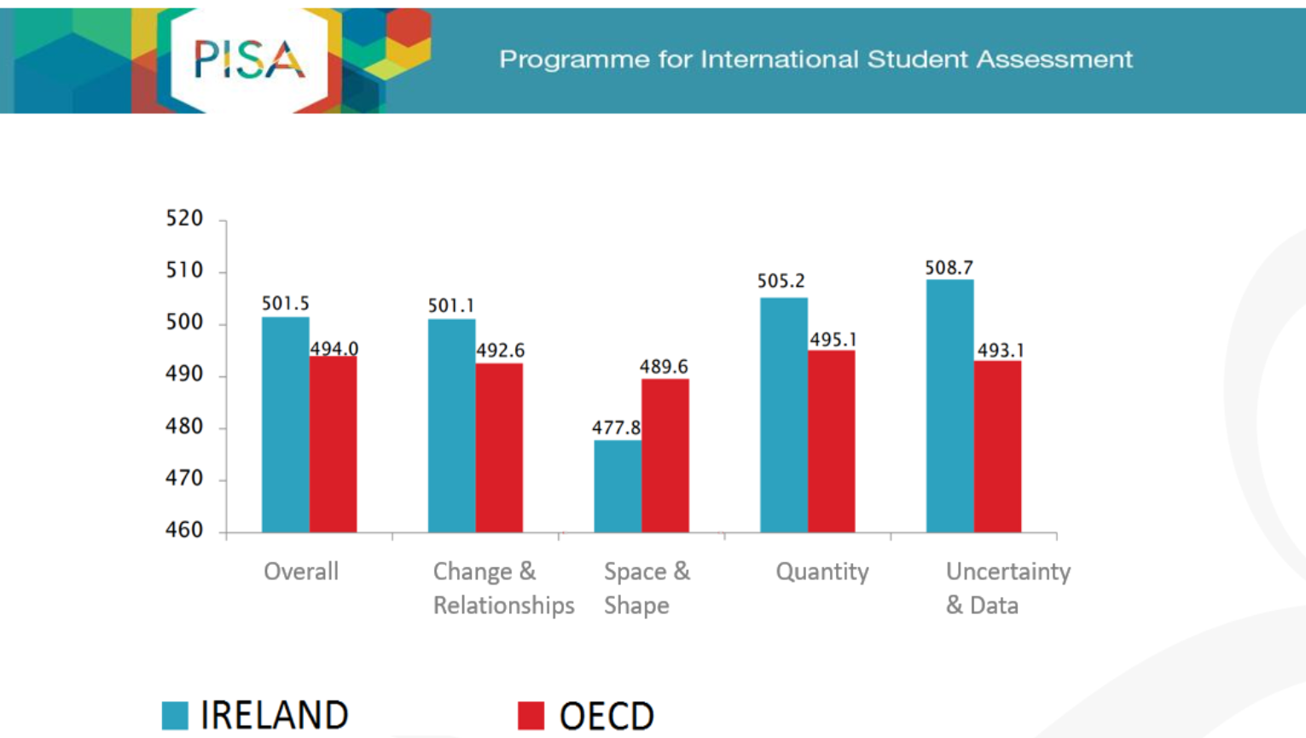
Mean Score

Slide 8
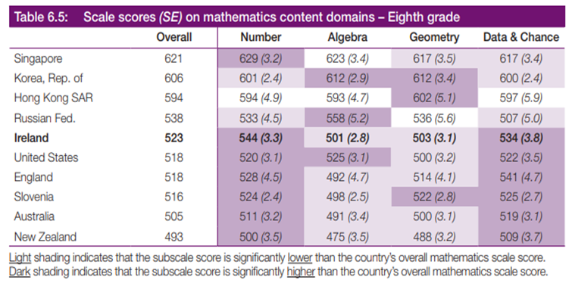

Slide 9
The van Hiele Theory of Geometric Thought

Slide 10
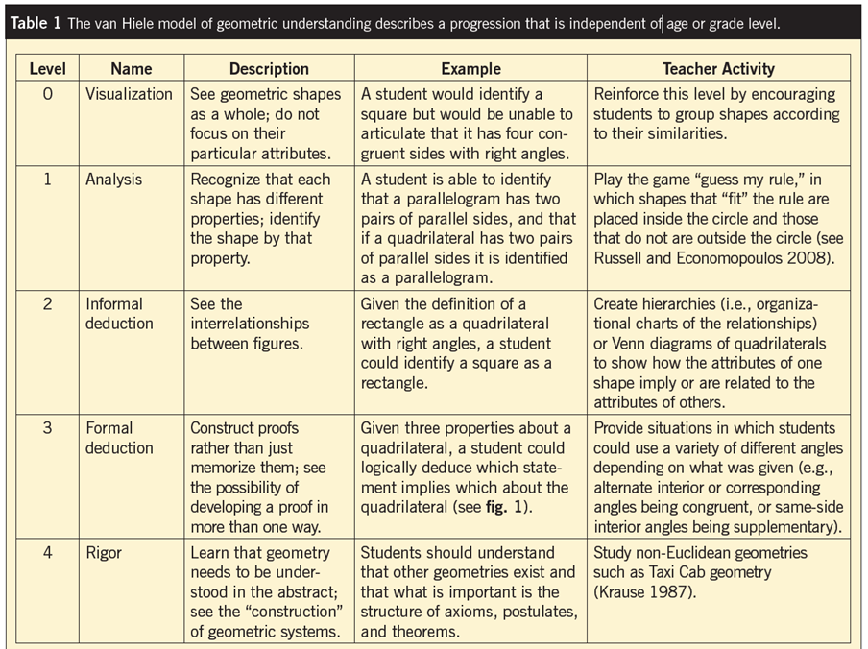
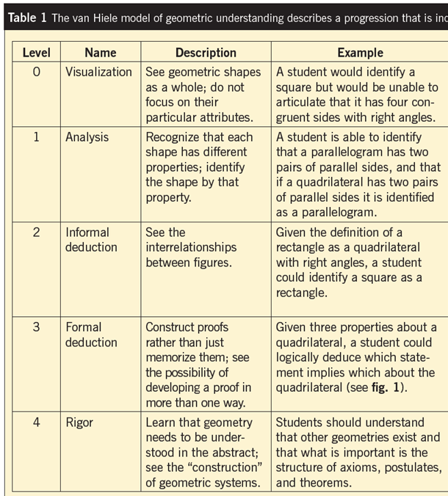
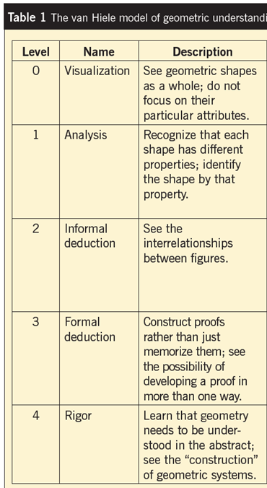
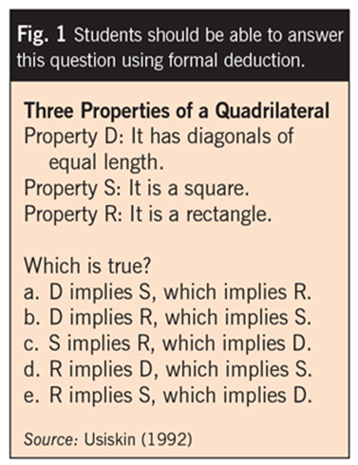

Slide 11
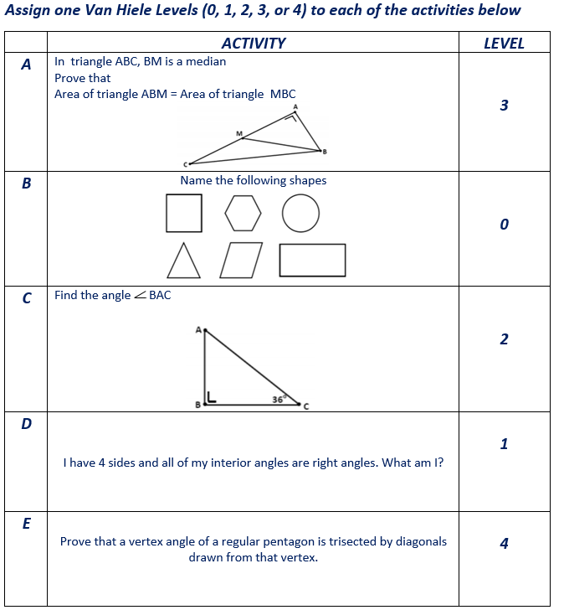
Identifying Van Hiele Levels

Slide 12
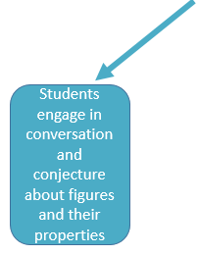
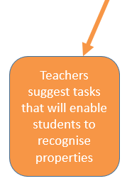
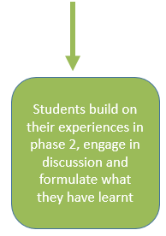
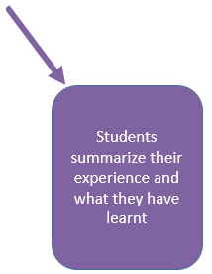

Slide 13
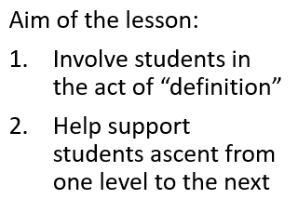
Hierarchy of Hexagons
An activity developed by Danielson (2014)

Slide 14
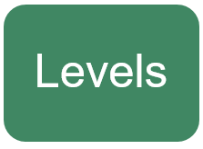
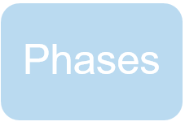
Analysis of the Hierarchy of Hexagon Class
Visualisation : Students cut out the shapes, choose their special shapes
Analysis: Students define a characteristic of the hexagon chosen
Deduction: Students develop relationships, “Can Stacies be Squeakies?”
Inquiry: Students engage in informal conversation about hexagons
Directed Orientation: Teacher asks students to give reasons for their choice
Explication: Students were asked to explain and justify their definitions
Free Orientation: Students created Venn diagrams to explore relationships

Slide 16
Investigation
Draw a line crossing all 3 parallel lines.
Do you notice anything interesting?
Repeat with different lines if needed

Slide 17
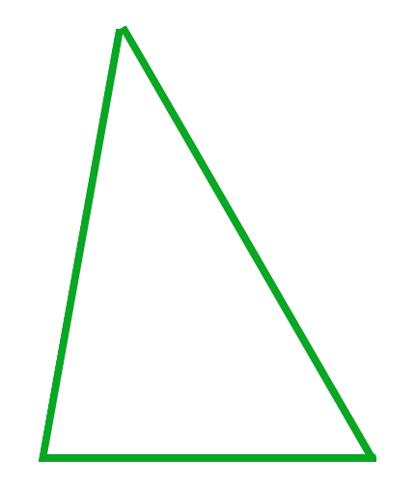
What are these?

Slide 18
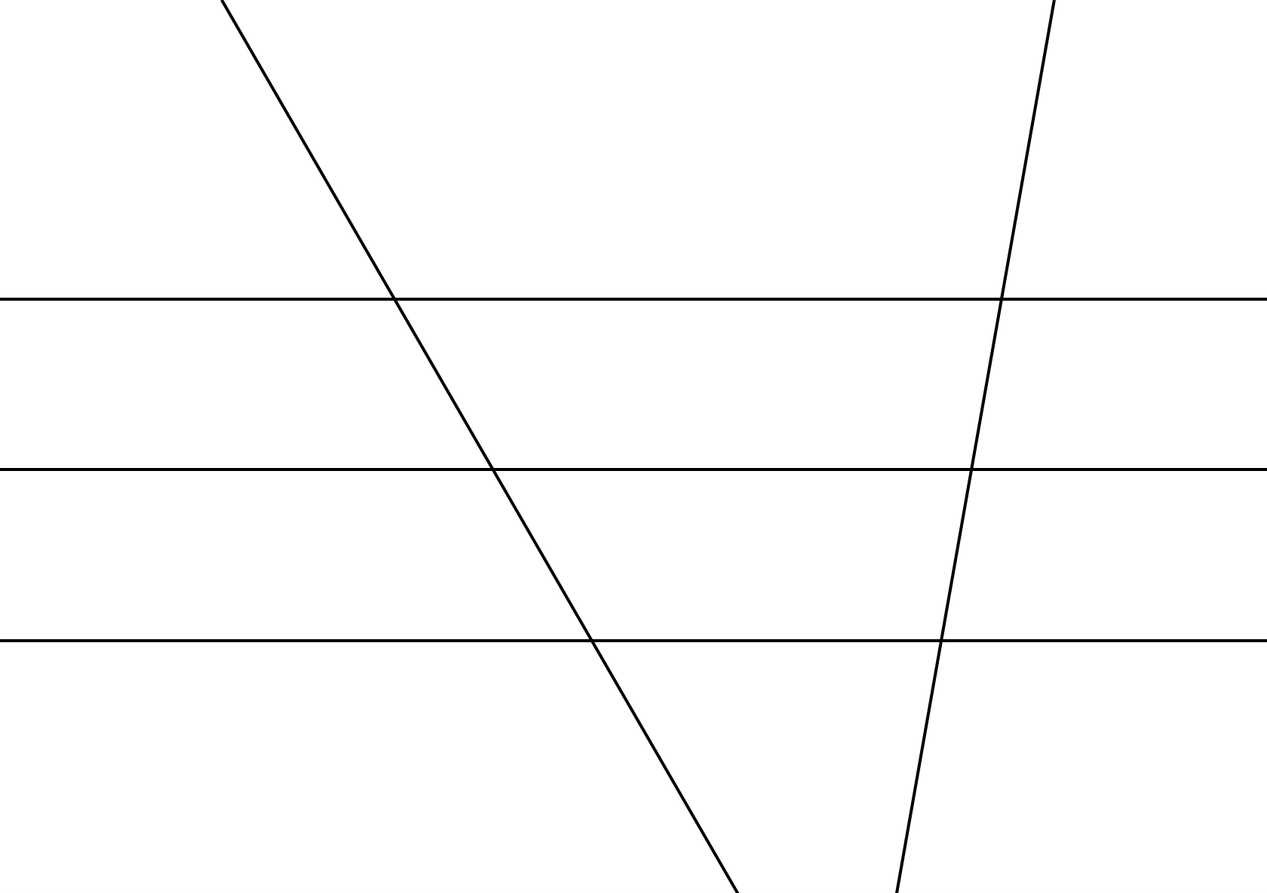
Constructivism with van Hiele

Slide 19
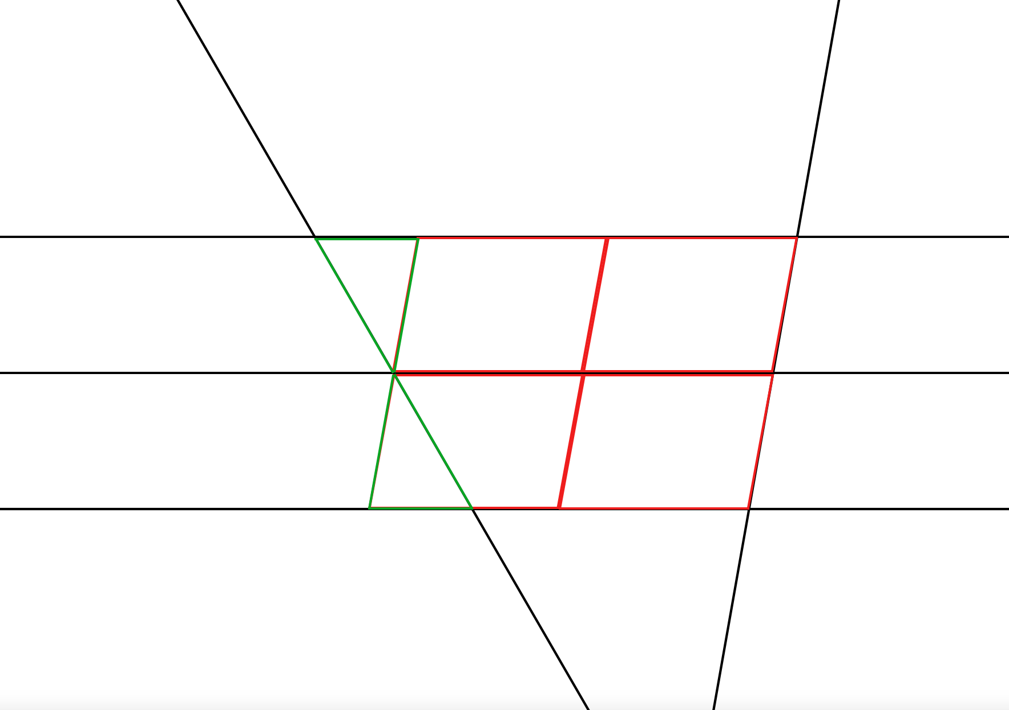
Possible Solutions
Now that we can visualise some of the shapes present in this diagram:
Can we identify as many properties and relationships as possible in the diagram?
Using some of those relationships, can we investigate if the fact we noticed earlier on will always be true?

Slide 20
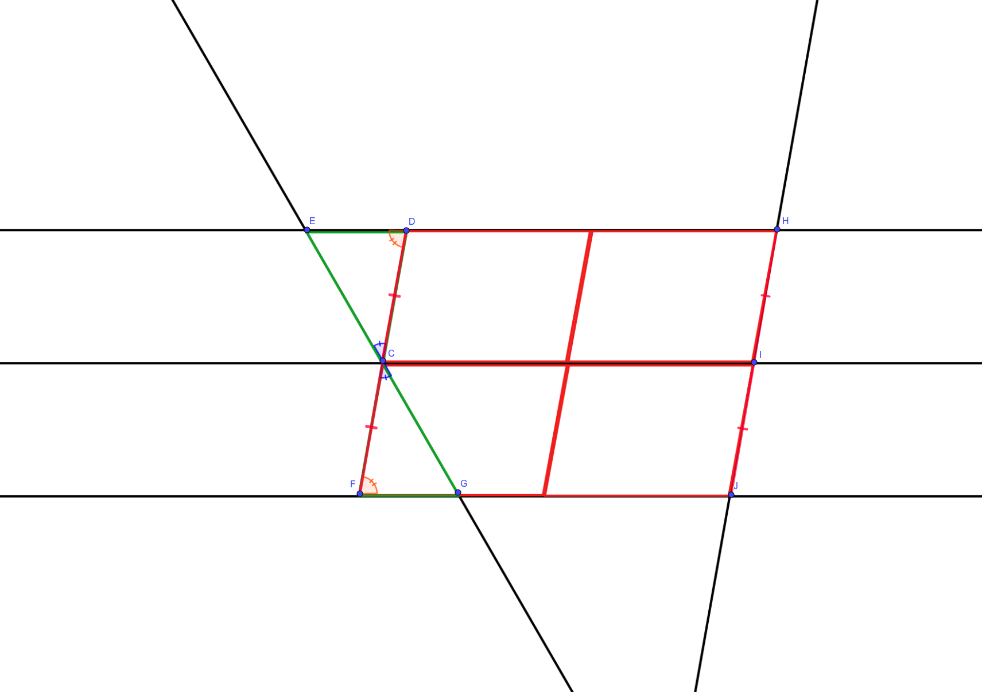
Solution

Slide 21
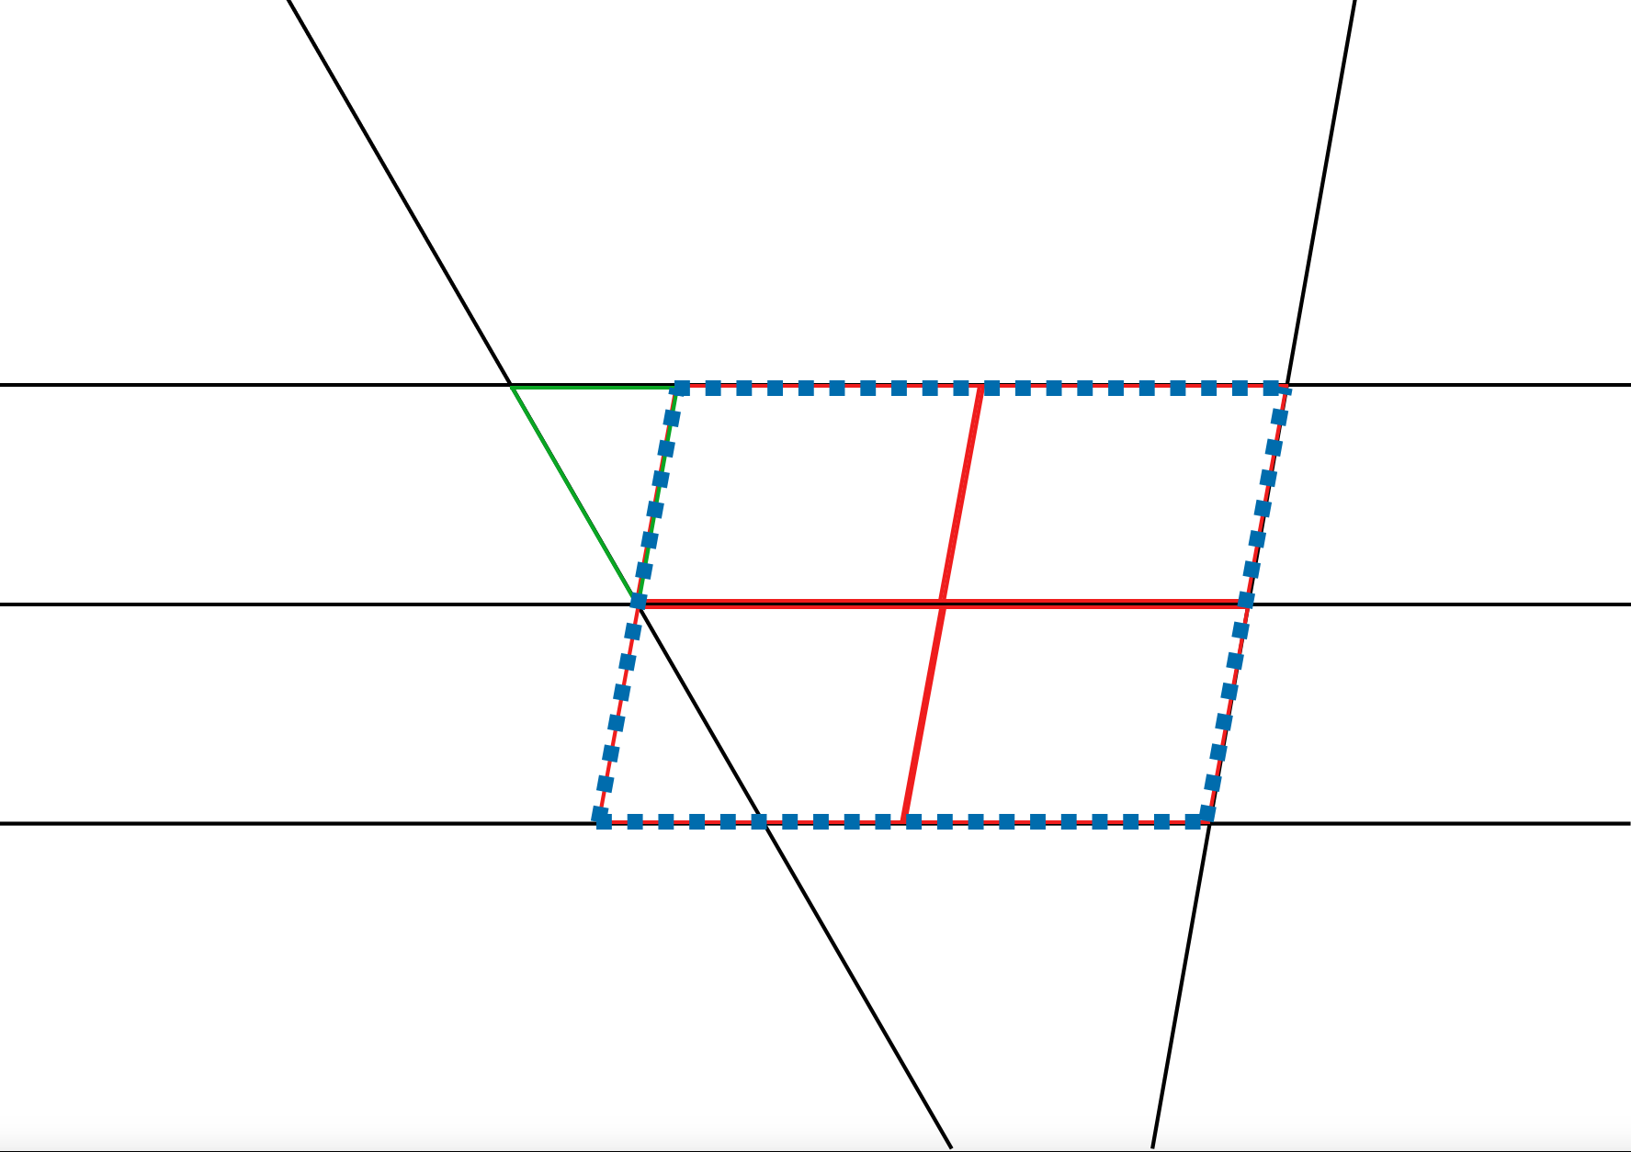
Ensure this is highlighted
Larger Parallelogram
Construction Line

Slide 22
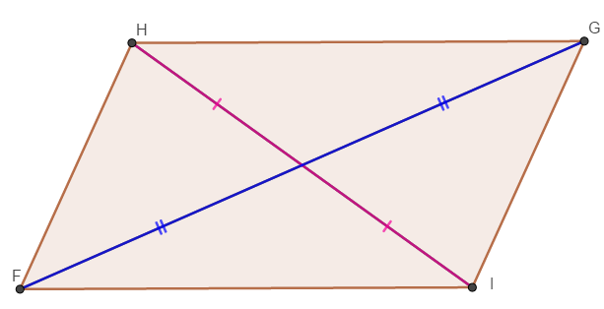
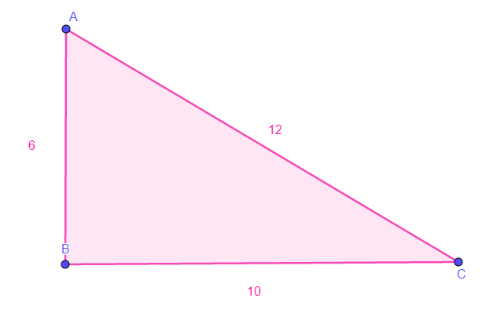
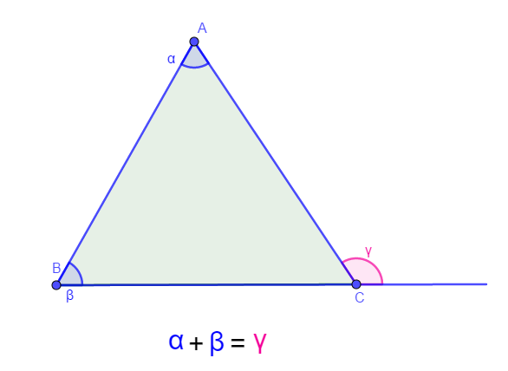
Concepts
Concept 2 (Theorem 8):
Two sides of a triangle must sum to be greater than the third side
Concept 1 (Theorem 10):
Diagonals of a parallelogram bisect each other
Concept 3 (Theorem 6):
In a triangle, the exterior angle is equal to the sum of the two interior opposite angles
Concept 4:
Understanding of a perpendicular bisector of a line segment

Slide 23
Applying van Hiele
Your group task:
Use prior knowledge to develop new knowledge
Can use manipulatives if desired
Can use the Learning Phases of van Hiele to guide your planning

Slide 24
Feedback
One presenter per group
Present to one group at a time
On the buzzer, rotate to the next group

Slide 26
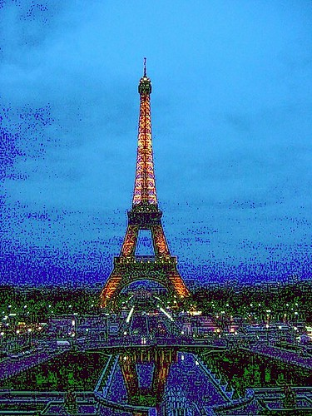
Can you construct the most stable tower possible using all of the objects given?

Slide 27
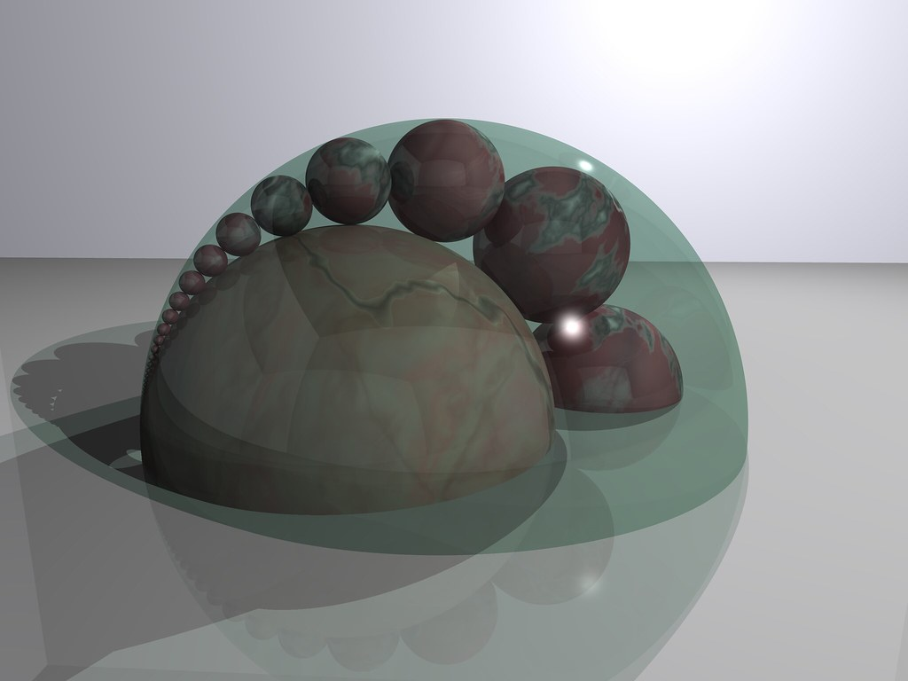
A basic construction
Construct a triangle given side lengths 9cm, 6cm, 4cm.
What difficulties would your students have with this?

Slide 28
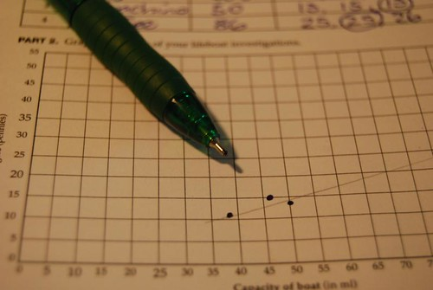
Starting at the start- a first step in constructions
Plot a point A anywhere on the squared paper
Plot four equidistant points from A
Now plot a fifth
What tool could we use to achieve this?
What would your students say a compass is for?
What van Hiele level would this put them at?

Slide 29
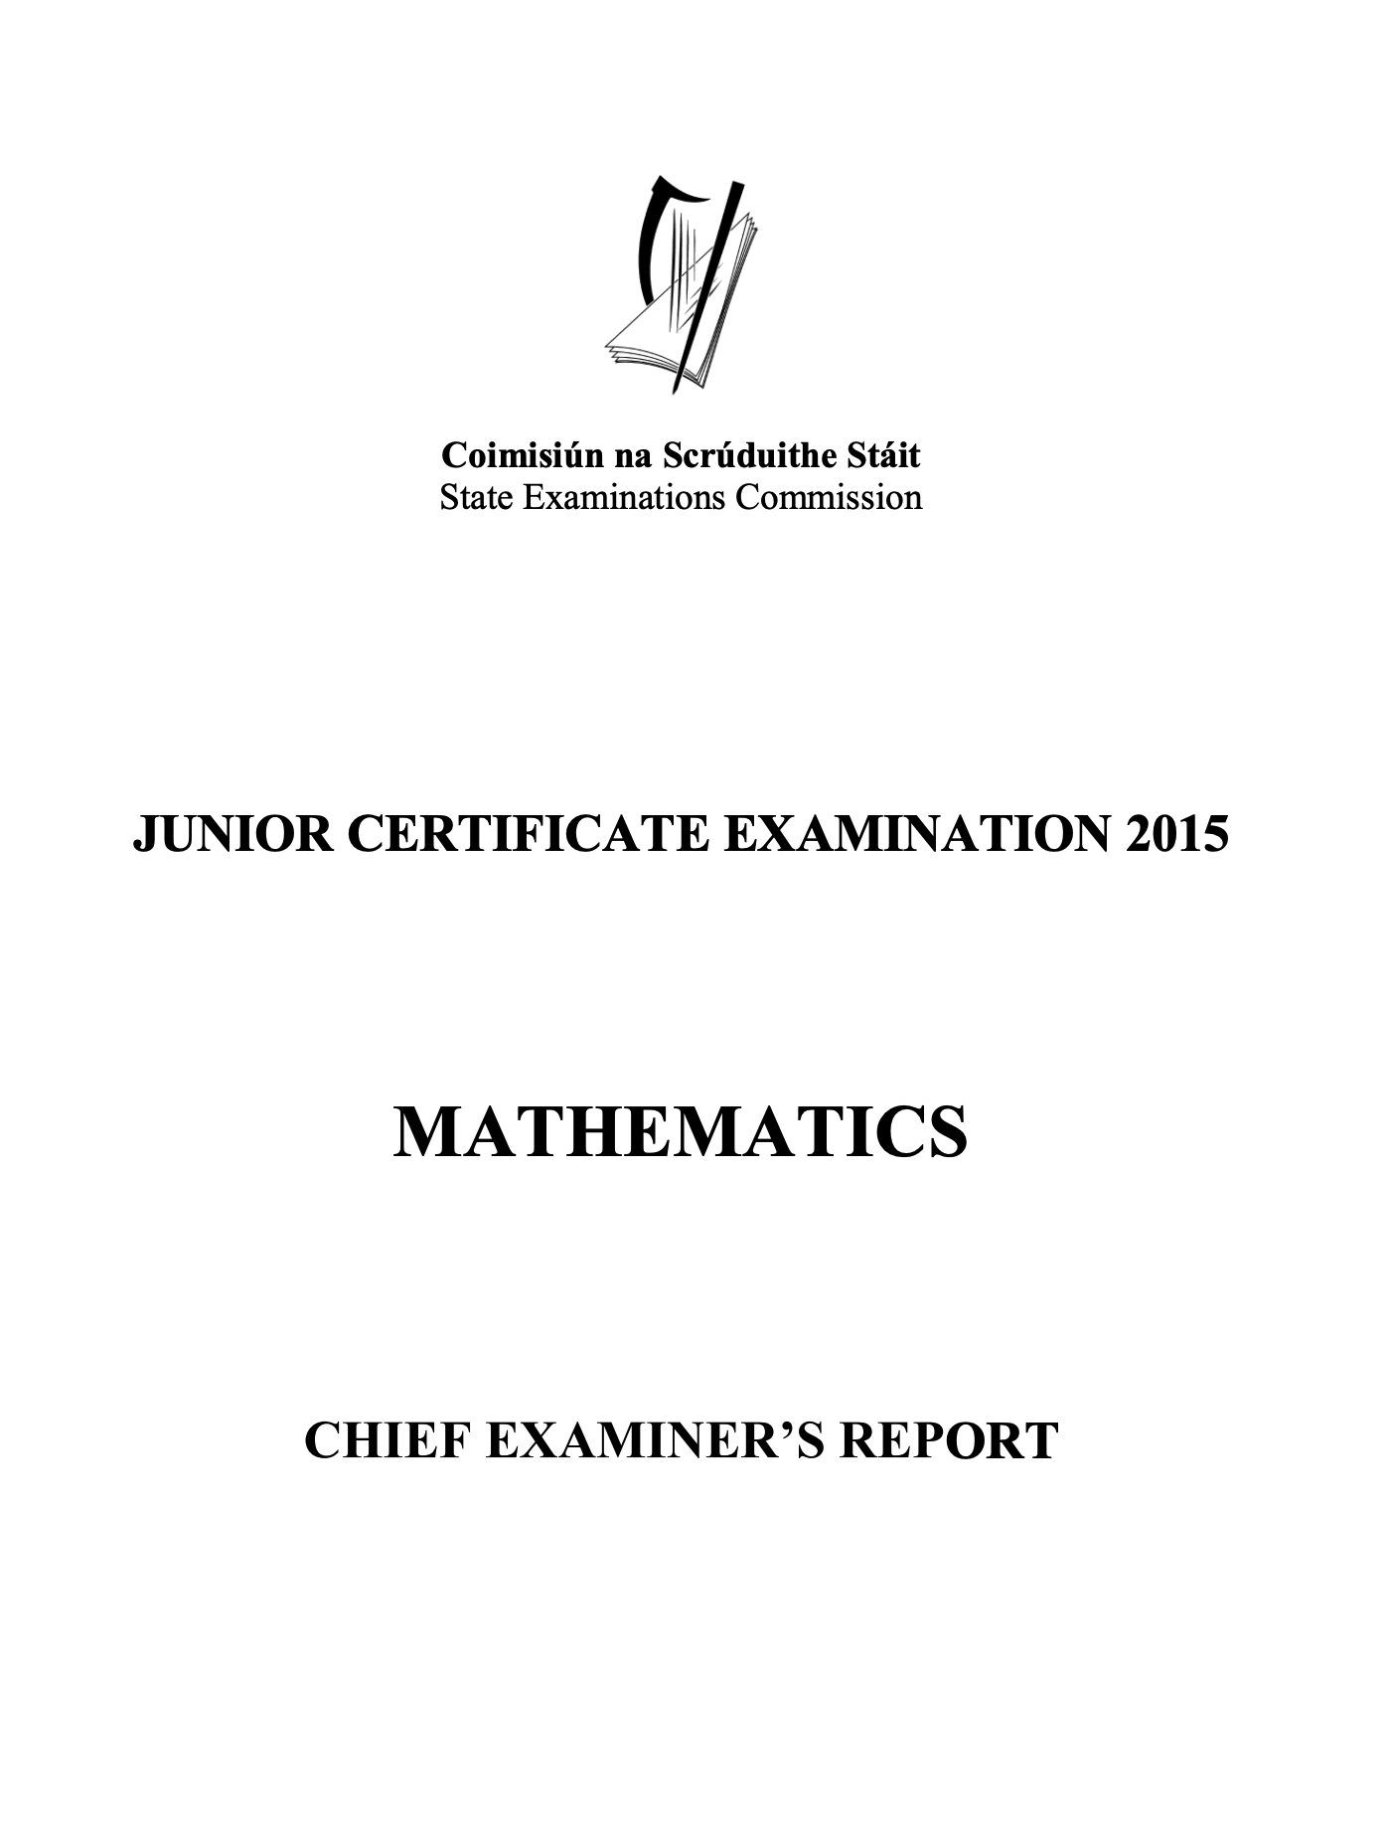
2015 JC Chief Examiner’s Report

Slide 30
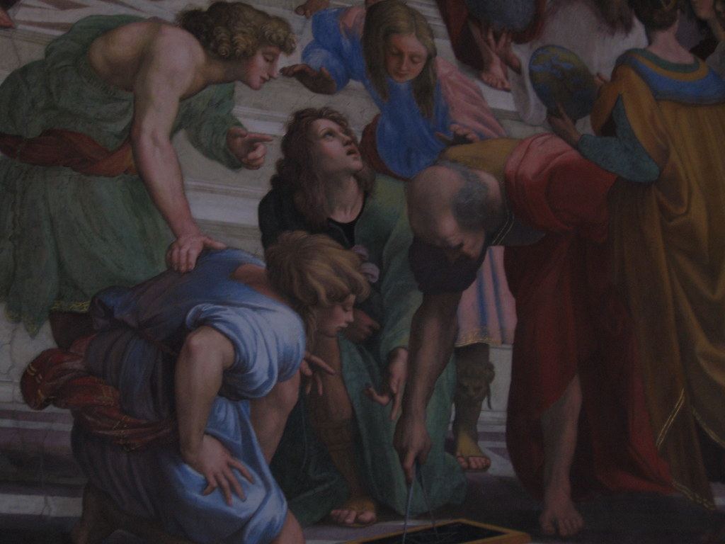
Find the area of your triangle using 3 different sets of calculations
Construct a triangle given side lengths 9cm, 6cm, 4cm.

Slide 31
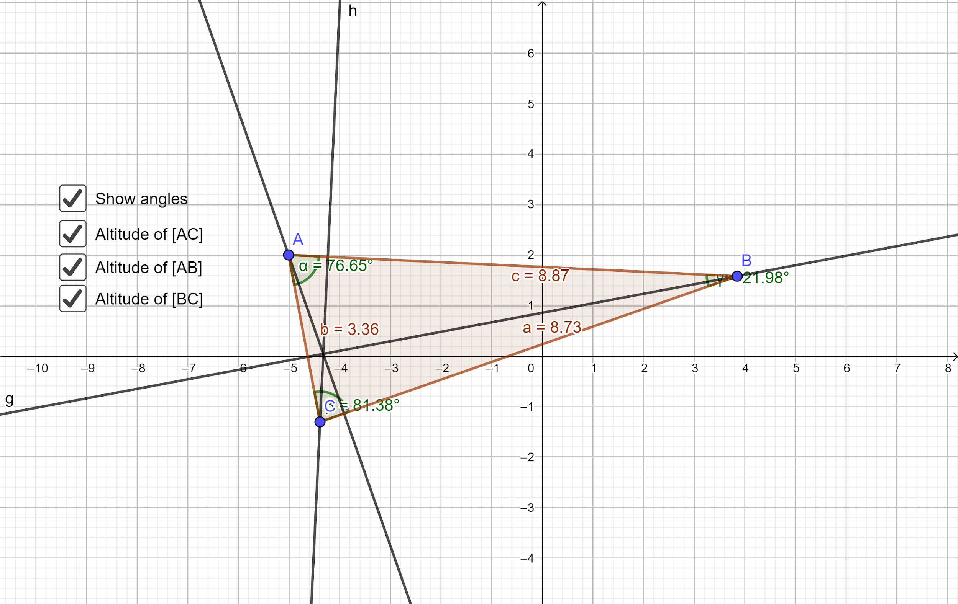
Summarise our learning
What other constructions become stumbling blocks because students do not have a sound knowledge of the basics?

Slide 32
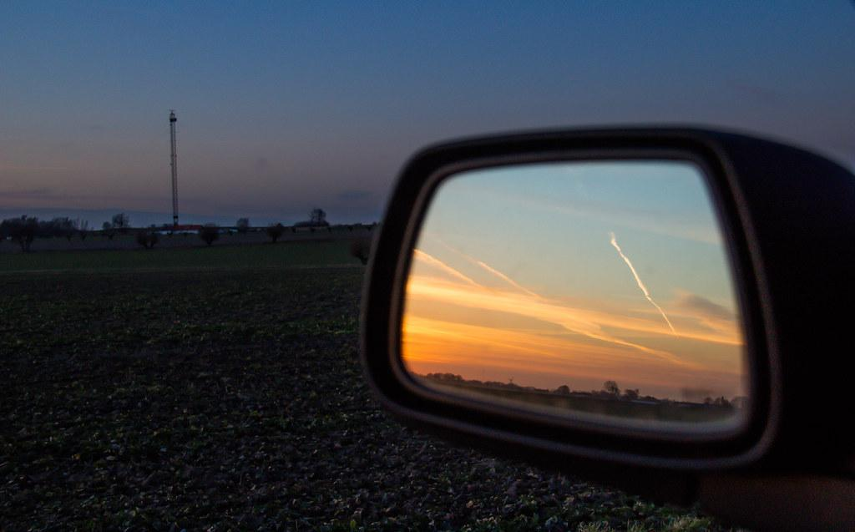
Looking back...
What can we say makes for effective Teaching and Learning in a Teaching Geometry for Understanding classroom?

Slide 33
Revisiting a problem
How would the students of a Teaching Geometry for Understanding classroom fare with this problem?
A point inside a square is connected to each of it’s four vertices.
What fraction of the square is shaded?
Source: More Geometry Snacks by Ed Southall, Vincent Pantaloni

