Slide 1
Algebra through the Lens of Functions
advisorname@pdst.ie

Slide 2
Workshop Resources
https://padlet.com/angeladwane/Algebra2020

Slide 3
Key Messages
By engaging deeply with functions at Junior Cycle, students acquire the conceptual understanding and skills to understand functions at Senior Cycle.
Multiple representations are important for sense making, for developing deep conceptual understanding and for developing adaptive thinking.

Slide 4
Learning Outcomes
By the end of this workshop we will understand:
that allowing students to engage with rich, open tasks will encourage them to become more confident in their mathematical ability, develop their critical thinking skills and will provide them with the tools needed to attempt unseen problems.
teaching algebra through functions is an approach that will allow students to make sense of algebraic procedures and will encourage a positive disposition towards their mathematics.

Slide 5
Introduction

Slide 6
Reflection
What challenges for teachers and barriers to students’ learning are presented by the teaching of algebra and functions?

Slide 7
Junior Cycle Specification
“Learners explore and analyse the relationships between tables, diagrams, graphs, words, and algebraic expressions as representations of functions”-pg 11 JC Specification

Slide 8
Leaving Cert Syllabus
Learners build on their proficiency in moving among equations, tables and graphs and become more adept at solving real-world problems” - pg 35 LC Syllabus
“The relationship between functions and algebra is further emphasised and learners continue to connect graphical and symbolic representations of functions”- pg 40 LC Syllabus

Slide 9
International Research

Slide 10
Chief Examiners Report JC 2015
“2x was often confused with x²” (JC HL)
“Those who did use algebraic manipulation often displayed a general idea of what to do, but were unable to carry out the procedures accurately” (JC OL)
“candidates appeared to have difficulty understanding the significance of m and c when a line is written in the form y = mx + c.”(JC HL & OL)

Slide 11
Chief Examiners Report LC 2015
“The idea of a function cuts across all of the syllabus strands, and might be profitably learned in this way rather than as a stand-alone strand in itself. It could be pointed out that the majority of these skills and concepts should be acquired at junior cycle and that all that should be needed as one progresses through the Leaving Certificate course is that they be consolidated and improved”

Slide 12
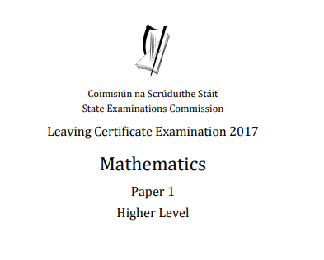
Problem Solving

Slide 13
Introducing Quadratic Functions

Slide 14
JC Specification
AF1: Students should investigate patterns and relationships:
represent these patterns and relationships in tables and graphs
generate a generalised expression in words and algebraic expressions and fluently convert between each representation
categorise patterns as linear, non-linear, quadratic, and exponential using their defining characteristics

Slide 15
JC Specification
Students should investigate patterns and relationships:
represent these patterns and relationships in tables and graphs
generate a generalised expression in words and algebraic expressions and fluently convert between each representation
categorise patterns as linear, non-linear, quadratic, and exponential using their defining characteristics
-JC Specification page 18 AF1

Slide 16
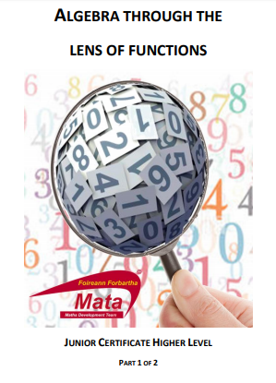
Prior Knowledge
Exploration of linear patterns
Creating and interpreting graphs of linear functions
Critical points of a linear function
Understanding of a variable and constant
Rate of change of a linear function

Slide 17
Prior Knowledge
Exploration of linear patterns:
Expressions
Equivalence
Distribution
Multiple Representations

Slide 18
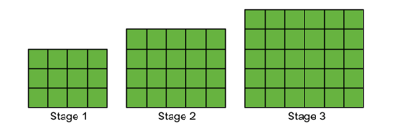
Activity
How many blocks in the 50th stage?

Slide 19
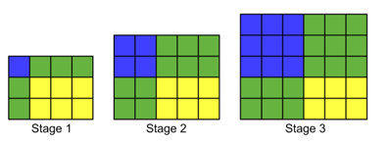
Activity
How many blocks in the 50th stage?

Slide 20
Activity - Solutions
How many blocks in the 50th stage?

Slide 21
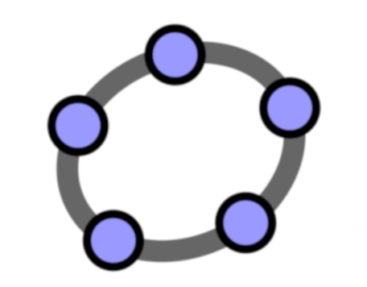
Multiple Representations

Slide 22
Activity - Extensions
Which stage has 90 squares?

Slide 23
Quadratic Patterns

Slide 24
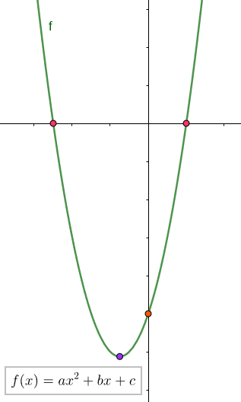
Future Learning
Solving Quadratic Equations
Key Features of Quadratic Functions
Graphical Solutions to Algebraic Inequalities
Analysing the Table of Values of Quadratic Functions in Greater Depth

Slide 25
Summary
Students are introduced to new algebraic procedure through the exploration of patterns.
Students see the need for new strategies.
Students make sense of their learning.
Students maintain a positive disposition to their mathematics.

Slide 26
Key Features of functions
1. The domain and range
2. Where the graph of the function meets the axes
3. Things that remain constant and those that vary in the function
4. The behaviour of the graph of the function
5. The rate of change of the function

Slide 27
Introducing Algebra through Linear Patterns
pdst.ie/schoolsupport

Slide 28
Exploring the properties of a Quadratic Function

Slide 29
Prior Knowledge
Exploration of quadratic patterns
Creating and interpreting graphs of quadratic functions
Recognising that the rate of change of a quadratic function is not constant
Solving quadratic equations (by trial & improvement)
Generating, manipulating (distributing multiplication, equivalent expressions…)and using quadratic expressions from a pattern

Slide 30
Junior Cycle Specification
AF1: Students should investigate patterns and relationships:
represent these patterns and relationships in tables and graphs
generate a generalised expression in words and algebraic expressions and fluently convert between each representation
categorise patterns as linear, non-linear, quadratic, and exponential using their defining characteristics
AF2: Students should investigate situations in which letters stand for quantities that are variable so that they can:
a. generate and interpret expressions in which letters stand for numbers
b. find the value of expressions given the value of the variables
c. use the concept of equality to generate and interpret equations

Slide 31
28 Minutes to Design a Rich Task
Work through an activity around this for students.
What would you want them to do?
What questions could you ask?
What would you want them to learn from this? You will then have 5 minutes to present and explain your work to another group.

Slide 32
Activity A
A farmer has 20m of fencing to enclose a sheep pen. He wants to make the “biggest” pen possible. We want you to make an activity around this for students. What would you want them to do?
Table: How much scaffolding is needed? Domain/range, Discrete vs continuous
Graph: graph setup, sense making, recognising/understanding key points and symmetry (paper folding?), u/v shaped parabolas, transformations??
Algebraic expression: formulating the expression, expanding brackets, factorising, solving equations, Finding roots and understanding their meaning in context

Slide 33
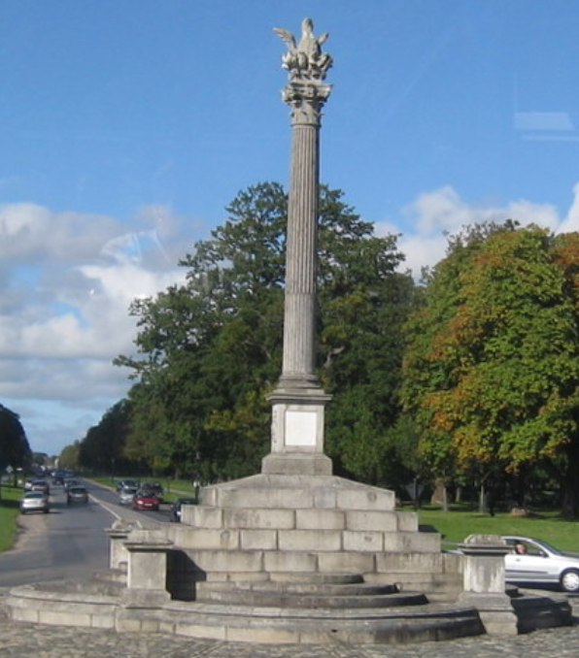
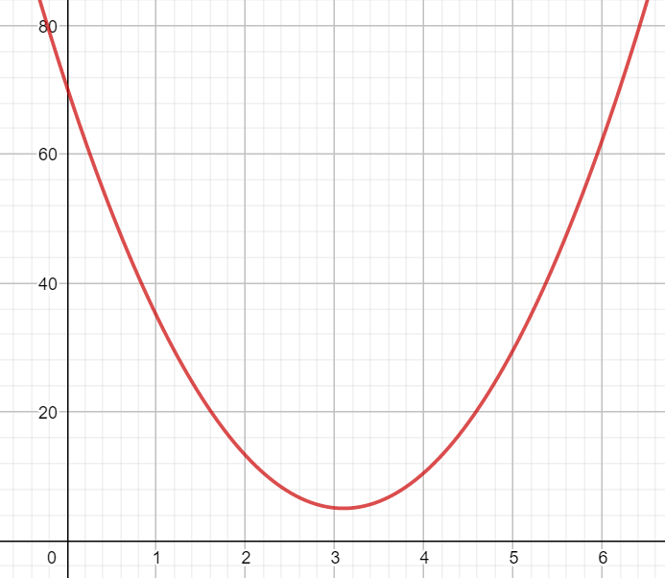
Activity B
The function l(x) below gives the approximate length of the shadow created by the Phoenix Monument on Saturday 30th of March 2019 from 09.00 to 15.00
l(x) = 6.8(x - 3.1)² + 5
Where l(x) is the length of the shadow in metres, and x is the time in hours after 09.00
We want you to make an activity around this for students. What would you want them to do?
Graph: Domain/range, Discrete vs continuous, graph setup, sense making, recognising/understanding key points and symmetry (paper folding?), transformations (hour change, measure from centre of monument vs. from edge of steps??
Algebraic expression: solving equations, working with complete square form (identifying shape and turning point)

Slide 34
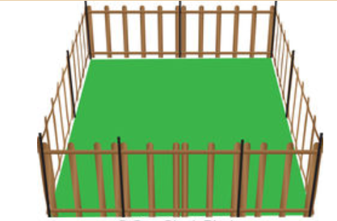
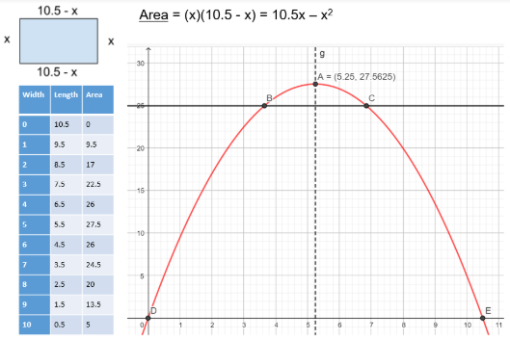
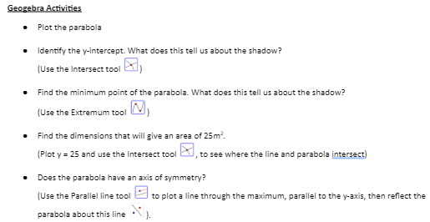
Developed Task Cards on Padlet
https://padlet.com/angeladwane/Algebra2020

Slide 35
Key Features of functions
1. The domain and range
2. Where the graph of the function meets the axes
3. Things that remain constant and those that vary in the function
4. The behaviour of the graph of the function
5. The rate of change of the function

Slide 36
Reflection

Slide 37
Challenges of teaching Algebra & Functions
How would engaging with these elements of the learning activities combat the challenges mentioned earlier in the workshop?
Using Patterns
Using multiple representations
Problem Solving
Real Contexts

Slide 38
Transformations of Quadratic Patterns

Slide 39
JC Specification
Students should investigate functions so that they can:
demonstrate understanding of the concept of a function
represent and interpret functions in different ways—graphically, diagrammatically, in words, and algebraically
-JC Specification page 17 AF7

Slide 40
JC Specification
AF7: Students should investigate functions so that they can:
demonstrate understanding of the concept of a function
represent and interpret functions in different ways—graphically, diagrammatically, in words, and algebraically

Slide 41
Transformations
Student’s expressions:
b = s²+5s + 6
b=(s+2)(s+3)
What would happen if we:
add 2 blocks to each stage?
double the amount of blocks in the pattern?
add 2 to our stage number?

Slide 42
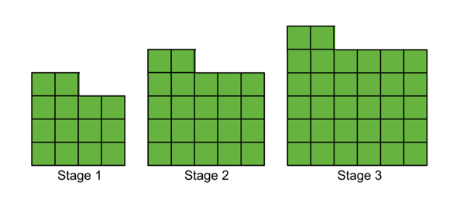
Changing the output
Adding a constant
Student original expressions:
b = s²+5s + 6
b=(s+2)(s+3)
What would happen if we added 2 blocks to each stage?
b = s²+5s + 6 + 2
b = s²+5s + 8

Slide 43
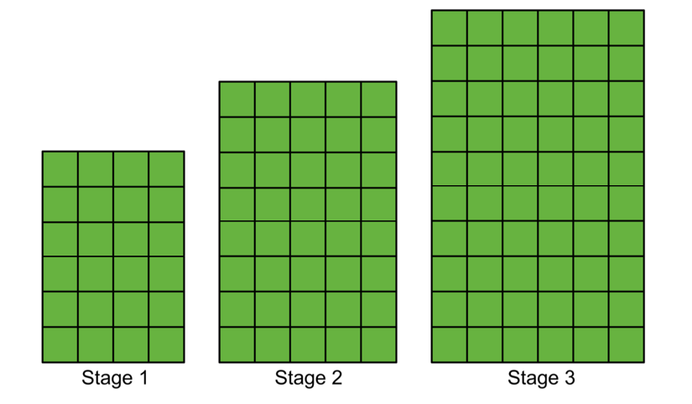
Changing the output
Multiplying by a constant
Student original expressions:
b = s²+5s + 6
b=(s+2)(s+3)
What would happen if we doubled the amount of blocks in the pattern?
b=2(s+2)(s+3)
b=2(s²+5s+6)

Slide 44
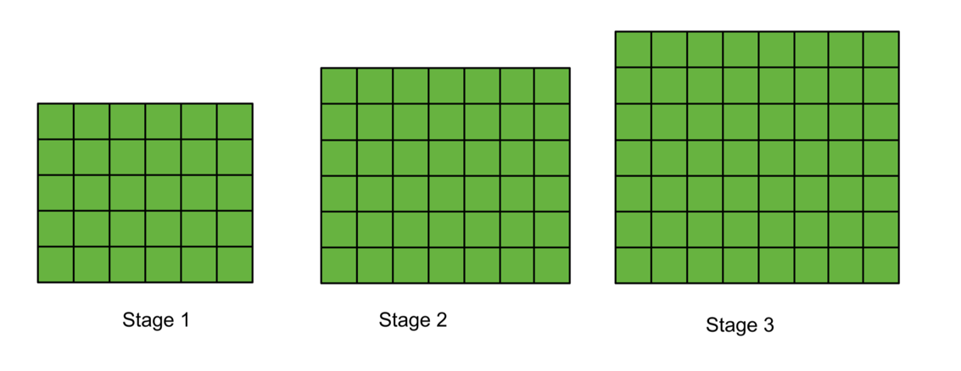
Changing the input (stage number)
Student original expressions:
b = s²+5s + 6
b=(s+2)(s+3)
What would happen if we add 2 to our stage number?
b=(s+4)(s+5)
b=(s+2)²+5(s+2)+6

Slide 45
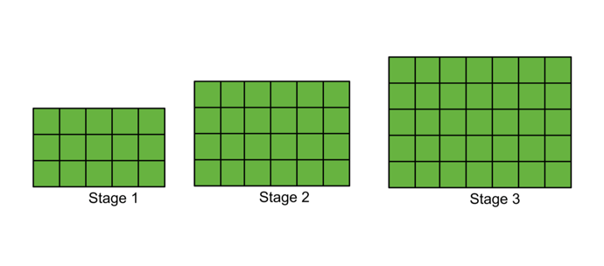
Changing the function
Add a column
Student original expressions:
b = s²+ 5s + 6
b=(s+2)(s+3)
What would happen if we added an additional column?
b = (s+2)(s+3 +1)
b = (s+2)(s+4)
b = s²+ 6s + 8

Slide 46
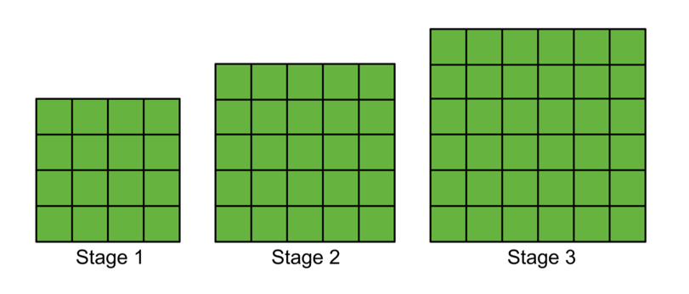
Changing the function
Adding a row
Student original expressions:
b = s²+5s + 6
b=(s+2)(s+3)
What would happen if we add a row?
b=(s+3)(s+3)
b=(s+3)²

Slide 47
Transformation of continuous functions
https://www.geogebra.org/m/zj5ryyUp
https://www.geogebra.org/classic/a6cddta6

Slide 48
Key Features of functions
1. The domain and range
2. Where the graph of the function meets the axes
3. Things that remain constant and those that vary in the function
4. The behaviour of the graph of the function
5. The rate of change of the function

Slide 49
Re-cap of workshop so far...
Quadratics Growing Pattern
Quadratics in Context

Slide 50
Chief Examiners Report LC 2015
“The idea of a function cuts across all of the syllabus strands, and might be profitably learned in this way rather than as a stand-alone strand in itself. It could be pointed out that the majority of these skills and concepts should be acquired at junior cycle and that all that should be needed as one progresses through the Leaving Certificate course is that they be consolidated and improved”

Slide 51
Key Features of functions
1. The domain and range
2. Where the graph of the function meets the axes
3. Things that remain constant and those that vary in the function
4. The behaviour of the graph of the function
5. The rate of change of the function

Slide 52
Exploring Functions

Slide 53
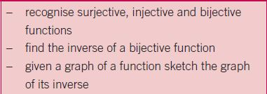
Link to the Syllabus

Slide 54
Activity
Match the algebra with the graph
Decide whether it is a function and if so, classify it as injective, surjective or bijective

Slide 55
Solutions

Slide 56
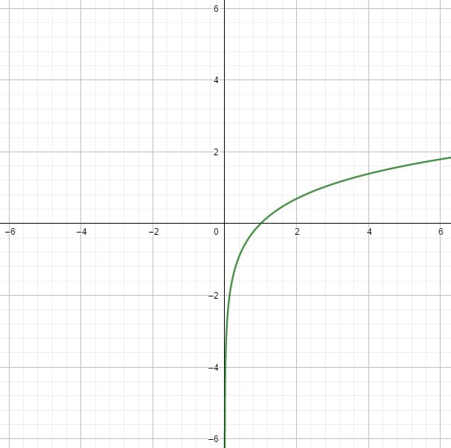
Bijective Function

Slide 57
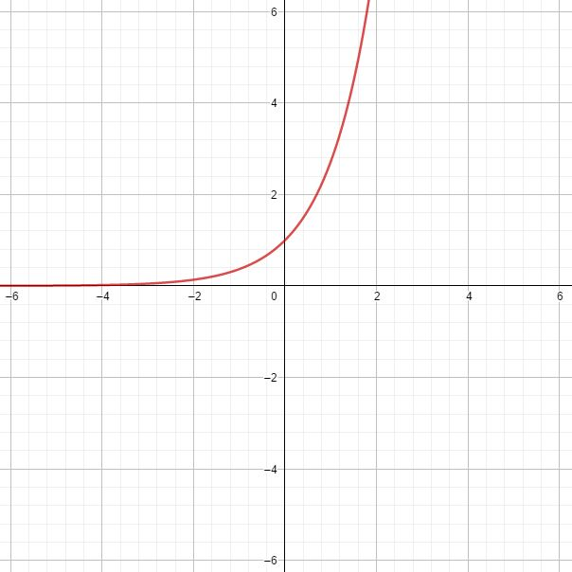
Injective Function

Slide 58
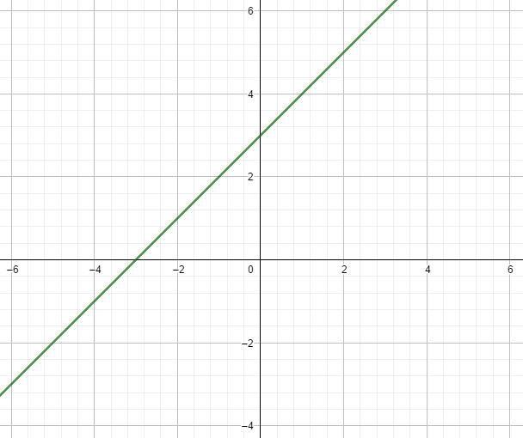
Bijective Function

Slide 59
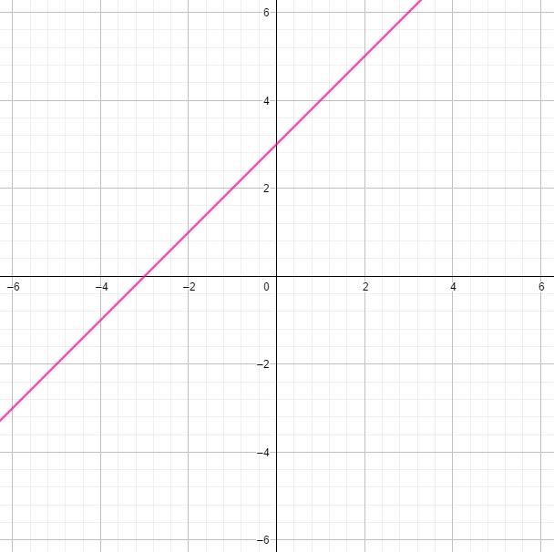
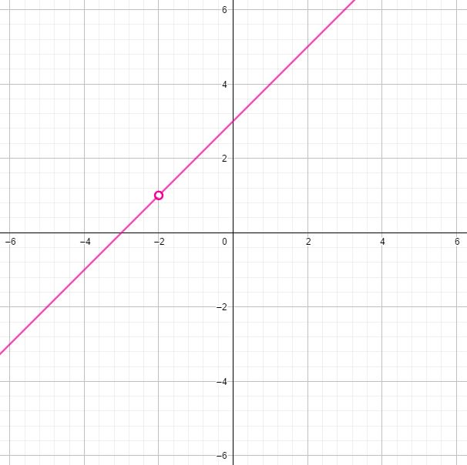
Not a Function

Slide 60
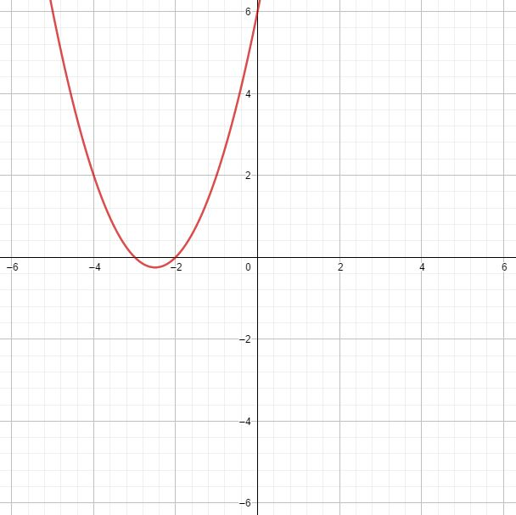
Function - neither injective nor surjective

Slide 61
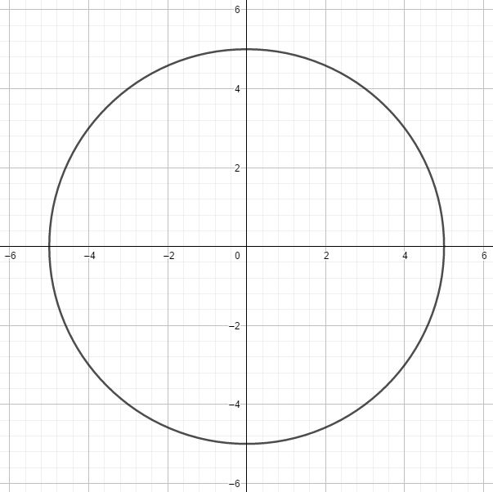
Not a Function

Slide 62
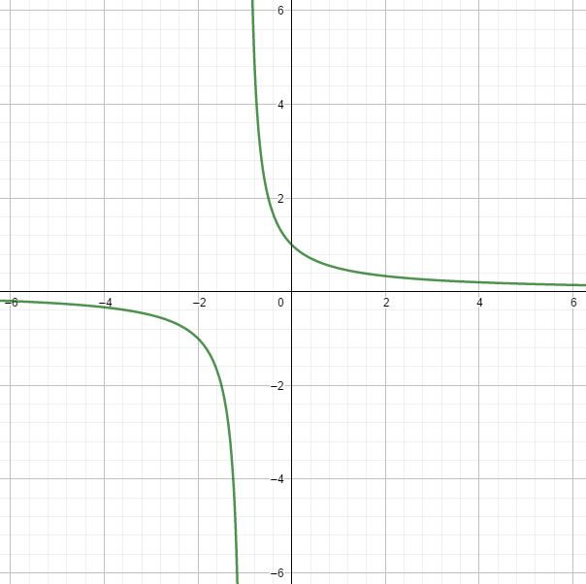
Not a Function

Slide 63
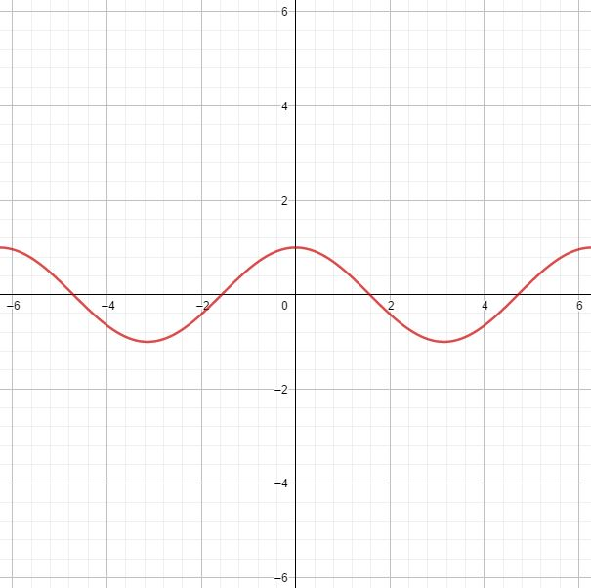
Surjective Function

Slide 64
Functions and their Inverses
Which of those functions had an inverse which is also a function?
Explain your answer

Slide 65
Summary

Slide 66
Unseen Functions

Slide 67
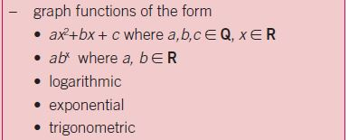
Link to the Syllabus

Slide 68
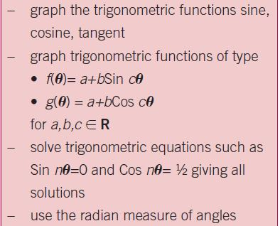
Link to the Syllabus

Slide 69
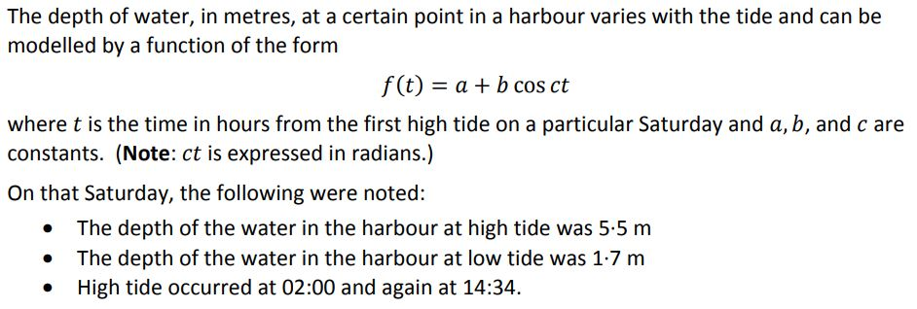
Unseen Functions - Prior Knowledge

Slide 70
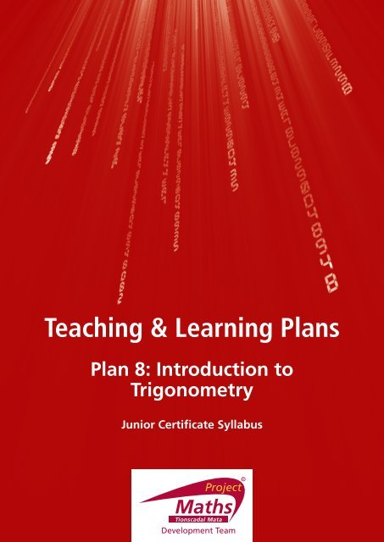
Prior Knowledge - The Unit Circle
Teaching & Learning Plan on the Unit Circle from projectmaths.ie
https://www.projectmaths.ie/documents/T&L/TheUnitCircle.pdf?strand

Slide 71
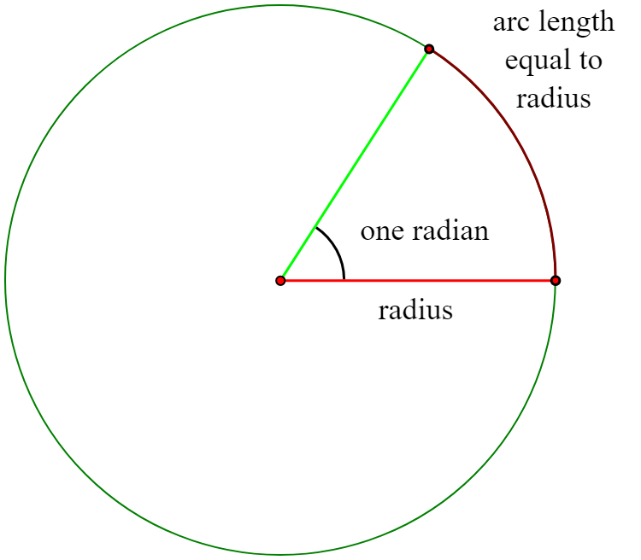
Prior Knowledge - Radians
Constructivism
Discovery of the radian from projectmaths.ie - https://www.youtube.com/watch?v=-fMO2Vk_c-M

Slide 72
Activity - Design
How can you help students to make sense of a previously unseen type of function?
Prior learning
Connections
Questioning
Knowledge Transfer
What skills and knowledge do students need to be comfortable with that will help them with this question?
What connections may be made to other topics that will help students to make sense of this question?
What kind of questions could the teachers ask to help students understand what is being asked of them?
Where else in their mathematical learning will these knowledge and skills prove to be important?

Slide 73
Activity - Ideas

Slide 74
Activity - Design
How can you use this question to help students understand the skills, knowledge and disposition needed to tackle unseen problems?
Prior learning
Connections
Questioning
Knowledge Transfer

Slide 75
Activity - Discussion
Why is it important to think about the questions we ask students?
Why might it be important to show students that the skills and knowledge they are using can be transferred?

Slide 76
Conclusion

Slide 77
Key Features of functions
1. The domain and range
2. Where the graph of the function meets the axes
3. Things that remain constant and those that vary in the function
4. The behaviour of the graph of the function
5. The rate of change of the function

Slide 78
Learning Outcomes
By the end of this workshop we will understand:
that allowing students to engage with rich open tasks will encourage them to become more confident in their mathematical ability, develop their critical thinking skills and will provide them with the tools needed to attempt unseen problems.
teaching algebra through functions is an approach that will allow students to make sense of the algebraic procedures will encourage a positive disposition towards their mathematics.

Slide 79
Key Messages
By engaging deeply with functions at Junior Cycle students acquire the conceptual understanding and skills to understand functions at Senior Cycle.
Multiple representations are important for sense making, for developing deep conceptual understanding and for developing adaptive thinking.

