Slide 1
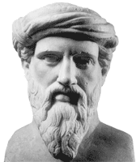
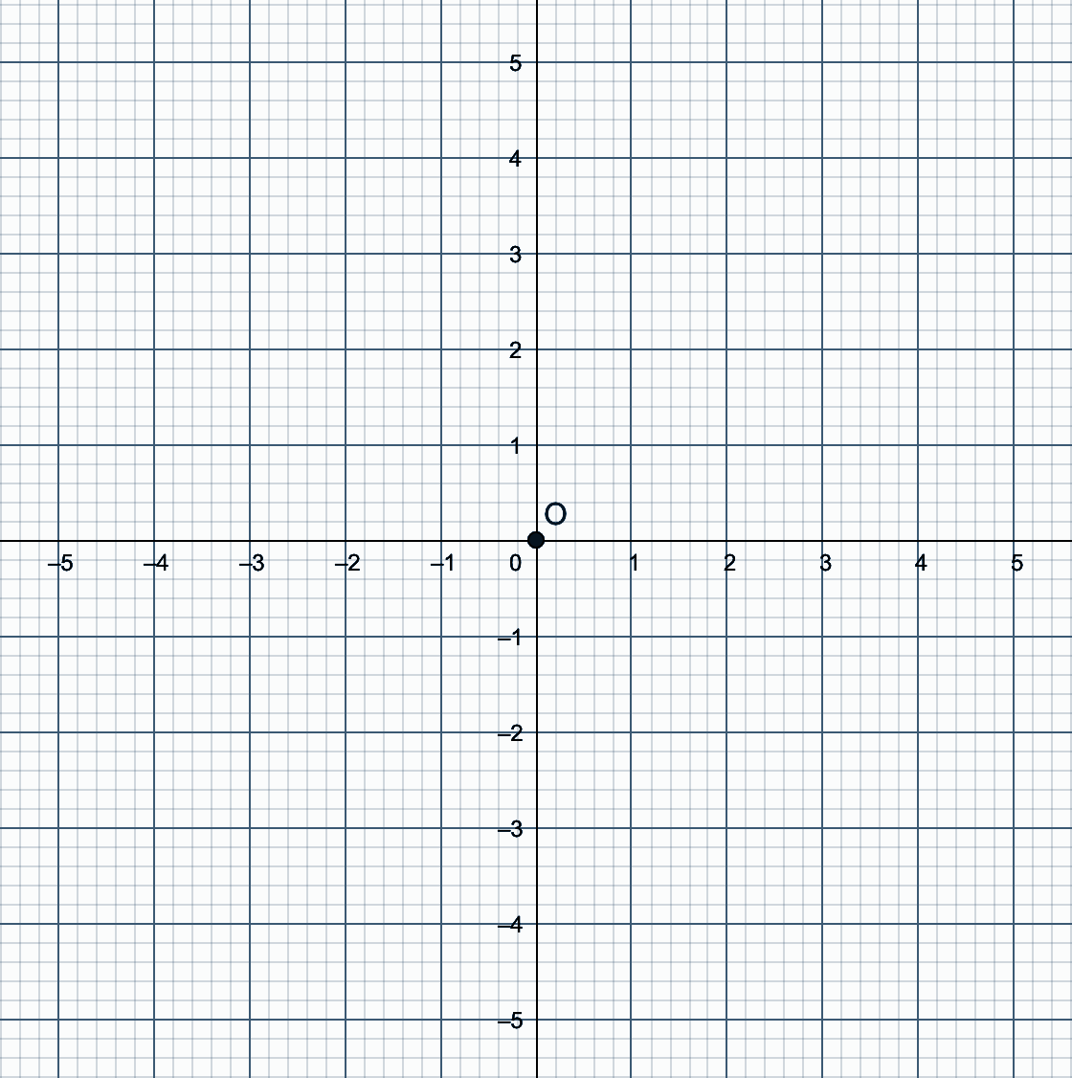
Going in circles with Pythagoras
Write down the coordinates of as many points as possible that are equidistant from the origin?
Notes:
Phase 1
Assessing Students prior knowledge with some formative assessment and an activity which should lead to a brief discussion about how to find as many points as possible using Pythagoras. Students may also use a compass which will should be encouraged.

Slide 2
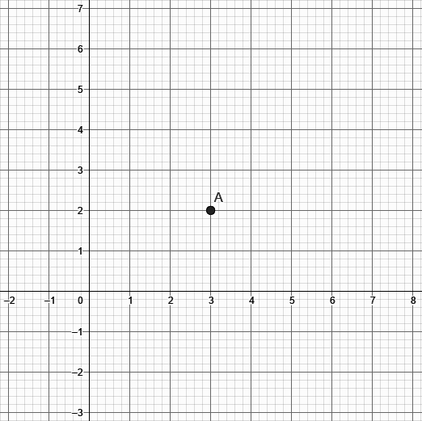
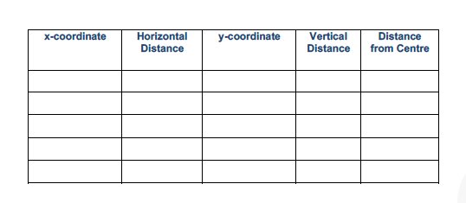
Write down the coordinates of as many points as possible that are equidistant from the point (3, 2)?
Do these points fit into an equation? Why does this work?
Notes:
Phase 2

Slide 3
Group Discussion
Should we be able to extend this learning to any size circle with centre (3,2)?
How about any circle, with any centre?
Can we write an equation like this for any circle?
Notes:
Phase 3
What words are important for students to learn? This phase is where we introduce these terms, during the discussion.

Slide 4
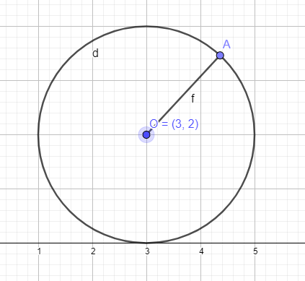
What is the equation of this circle with centre c and radius 2?
A(x,y)
2
c(3,2)
Notes:
Phase 4
(x - 3)² + (y - 2)² = 2²

Slide 5
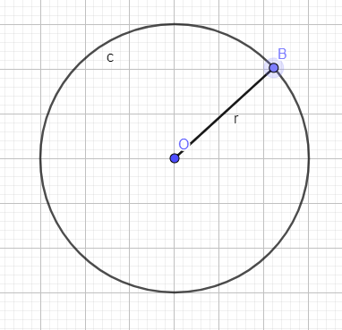
What is the equation of this circle with centre c and radius r?
B(x,y)
r
c(h,k)
Notes:
Phase 4
Alternative (use the previous version as a scaffold for some or all students)
(x - h)² + (y - k)² = r²

Slide 6
Class Discussion
Summarise your learning from today’s lesson
Notes:
Phase 5

