Slide 1
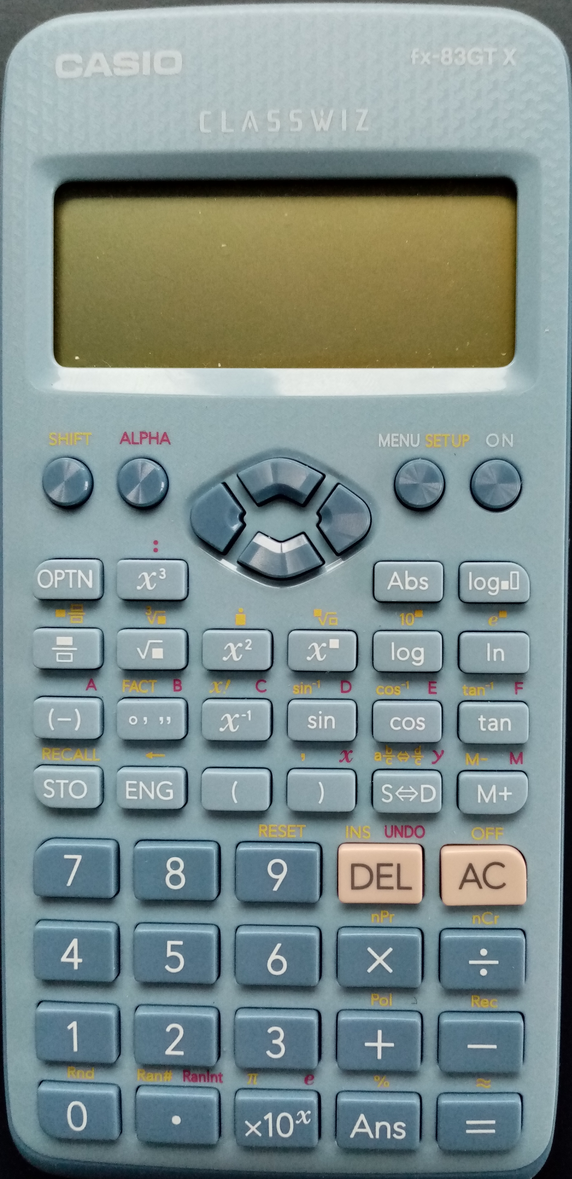
Casio fx-83GT Calculator
This presentation will go through how to calculate:
Standard deviation (σ) from a list of numbers.
Standard deviation (σ) from a frequency table.
Correlation coefficient (r).

Slide 2
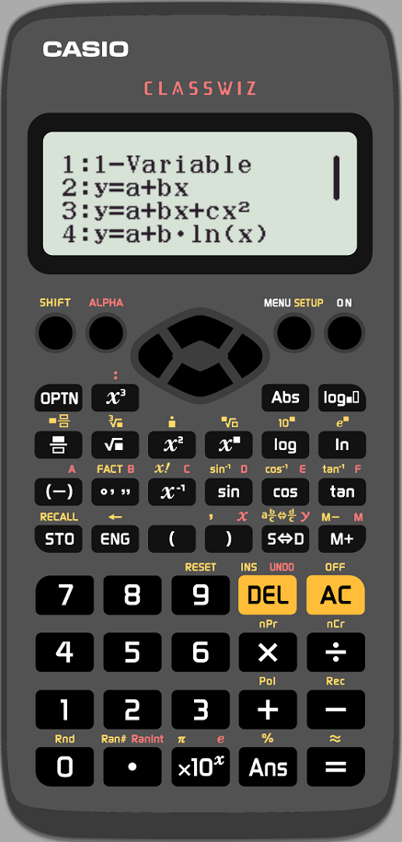
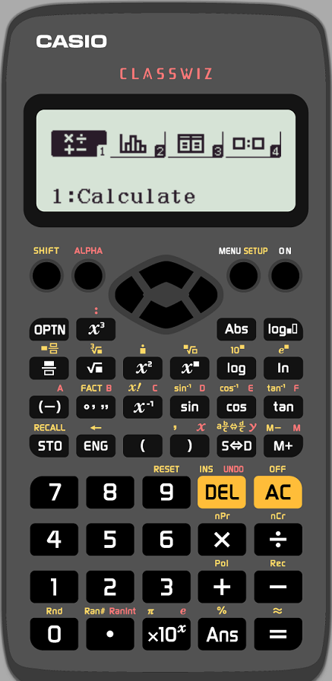
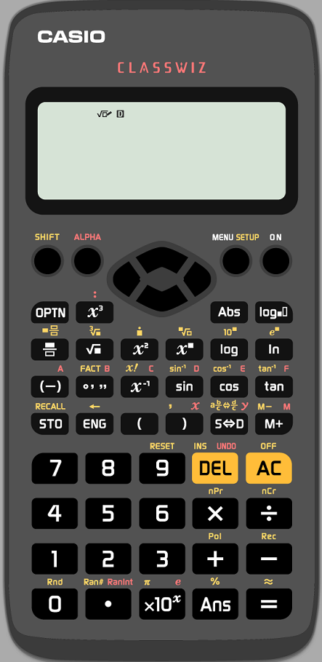
1. Set the calculator to univariate statistics mode
Press “AC”
Press “MENU”
Select “2” for statistics
Select “1” for 1-Variable

Slide 3
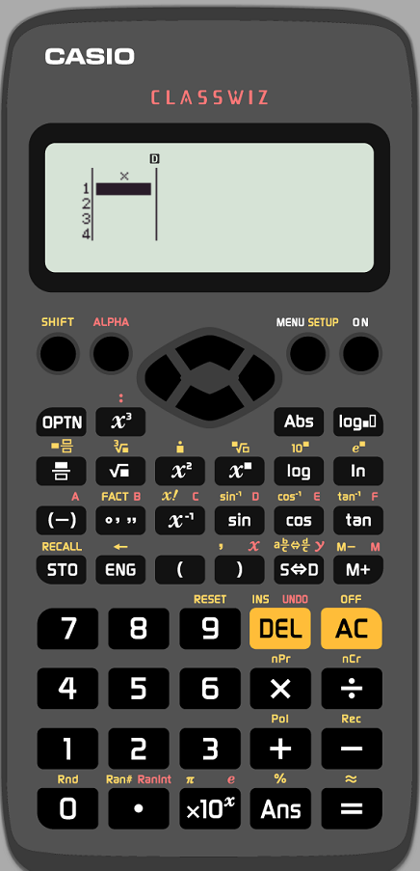
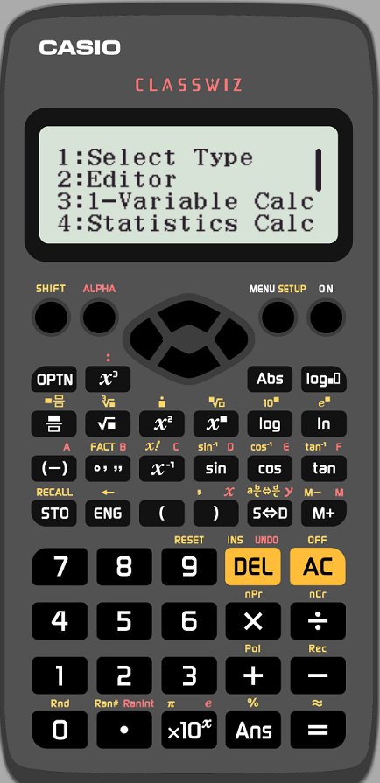
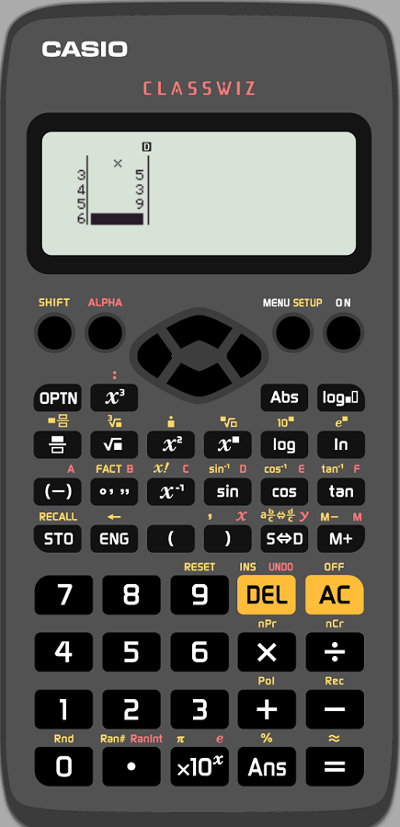
1. Standard Deviation from a List of Numbers
Calculate the standard deviation of : 7, 3, 5, 3, 9
Enter each value from the list followed by “=“
The up/down arrows can be used to edit entries
When all the values are entered press “OPTN”
Press “3” for “1-Variable Calc”
“σx” is the standard deviation value

Slide 4
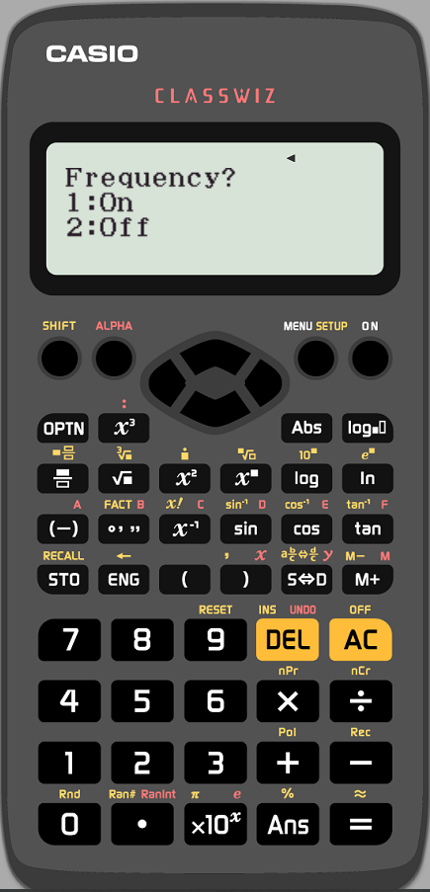
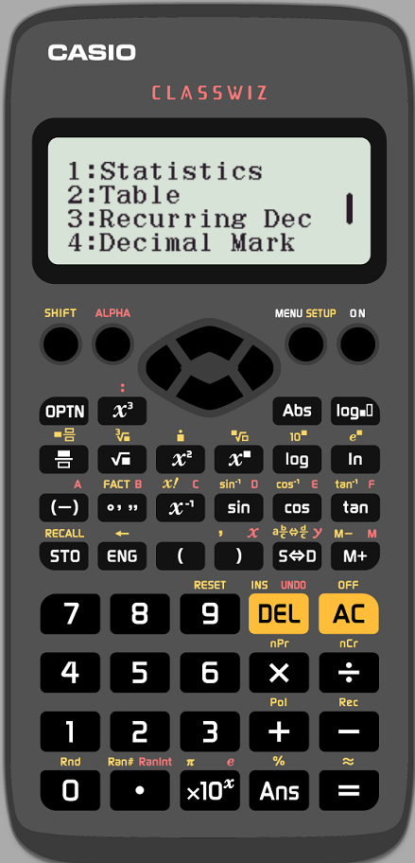
2. Set the calculator up for a frequency table
Press “SHIFT” then “SETUP”
Arrow down once and press “1” for “Statistics”
Press “1” to turn frequency on
Press “SETUP” then “2” for Statistics
Press “1” for “1-Variable”

Slide 5
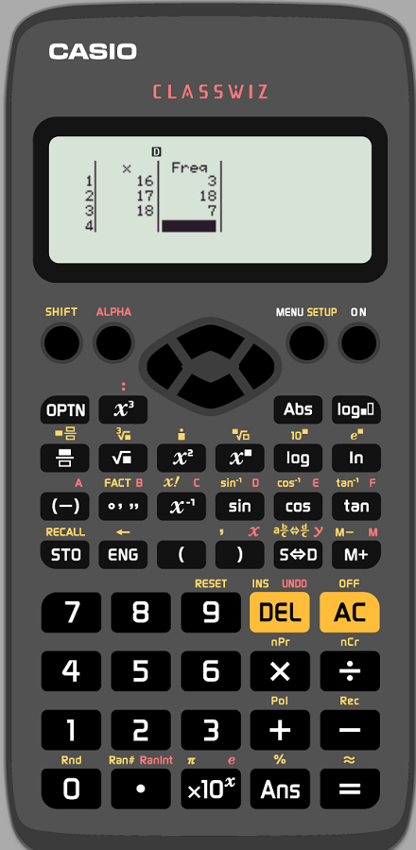
2. Standard Deviation from a Frequency Table
Calculate the standard deviation from the table :
Age | Frequency
16 | 3
17 | 18
18 | 7
Enter each value from the table followed by “=“
Use the direction arrows to edit the frequencies
When all the values are entered press “OPTN”
Press “3” for “1-Variable Calc”
“σx” is the standard deviation value

Slide 6
3. Set the calculator to bivariate statistics mode
Press the “MENU” button
Select “2” for statistics
Select “2” for bivariate (y=a+bx)

Slide 7
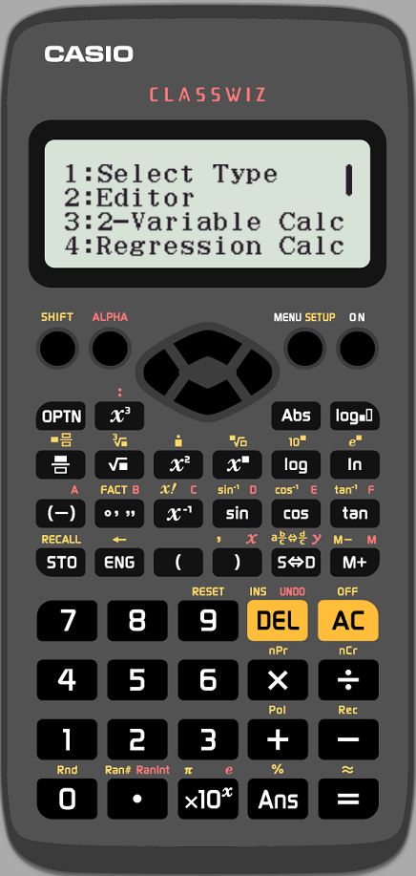
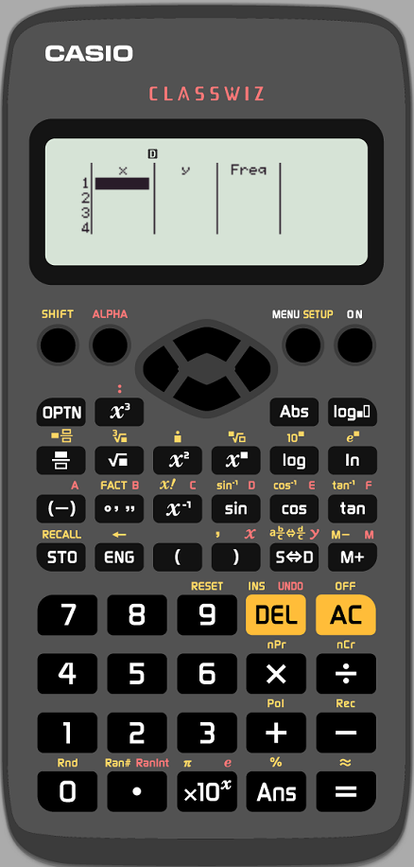
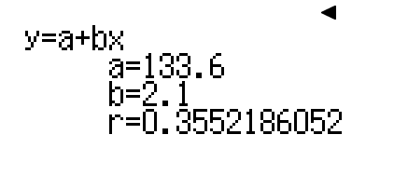
3. Correlation Coefficient
Age (years) | Height (cm)
15 | 166
16 | 171
17 | 159
18 | 177
Calculate the correlation coefficient between age and height for the values in the table
Enter each value from the table followed by “=“
Use the up/down arrows to edit (frequency is set to 1 by default)
When all the values are entered press “OPTN”
Press “4” for “Regression Calc”
“r” is the correlation coefficient

