Slide 1
van Hiele Example
3D Trigonometry

Slide 2
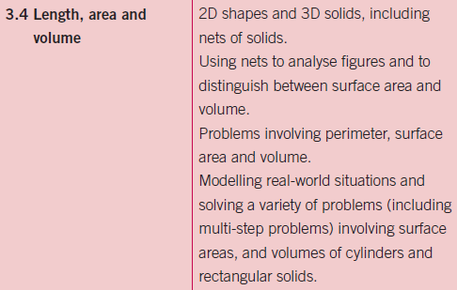
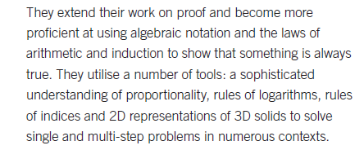
Leaving Certificate Syllabus

Slide 3
3D Problems
What do students find difficult about 3D trigonometry?
How do you help students gain an understanding of 3D trigonometry?
… (The) study found a relationship between young children’s construction skills and strong number sense and success in solving mathematical word problems (Nath & Szücs, 2014)
Children are as nonresponsive to short term explicit instruction on spatial transformation tasks as adults. (Ehrlich, Levine & Goldin-Meadow, 2006)

Slide 4
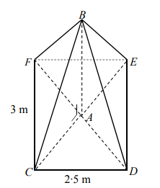
Notes:
Phase 1
Key Message: Students cannot easily decode this diagram, there are many ways they could view it
What can you see when you look at this diagram? Would your students all see the same thing?
A teacher may see a pyramid, a student may not, there are many different pictures to be identified here
(possibilities are a pyramid, an envelope, an irregular pentagon, a pentagram etc.)
Construct models of what you see. Use:
cocktail sticks with blutack/ mini marshmellows
Paper models
3D construction models with brassrods and string.
Cardboard models
GeoGebra
Magformers
Magnetix etc
The context of the question reveals more about the shape but many students still may not be able to marry the diagram and the description at this stage.
How would you support students in understanding what this diagram represents.
The formative assessment opportunity here should reveal if students understand the right angled sign in the diagram and the implications of this.
Additional Notes:
This is taken from the 2016 LCHL
Resources:

Slide 5
Notes:
Phase 2
Key Message: Students need to see the 2-D shapes in the 3-D shape to properly decode the structure. They are linking prior learning to this current learning.
Using your model, identify as many 2-D shapes as possible.
Construct cutouts of your shapes (Cardboard, Digital, etc.)
Mark in all sides and angles that are equal on your cutouts.
How do we know they are equal?
Additional Notes:
This is taken from the 2016 LCHL
Resources:

Slide 6
Notes:
Phase 3
Key Message: Students explicitate what they have learned from the previous exercises.
Students should be able to see that there are 5 exterior shapes/faces (One rectangle, which itself can be broken up, and four isosceles triangles) as well as explaining why they are isosceles. There are also four internal right-angled triangles. Students should be able to explain why they are congruent.
All informal language use by the students should now be replaced by the correct language.
Edge, vertex/vertices, face, right-angle, diagonal, rectangular based pyramid, ...
This is taken from the 2016 LCHL

Slide 7
Show that |AC|= 1.95m, correct to two decimal places.
The angle of elevation of B from C is 50° (i.e. |∠BCA| = 50°). Show that |AB| = 2.3 m, correct to one decimal place.
Find |BC|, correct to the nearest metre.
A glass Roof Lantern in the shape of a pyramid has a rectangular base CDEF and its apex is at B as shown. The vertical height of the pyramid is |AB|, where A is the point of intersection of the diagonals of the base as shown in the diagram. Also |CD| = 2.5m and |CF| = 3m
Notes:
Phase 4
Key Message: Students can now decode the diagram fully and are ready to tackle this problem.

Slide 8
Show that |AC|= 1.95m, correct to two decimal places.
The angle of elevation of B from C is 50° (i.e. |∠BCA| = 50°). Show that |AB| = 2.3 m, correct to one decimal place.
Find |BC|, correct to the nearest metre.
A glass Roof Lantern in the shape of a pyramid has a rectangular base CDEF and its apex is at B as shown. The vertical height of the pyramid is |AB|, where A is the point of intersection of the diagonals of the base as shown in the diagram. Also |CD| = 2.5m and |CF| = 3m
Notes:
Phase 5
Key Message: Students summarise what they have learned about 3-D Trigonometry problems
Script: What have you learned from this activity?
Possible student answers:
3-d problems can be broken up into simpler 2-d problems
These problems are JC level
The 3-d model can be difficult to see but practice reveals the shapes involved
Additional Notes:
This is taken from the 2016 LCHL
:

