Slide 1
Teaching Geometry for Understanding: Coordinate Geometry
postprimarymaths@pdst.ie
@ProjectMaths_ie

Slide 2
Resources
https://www.scoilnet.ie/pdst/maths/
@ProjectMaths_ie

Slide 3
Key Messages
Teaching Geometry in an integrated way deepens students’ understanding.
Constructivism provides rich learning experiences and promotes problem solving skills, through students working together to develop their own understanding of Mathematics.
It is important to build on students’ prior knowledge from Junior Cycle to extend their learning at Senior Cycle.

Slide 4
Learning Outcomes
By the end of this workshop participants will have:
explored that allowing students to engage with rich open tasks will encourage all students to become more confident in their mathematical ability, develop their critical-thinking skills and will provide them with the tools needed to attempt unseen problems.
discussed the importance of their students engaging with geometry as one coherent topic.
considered the value of effective collaboration.

Slide 5
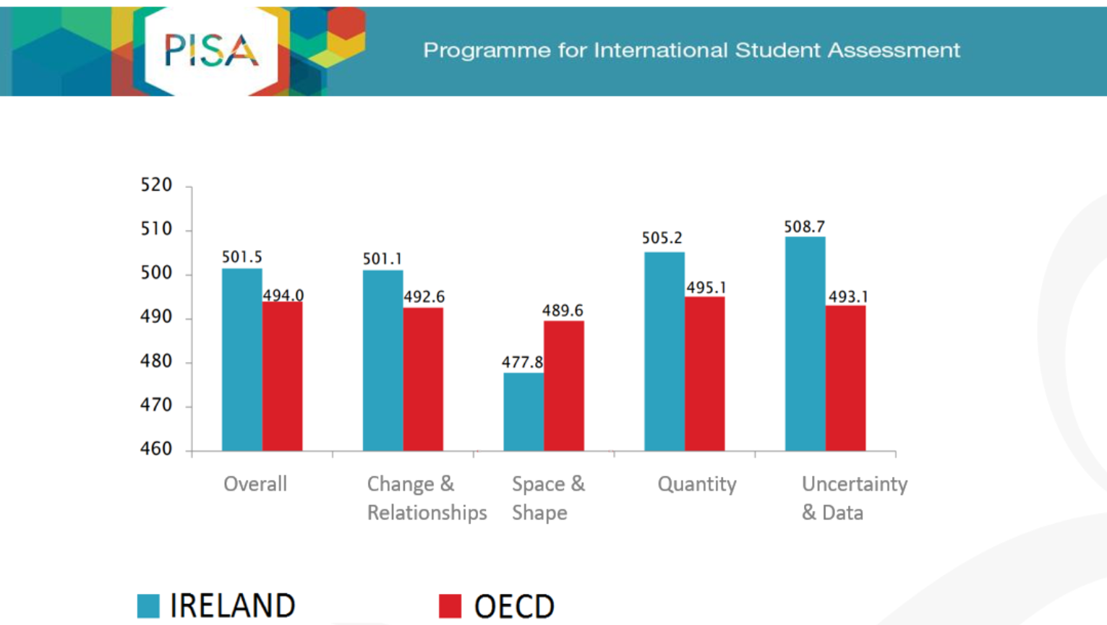
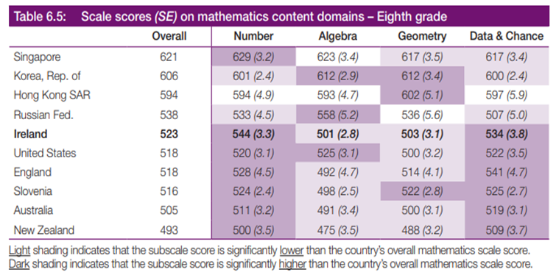
Looking at International Comparison Studies
Consider the evidence from the international comparison studies on the handouts. What does this say about our students current understanding of Geometry?

Slide 6
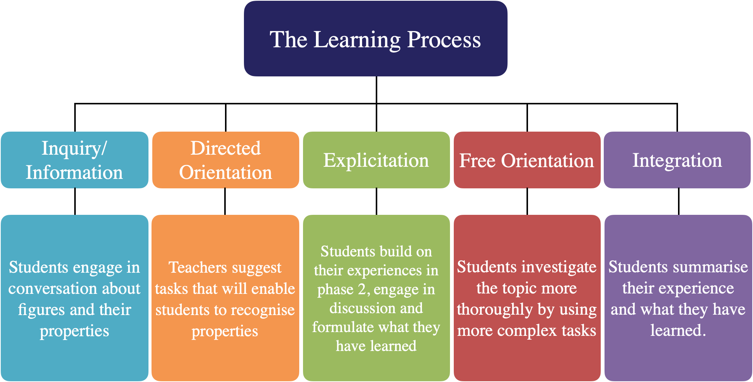
The van Hiele Theory of Geometric Thought
What are the key elements of the van Hiele Theory?
How do they inform our practice in light of the evidence presented?

Slide 7
How would your students approach this question?
The points A(-9, 3), B(-4, 3) and C(-4, 10) are the vertices of the triangle ABC.
Find the area of the triangle ABC.
What are the implications of the approaches taken to tackling this problem?

Slide 8
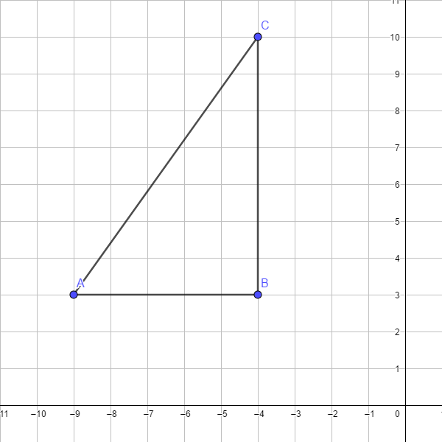

Slide 9
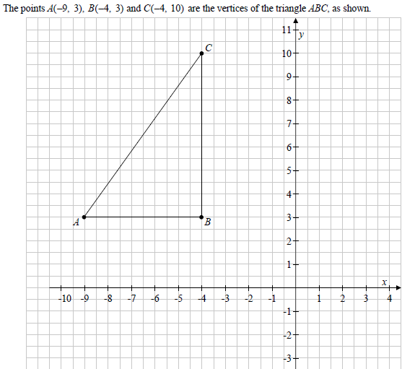
Visualise the problem
2014 Paper 2 OL Q4

Slide 10
Unit of Work:
The Area Of A Triangle

Slide 11
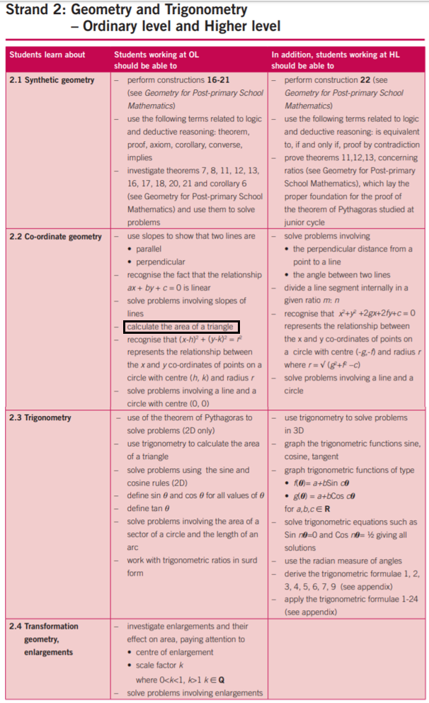
An Integrated Approach

Slide 12
Prior Knowledge
Plotting cartesian points on a cartesian plane
Properties of congruent triangles
Constructions of triangles given SSS, SAS, ASA or RHS data
Recognise images of points and objects under a given translation
Area of regular 2 dimensional shapes and composite shapes made from a combination of these
If two lines are parallel then a transversal makes two equal alternate angles on the two lines
(Theorem 3 Converse)

Slide 13
Unit of Work: Area of Triangles
Lesson | Description of the Content
1 | Axiom 4, Congruent triangles Identifying the properties of congruent triangles. SSS, SAS, ASA, RHS
2 | Construction 10 Triangle given the lengths of 3 sides Construction 11 Triangle given SAS data Construction 12 Triangle given ASA data Construction 13 Right angled triangle, given length of hypotenuse and one other side Construction 14 Right angled triangle, given one side and one acute angle
3 | Inquiry based activity on the area of a right-angled triangle
4 | Inquiry based activity on the area of non right angled triangles
5 | Deduction of Theorem 9, corollary 1: A diagonal divides a parallelogram into two congruent triangles Deduction of Theorem 17: The diagonal of a parallelogram bisects the area
6 | Application of learning from the inquiry based activities
7 | Transformation geometry. Inquiry based activity on translation of shapes and coordinate points in a Cartesian plane. Use of GeoGebra
8 | Calculate the area of a triangle using trigonometry. Inquiry based activity.

Slide 14
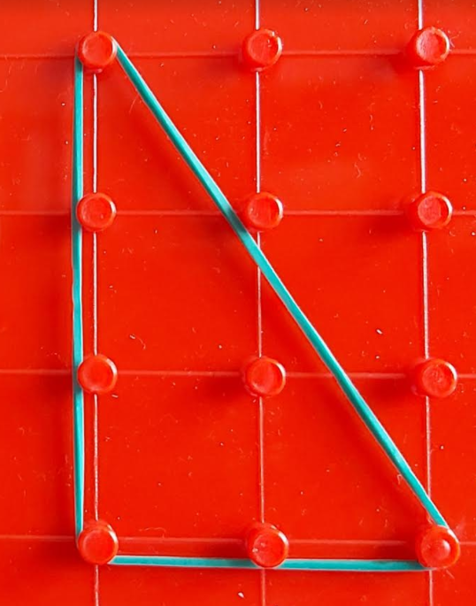
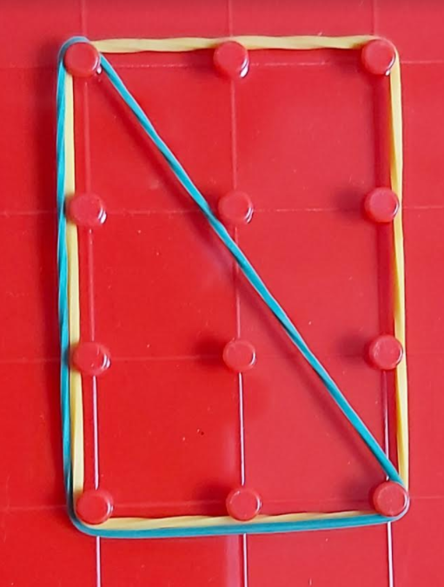
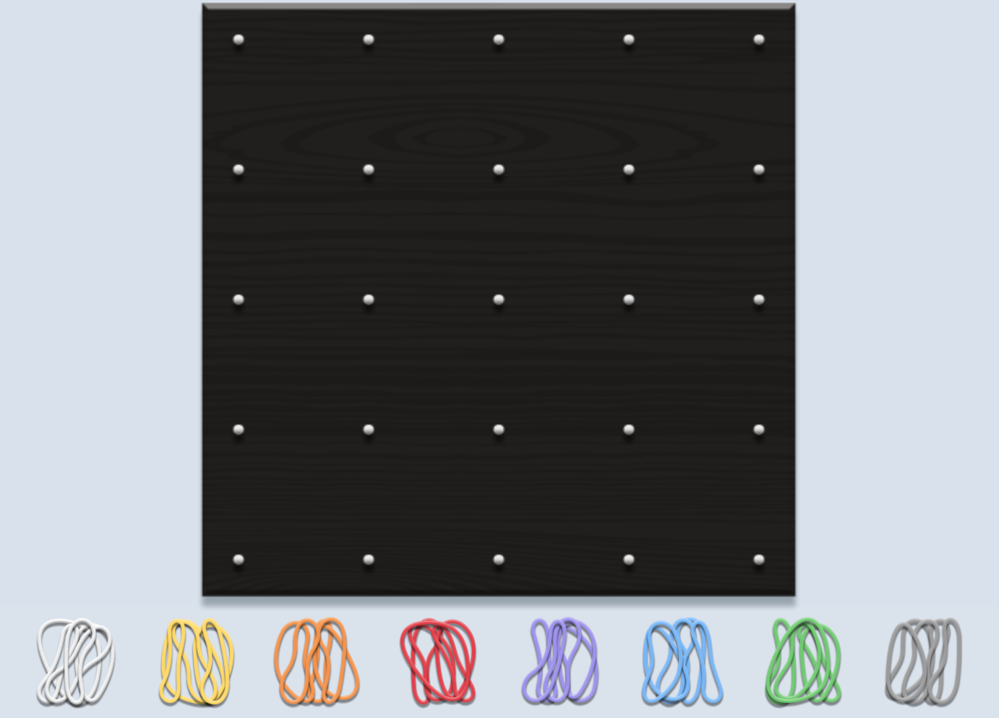
Lesson 3
Using the geoboard construct a right angled triangle.
How could you determine the area of the triangle?

Slide 15
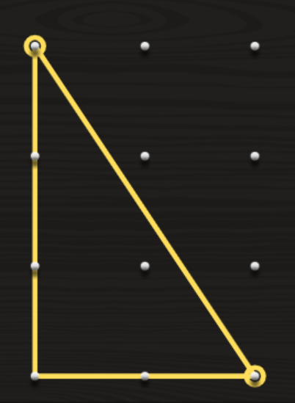
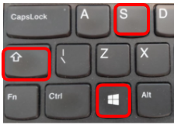
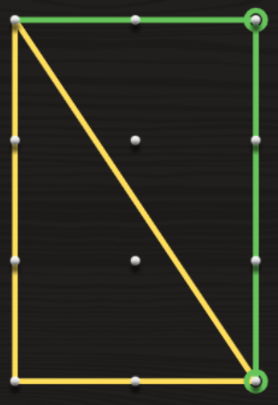
Lesson 3
Using the geoboard construct a right angled triangle.
How could you determine the area of the triangle?

Slide 16
Lesson 4
Use the geoboards to construct the following scalene triangles :
1. All angles acute and one side vertical
2. All angles acute and no vertical or horizontal sides
3. An obtuse angle and no vertical or horizontal sides

Slide 17
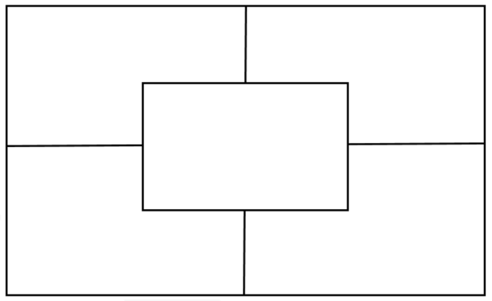
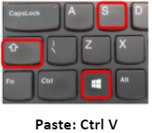
Breakout Room :
Jamboard Activity
How can you determine the area of the triangle in each case?
Summarise what you have learnt.
General Statement
Link to jamboard

Slide 18
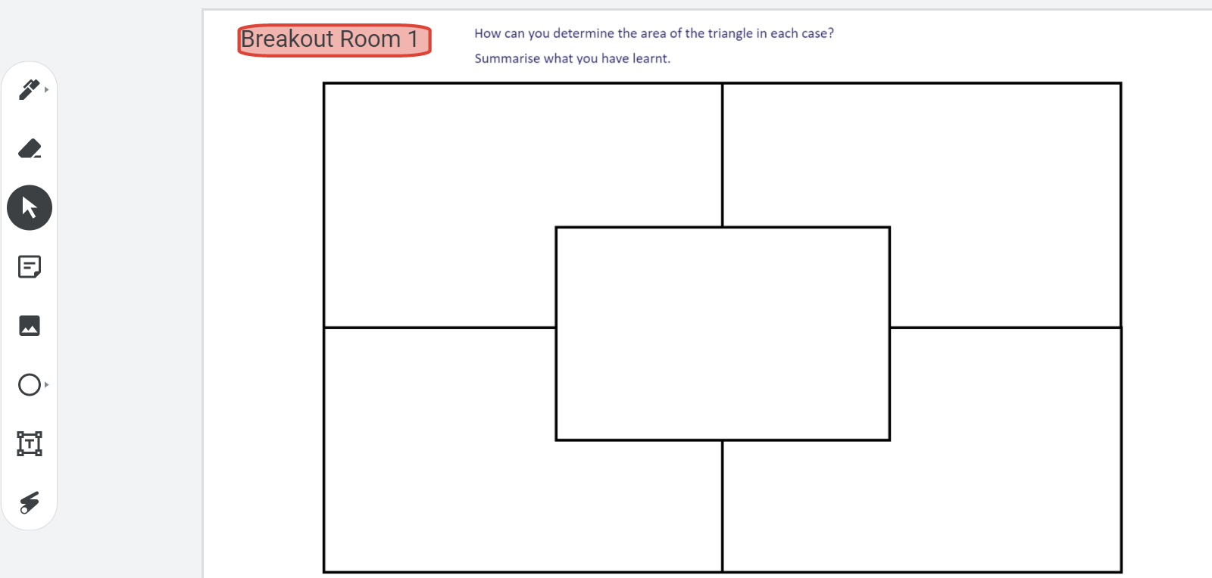
Link to jamboard

Slide 19
Poster

Slide 20
Application of learning
Hence find the area of a triangle with vertices
(-3, 4) (4, 2) (6,10).

Slide 21
Student Reflection
Review and summarise what you have learnt about the area of a triangle through these activities.
Consider what new thinking has replaced your previous level of thinking.
Link to padlet
QR Code for padlet

Slide 22
Student Reflection Feedback

Slide 23
Teacher Feedback
Compare and contrast this approach with those recorded at the beginning of the workshop.
How will this approach translate into the classroom?

Slide 24
Putting Learning into Action:
Gathering the Branches of Geometree?

Slide 25
Reviewing the unit of work
Lesson | Description of the Content
1 | Axiom 4, Congruent triangles Identifying the properties of congruent triangles. SSS, SAS, ASA, RHS
2 | Construction 10 Triangle given the lengths of 3 sides Construction 11 Triangle given SAS data Construction 12 Triangle given ASA data Construction 13 Right angled triangle, given length of hypotenuse and one other side Construction 14 Right angled triangle, given one side and one acute angle
3 | Inquiry based activity on the area of a right-angled triangle
4 | Inquiry based activity on the area of non right angled triangles
5 | Deduction of Theorem 9, corollary 1: A diagonal divides a parallelogram into two congruent triangles Deduction of Theorem 17: The diagonal of a parallelogram bisects the area
6 | Application of learning from the inquiry based activities
7 | Transformation geometry. Inquiry based activity on translation of shapes and coordinate points in a Cartesian plane. Use of GeoGebra
8 | Calculate the area of a triangle using trigonometry. Inquiry based activity.
https://tinyurl.com/UoWSample

Slide 26
Task:
In your breakout room, your group will be given a Jamboard containing multiple concepts in geometry. Your task is to:
Outline a sequential unit of work including these topics.
Discuss and document your rationale.
QR Code for padlet
Link to Jamboard

Slide 27
Reflection

Slide 28
Highlight your Learning under the Following Headings
QR Code for padlet
Teaching Geometry in an integrated way deepens students’ understanding.
Constructivism provides rich learning experiences based on student understanding and promotes problem solving skills.
By engaging deeply with Geometry at Junior Cycle, students acquire the conceptual understanding and skills to understand Geometry at Senior Cycle.

Slide 29
School Support
Single Visit
School Support
Sustained Support
: postprimarymaths@pdst.ie
: @ProjectMaths_ie
pdst.ie/schoolsupport

Slide 30
PDST Supports
PDST Supports
Seminars
Webinars
Professional Learning Communities
School Visits
PDST Websites
Lesson Study
Single Visit
Sustained Support
pdst.ie
scoilnet.ie
projectmaths.ie

Slide 31
PDST Post Primary Maths Team
Advisors:
Angela Dwane
angeladwane@pdst.ie
Dympna McCoy
dympnamccoy@pdst.ie
Arlene Murphy
arlenemurphy@pdst.ie
Darren Murphy
darrenmurphy@pdst.ie
Enda Donnelly
endadonnelly@pdst.ie
Warren McIntyre
warrenmcintyre@pdst.ie
Michael Walsh
michaelwalsh@pdst.ie
Twitter
@ProjectMaths_ie
Team Leader
Stephen Gammell
stephengammell@pdst.ie
Administrator
Gráinne Haughney
grainnehaughneymdt@pdst.ie
General Enquiries:
Postprimarymaths@pdst.ie

Slide 32
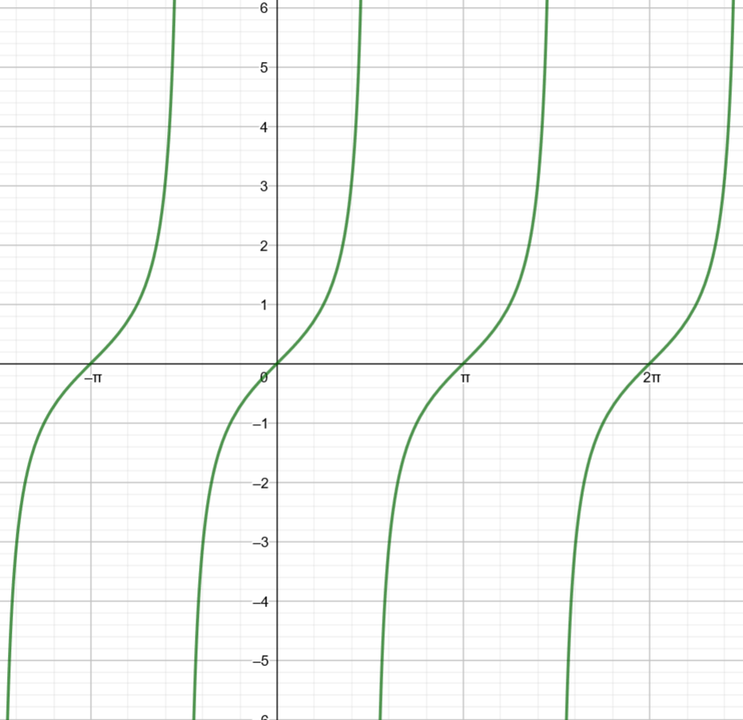
Tan q

Slide 33
References
ERC. (2015) TIMSS in Ireland: Mathematics and Science in primary and post-primary schools.
ERC, (2012) Learning for Life: The Achievements of 15-year-olds in Ireland on Mathematics, Reading Literacy and Science in PISA 2012
Fuys, D., Geddes, D., & Tischler, R. (1988). Journal for. Research in Mathematics Education Mono-graph 3: The van Hiele model of thinking in geometry among adolescents. Reston, VA: NationalCouncil of Teachers of Mathematics.
Crowley, M.L. (1987): The Van Hiele Model of the development of geometricthought, in N.C.T.M. (1987): Learning and teaching geometry, K-12.(N.C.T.M.: Reston, USA), pp. 1-16.
Newman, F. M., Marks, H. M., & Gamoran, A. (1996). Authentic Pedagogy and Student Performance. American Journal of Education, 104, 28-312
Lubienski, Sarah & Stilwell, Jean. (2011). Teaching Low-SES Students Mathematics Through Problem Solving: Tough Issues, Promising Strategies and Lingering Dilemmas.

