Slide 1
Calculus Seminar
Investigating connections across calculus

Slide 2
Seminar Schedule
Session 1 9:00 - 9:05 9:05 - 10:05 | Introduction Differentiation
Break (15 mins)
Session 2 10:20 - 11:20 | Integration
Break (30 mins)
Session 3 11:50 - 12:50 12:50 - 13:00 | Related Rates of Change Reflection

Slide 3
Legend
Resource
Prior Knowledge
Group work
Teaching Approach
Reflection
Next step
Digital Resource
Planning

Slide 4
Event Protocols

Slide 5
Blended Learning Resources for Maths

Slide 6
Learning Log
Digital or paper-based
Teacher perspective
Reflections

Slide 7
Learning Outcomes
● Have a clear understanding of the key messages of this workshop and how the workshop aligns with the key tenets of policy.
● Understand the importance of making connections between calculus in the mathematics classroom and the applications of calculus across other syllabi within senior cycle education.
● Have considered that effective use of digital technologies can enhance student understanding within the mathematics classroom.
● Understand that allowing students to engage with rich open tasks will encourage them to become more confident in their mathematical ability, develop their critical-thinking skills and will provide them with the tools needed to attempt unseen problems.
● Recognise the importance of reflecting on their practice, the value of effective collaboration and the long term benefits of engaging with continual professional development.

Slide 8
Our key messages for this seminar
Utilising a constructivist approach and building upon prior knowledge from Junior Cycle is important for sense-making in calculus.
Students’ investigation of calculus should exploit connections with other Senior Cycle STEM subjects.
Visual representations of Mathematical concepts provide greater opportunity for students to develop deep conceptual understanding

Slide 9
What is the Derivative?

Slide 10
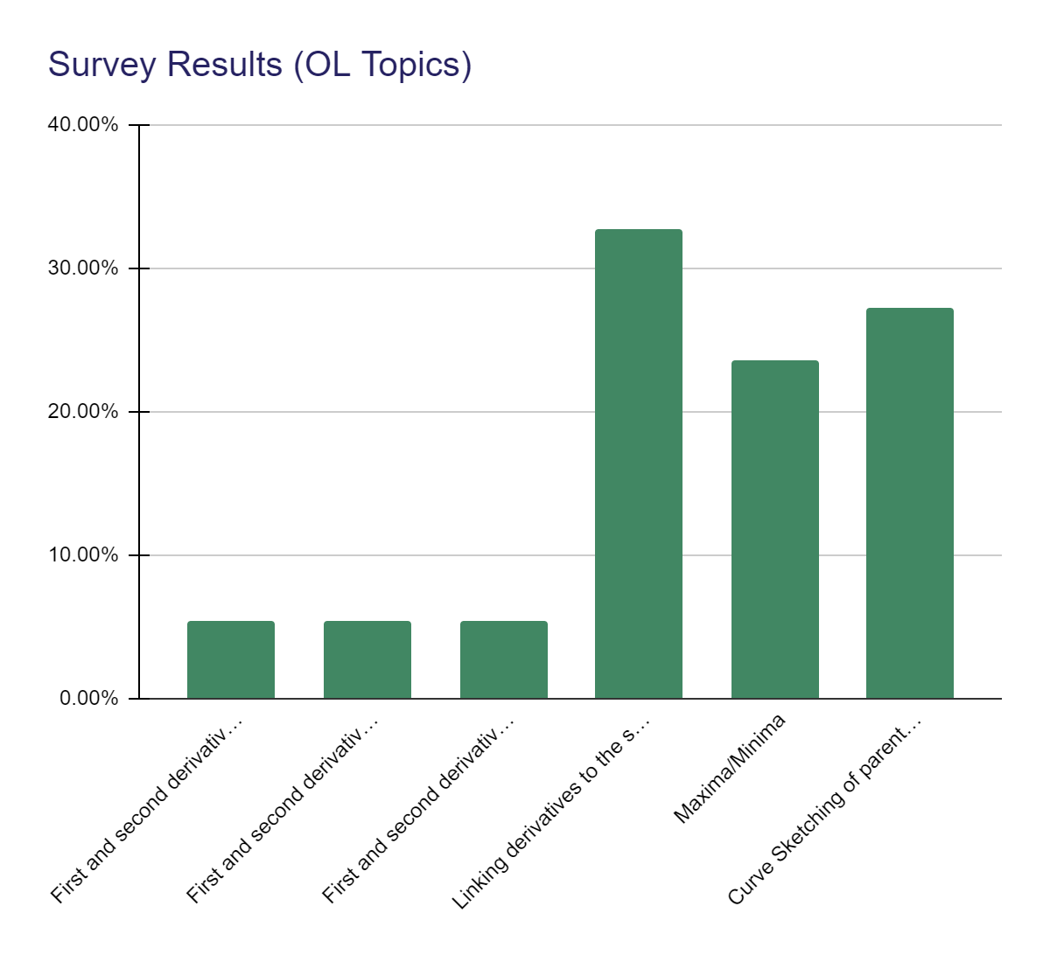
Why spend time on differential calculus today?
Junior Cycle
Senior Cycle

Slide 11
Syllabus

Slide 12
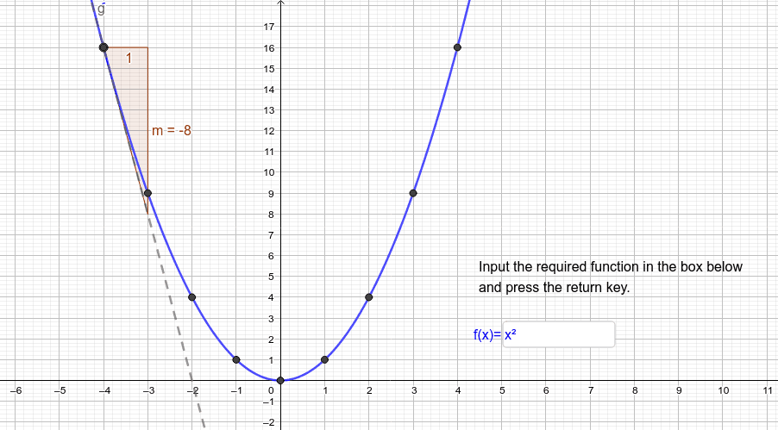
Teaching Calculus for Understanding
Breakout Room
Open the participant guide
Introduce yourself
Open & explore ‘Teaching Calculus for Understanding’ (Lesson 5, Assignment 1)
Discuss:
Have you engaged with this resource? If so, share your experience.
How do you see this task working in your school context?

Slide 13
The Derivative
What do you see as the main challenges involved in teaching the derivative?
Go to www.menti.com and insert the following passcode:
46 85 91 6

Slide 14
Use of vocabulary & symbols (OL)

Slide 15
Use of vocabulary & symbols (HL)

Slide 16
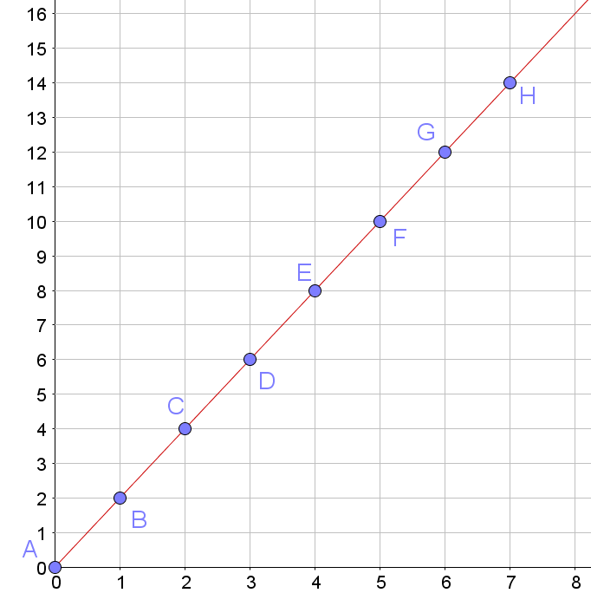
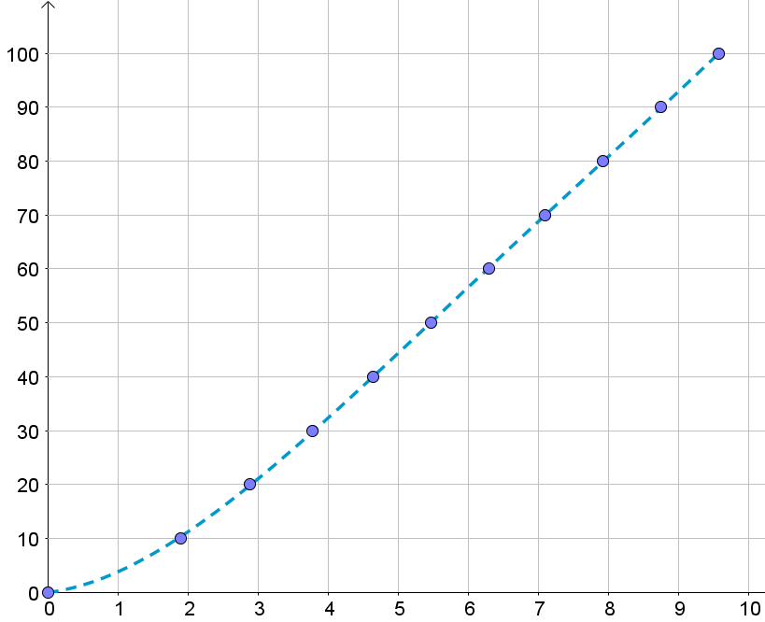
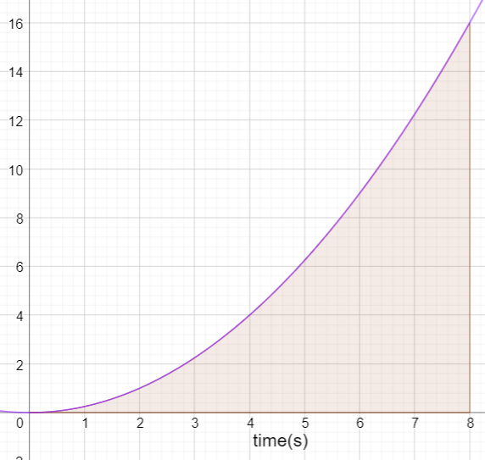
Train Speed
Runner Speed
Cyclist Distance
Distance (km)
Distance (m)
Time (minutes)
Time (s)
Speed (m/s)
Time (seconds)

Slide 17
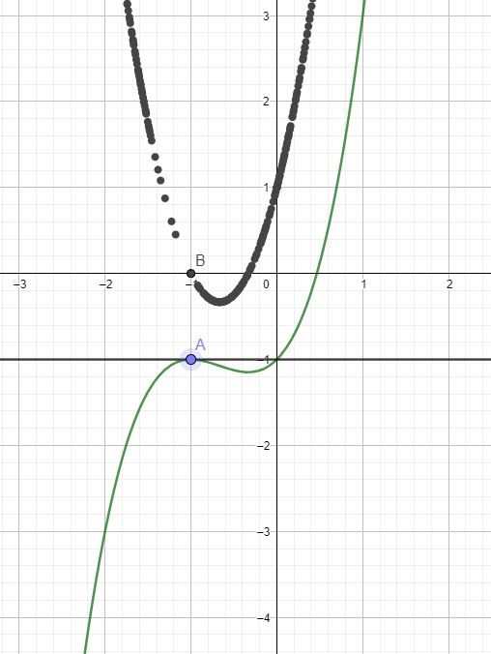
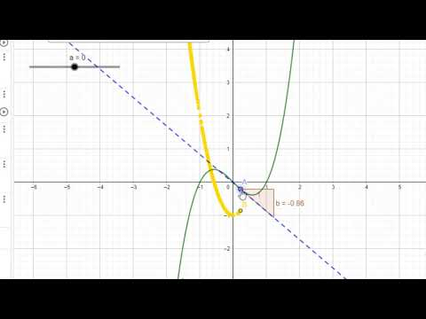
Derivative Task
Describe the ‘story’ of the tangent to this curve

Slide 18
Collaborative Activity - Breakout Rooms

Slide 19
Students create their own file

Slide 20
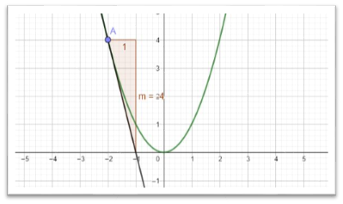
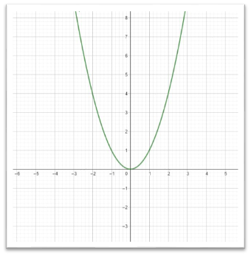
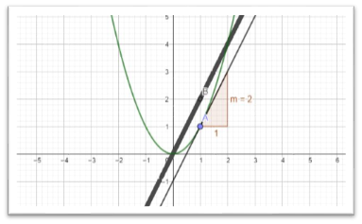
Students create their own file

Slide 21
Questioning
What do you notice about the turning points of the original function?
What happens to the parent function when the derivative function crosses the x axis?
What do you notice about the derivative function when the slope of the parent function is…
increasing?
decreasing?
moving from decreasing to increasing/increasing to decreasing/at the point of inflection?

Slide 22
Collaborative activity

Slide 23
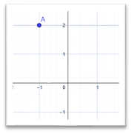
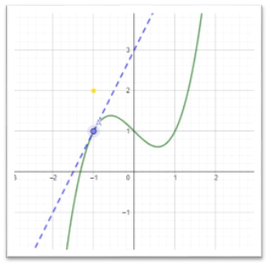
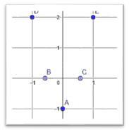
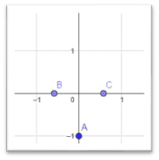
Tell the ‘story’ of the tangent

Slide 24
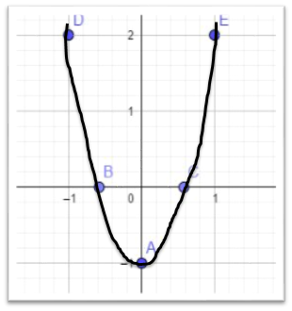
Compare graphs

Slide 25
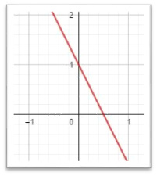
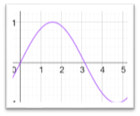
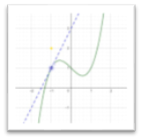
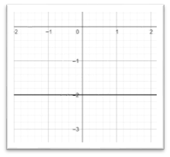
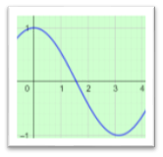
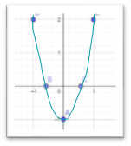
Compare Graphs

Slide 26
Individual student work

Slide 27
Class Discussion

Slide 28
Next Steps

Slide 29
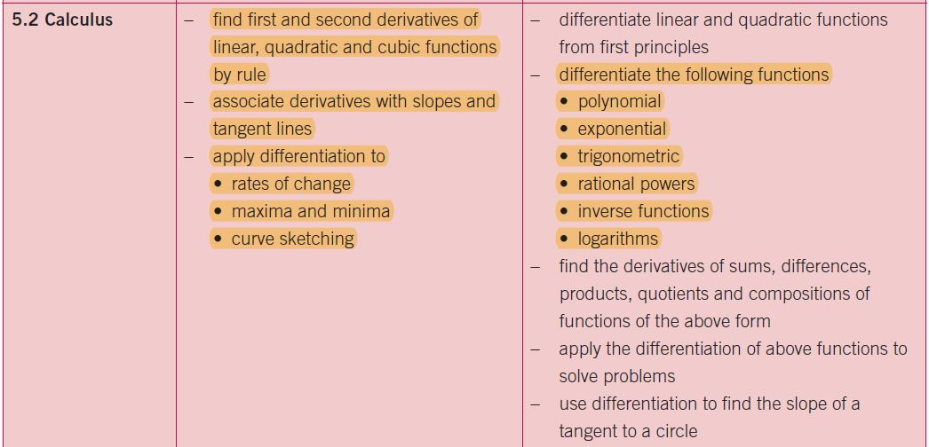
Syllabus

Slide 30
Reflection on Teaching Approaches
https://padlet.com/postprimarymaths/reflectiononteaching

Slide 31
Break Time
Section 2 starts at 10:25
I wonder what comes before cough f?

Slide 32
Integral Calculus
Making sense of area and average value

Slide 33
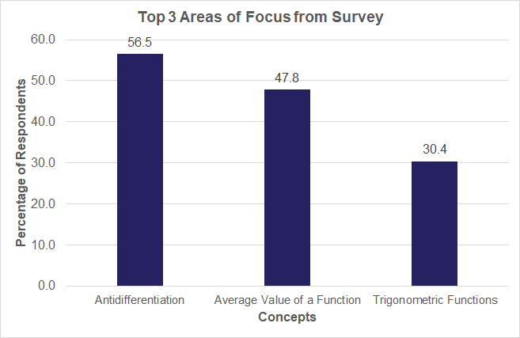
Why Spend Time on Integral Calculus Today?

Slide 34
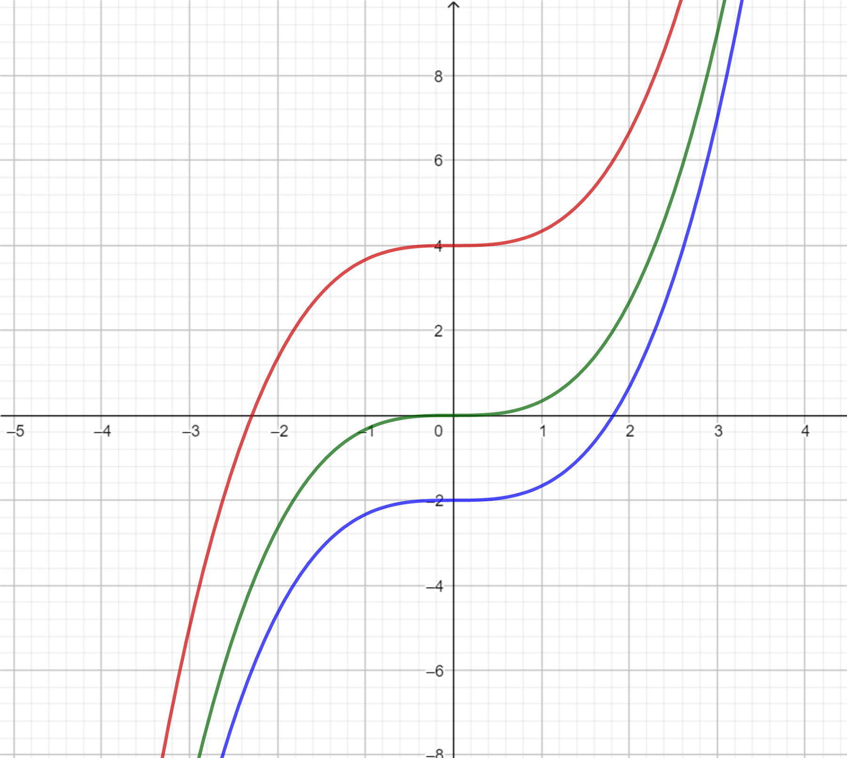
Function - Derivative Matching Exercise
Algebraic Expressions
Graphs

Slide 35
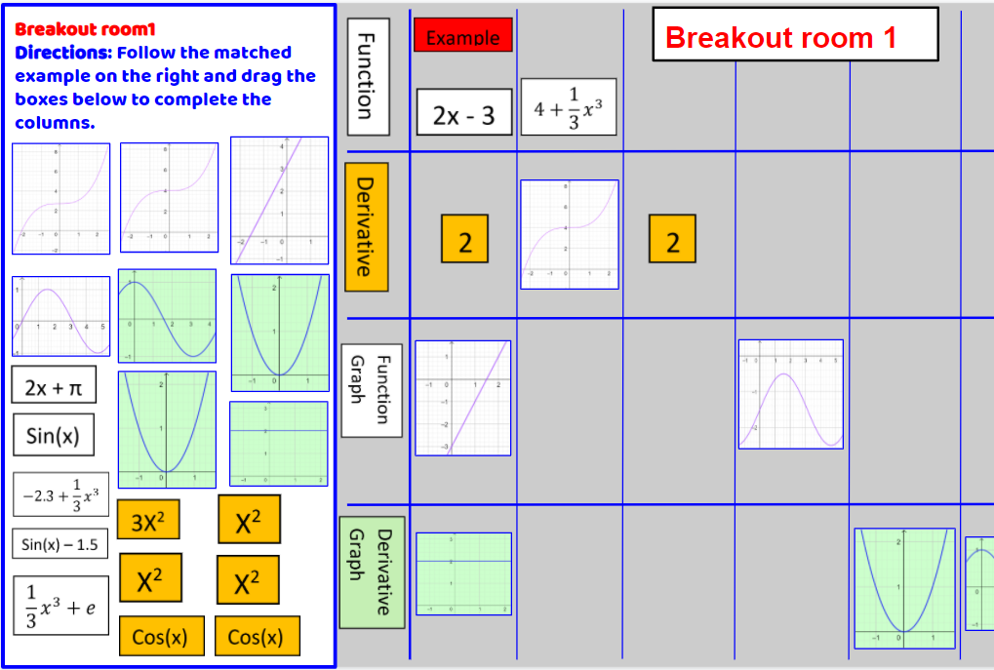
Matching Exercise: Breakout Session Directions
Everyone opens the Google slides file but only 1 person does the dragging
Click “View → Zoom → Fit” and then
“View → Full screen”

Slide 36
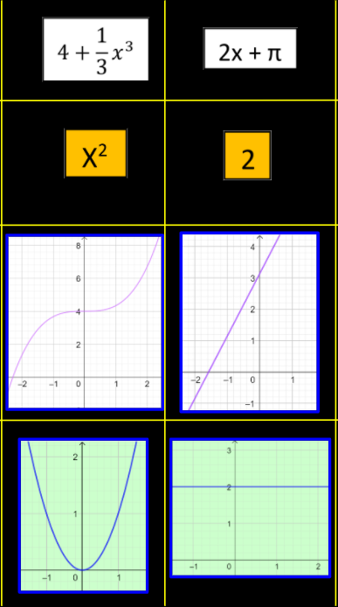
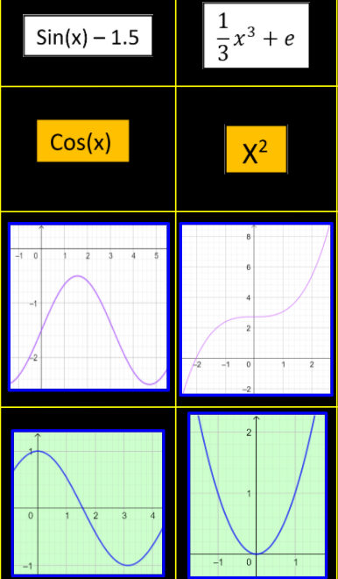
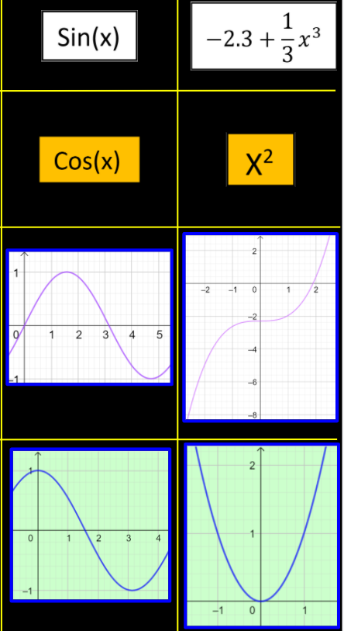
Matching Exercise Solutions

Slide 37
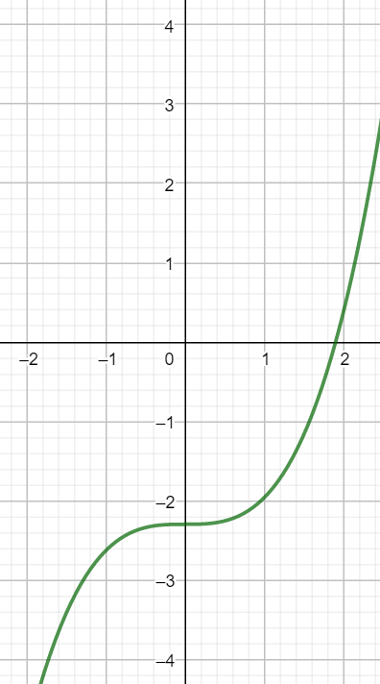
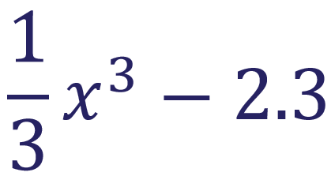
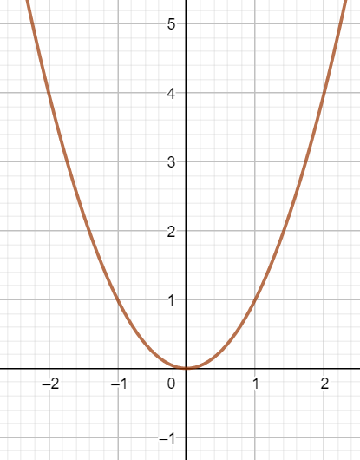
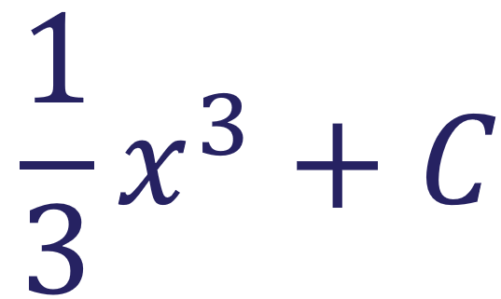
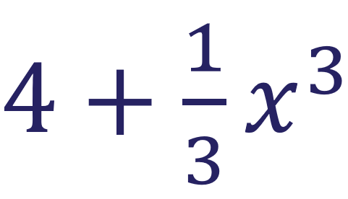
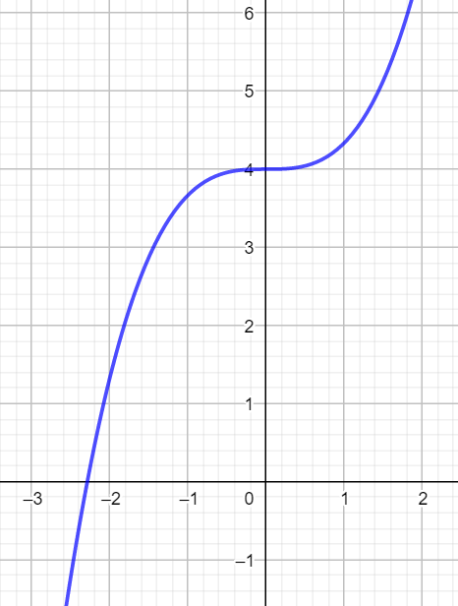
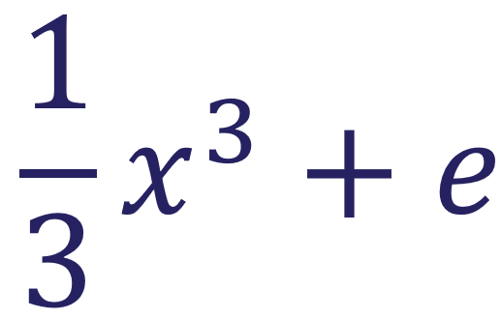
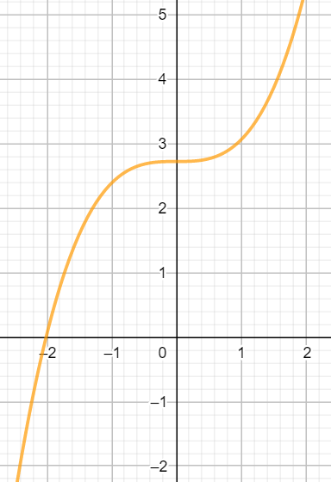
Function - Derivative Matching Exercise
f(x) → f’(x)
y → dy/dx
f(x) → f’(x)
f(x) → f’(x)

Slide 38
The Antiderivative
Antiderivative: G(x)
← Function: g(x)
Anti-differentiating

Slide 39
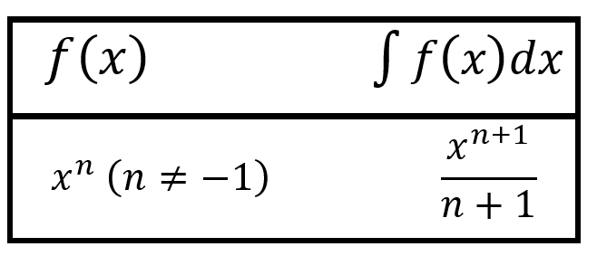
Constructing and Understanding The Formula
At this stage how would your students do if asked to find the antiderivative of e.g. x² ?
Where might they go wrong? E.g. if they wrote 2x
How can we get them to check their answer?

Slide 41
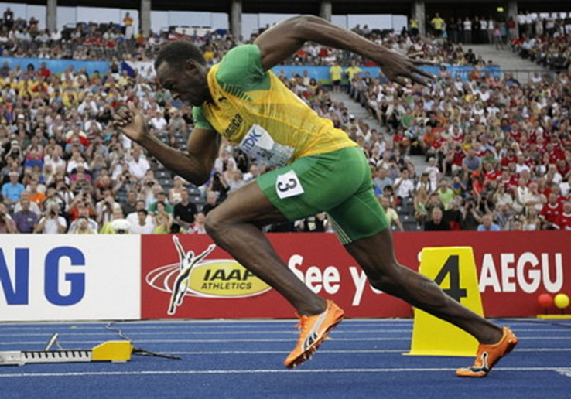
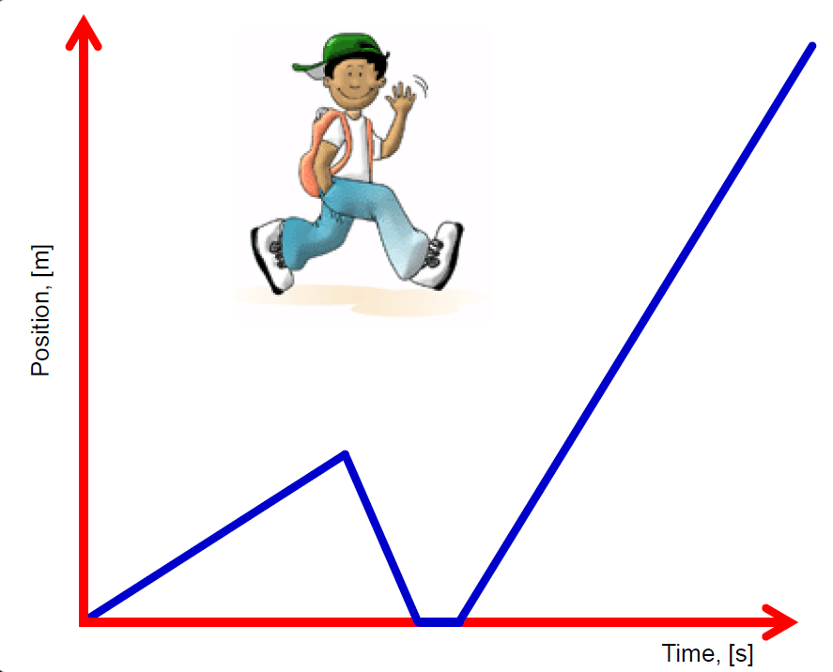
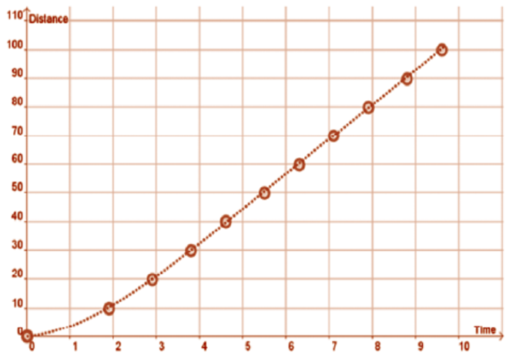
We’ve looked at Lots of Distance - Time Graphs
JC: Rate of Change
LC: Differential Calculus

Slide 42
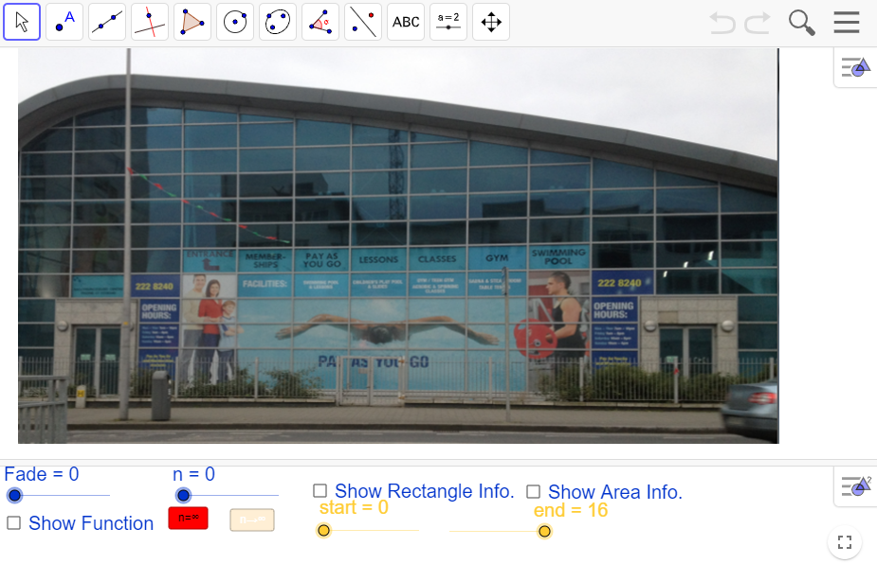
Another Approach

Slide 43
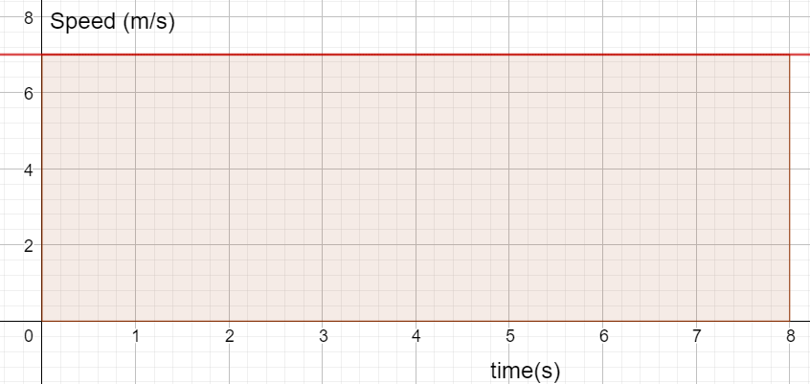
Speed - Time Graph 1

Slide 44
Speed - Time Graph 1
How far does the cyclist travel in 8 s?
Can you write an expression for: 1. The speed of the cyclist
2. The distance travelled (a table of time vs distance might help).

Slide 45
Effective Questions
Can you describe what is happening in the graph?
A cyclist travels at 7m/s for 8s, how far do they travel? How did you work this out?
What is the average speed?
What’s the area of the rectangle under the speed line?
How did you work out the area?
What are the units?
What do you notice?
Can you explain (Why area = distance)?
How far does the cyclist travel in 8 s?
Can you write an expression for: 1. The speed of the cyclist
2. The distance travelled (a table of time vs distance might help).

Slide 46
Speed - Time Graph 1 Key Learning
Area of a rectangle = (Height)(Width) Distance = (Speed)(Time)
Units = (m/s)(s) = m
Area under a speed-time graph for a given time gives the distance travelled.
Speed =7
Distance = 7t

Slide 47
Speed - Time Graph 2
How far does the cyclist travel in 8 s?
What is her average speed?
Can you write an expression for: 1. The speed of the cyclist
2. The distance travelled (a table of time vs distance might help).

Slide 48
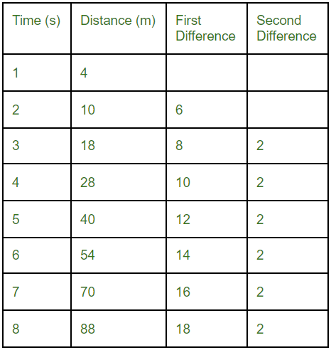
Speed - Time Graph 2
Area of trapezoid = (3+19)/2)(8) = 88
(from graph or calculation) Average speed by time = (11)(8) = 88m Physics: distance = (u+v)/2)(t) = (3+19)/2)(8) = 88 = ut + ½at² = (3)(8) + ½(2)(8)² = 88
Speed = 2t + 3 Distance = t² + 3t

Slide 49
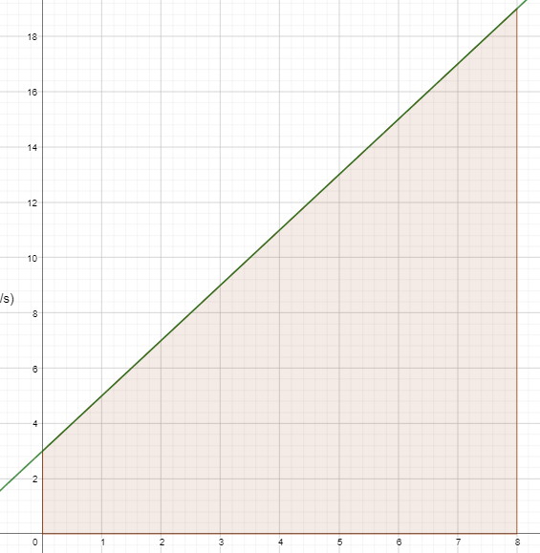
Speed - Time Graph 2
Speed = 2t + 3 Distance = t² + 3t
2t
Area=(½)(t)(2t)=t²
Area=(t)(3)=3t
3
Width = t

Slide 50
Speed - Time Graph 2
How far does the cyclist travel in 8 s?

Slide 51
Speed - Time Graph 2 Key Learning
We can get the average height of a continuous function over a given interval by dividing the total area by the interval width.
Area = 88
Speed = 2t + 3 Distance = t² + 3t
Width = 8

Slide 52
Speed - Time Graph 3
!???

Slide 53
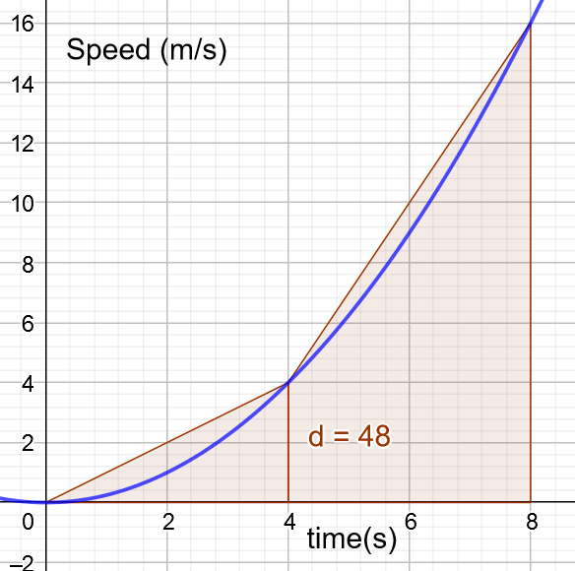
Speed - Time Graph 3

Slide 54
The Antiderivative
Differentiation
Distance
Speed
Integration
Distance
Speed

Slide 55
Speed - Time Graph 3
Speed = t²/4 → Distance =
Distance travelled in 8s =
Average speed in the 8s =
Distance travelled between 3s and 6s =

Slide 56
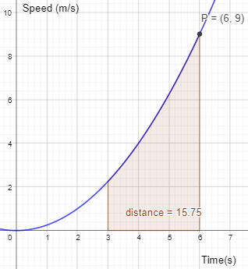
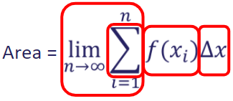
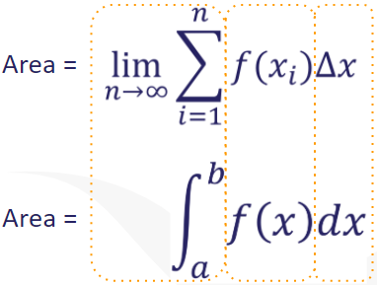
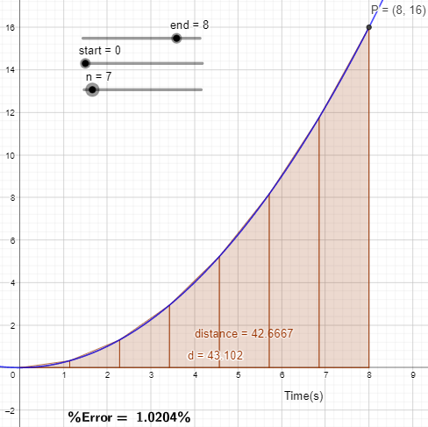
Integral Calculus
Trapezoidal Rule
Making sense of the notation
Applying Intervals

Slide 57
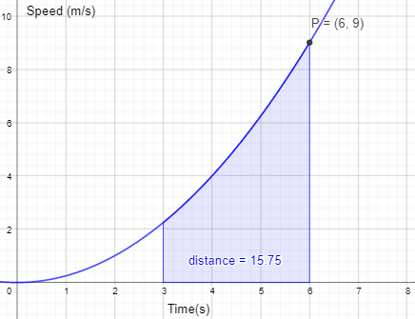
Average Value - Understanding The Formula

Slide 58
The Syllabus

Slide 59
Reflection on Teaching Approaches

Slide 60
Break Time
Section 3 starts at 11:50

Slide 61
Related Rates of Change
Why were the answers to the oil spill question not so slick?

Slide 62
Learning Outcomes
Understand that allowing students to engage with rich open tasks will encourage them to become more confident in their mathematical ability, develop their critical-thinking skills and will provide them with the tools needed to attempt unseen problems

Slide 63
2015 LC HL Exam
https://tinyurl.com/RelatedRates2015

Slide 64
Chief Examiners Report 2015
At Higher level, candidates struggled with a problem-solving question that involved finding the time it took an oil slick to reach land (Paper 1, Question 8(d)). While the question was a challenging one, there were a number of different possible approaches to solving the problem. However, candidates showed little initiative in coming up with a solution.
Recommendations
Teachers should provide students with opportunities to practice solving problems involving real-life applications of mathematics, and get used to dealing with “messy data” in such problems. Students should also be encouraged to construct algebraic expressions or equations to model these situations, and/or draw diagrams to represent them.

Slide 65
Problem Solving Skills
At each syllabus level students should be able to:
Explore patterns and formulate conjectures
Explain findings
Justify conclusions
Communicate mathematics verbally and in written form
Apply their knowledge and skills to solve problems in familiar and unfamiliar contexts
Analyse information presented verbally and translate it into mathematical form
Devise, select and use appropriate mathematical models, formulae or techniques to process information and to draw relevant conclusions

Slide 66
Rich Task
What are rich tasks?
Accessible to all learners
Multiple approaches and representations
Collaboration and discussion
Engagement, curiosity and creativity
Cross-topic connections
Opportunities for extension

Slide 67
What is changing, what are the variables?
Height of the balloon
Temperature of the air
Volume of air in the balloon
How are they related?
Radius of the balloon
Surface area of the balloon
How would we describe the rate of change of these variables

Slide 68
Breakout Room: Activity 1
An 8m ladder is leaning against the wall. The top of the ladder is slipping down the wall at a constant rate of 2m/s.
As the ladder slips down the wall, identify the variables and explore how these variables are changing with respect to time. Explain your reasoning.
Are there related variables? If so how are they related?
https://tinyurl.com/JamVar

Slide 70
Common Notation

Slide 71
Breakout Room: Activity 2
Building relationships, making connections
On the jamboard provided, indicate which correctly describe the relationships between the variables.
Could we use these correct relationships to find the rate at which the bottom of the ladder is slipping, dx/dt?
https://tinyurl.com/connecteq

Slide 72
Making Connections
Could we use these relationships to find the rate at which the bottom of the ladder is slipping, dx/dt?

Slide 73
Rich Task
What are rich tasks?
Accessible to all learners
Multiple approaches and representations
Collaboration and discussion
Engagement, curiosity and creativity
Cross-topic connections
Opportunities for extension

Slide 74
How would our 2015 students have approached the oil slick problem?
What do we want?
What are we given?
What do we need to find?

Slide 75
How will this approach help our 2015 students and the oil slick problem?

Slide 76
Reflecting on student’s learning experiences
Consider the oil spill question designed as a rich task activity.
You previously identified where your students may have difficulties with this problem. Has this approach developed any problem solving strategies which will lend itself to greater understanding?
https://tinyurl.com/perdifficulty

Slide 77
Reflection
A look at the key learning from this seminar

Slide 78
Reflecting on the Seminar
Seminar
Section 1
Section 2
Section 3

Slide 79
Our key messages for this seminar
Utilising a constructivist approach and building upon prior knowledge from Junior Cycle is important for sense-making in calculus.
Students’ investigation of calculus should exploit connections with other Senior Cycle STEM subjects.
Visual representations of Mathematical concepts provide greater opportunity for students to develop deep conceptual understanding

Slide 80
Evaluation
https://tinyurl.com/PDSTOnlineCalSemEval

Slide 81
PDST Post Primary Maths Team
Team Leader
Stephen Gammell
stephengammell@pdst.ie
Administrator
Gráinne Haughney
grainnehaughneymdt@pdst.ie
General Enquiries:
postprimarymaths@pdst.ie
Advisors: fullname@pdst.ie
Angela Dwane
Dympna McCoy
Arlene Murphy
Darren Murphy
Enda Donnelly
Warren McIntyre
Michael Walsh
@ProjectMaths_ie

Slide 82
PDST Supports
PDST Supports
Seminars
Webinars
Professional Learning Communities
School Visits
PDST Websites
Lesson Study
Single Visit
Sustained Support
pdst.ie
scoilnet.ie
projectmaths.ie

Slide 83
Support Events for Remote/Blended Learning in Maths

Slide 84
School Support
Tan q
Book a school visit
Contact us:
postprimarymaths@pdst.ie

