Slide 1
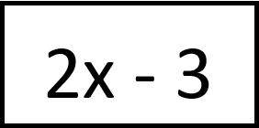
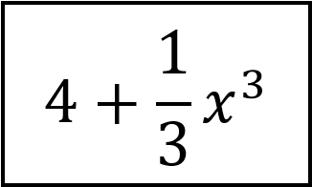
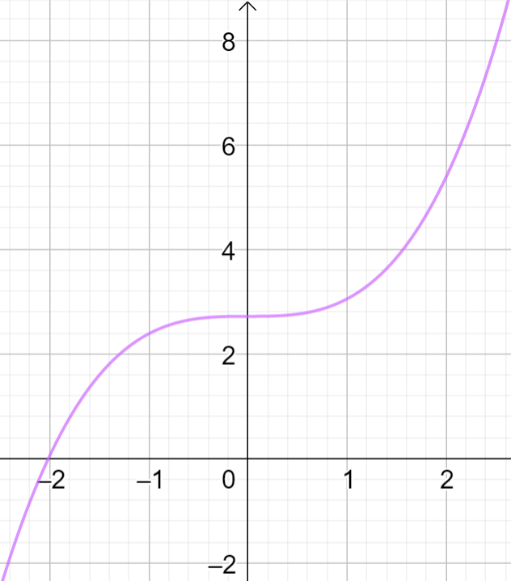
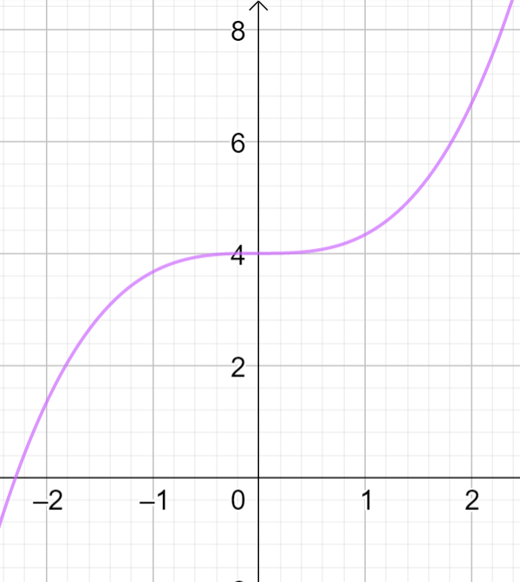
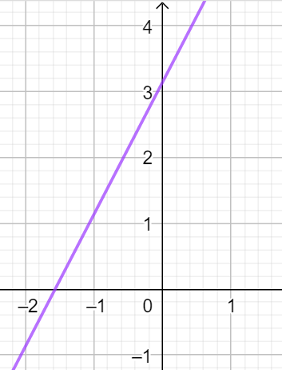
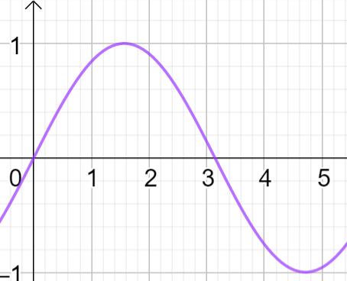
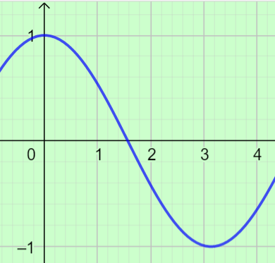
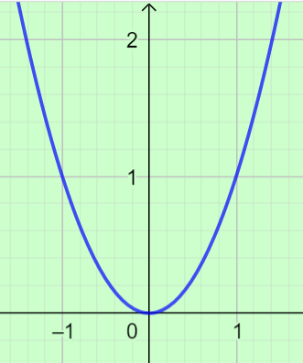
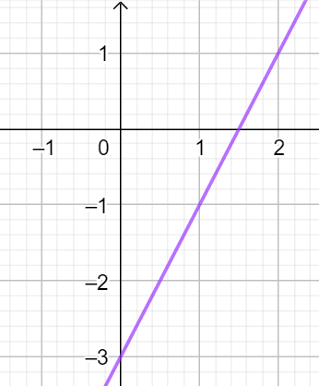
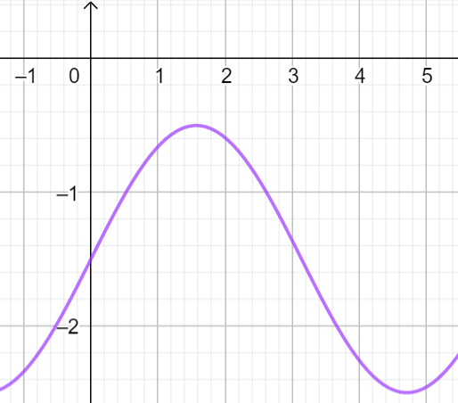
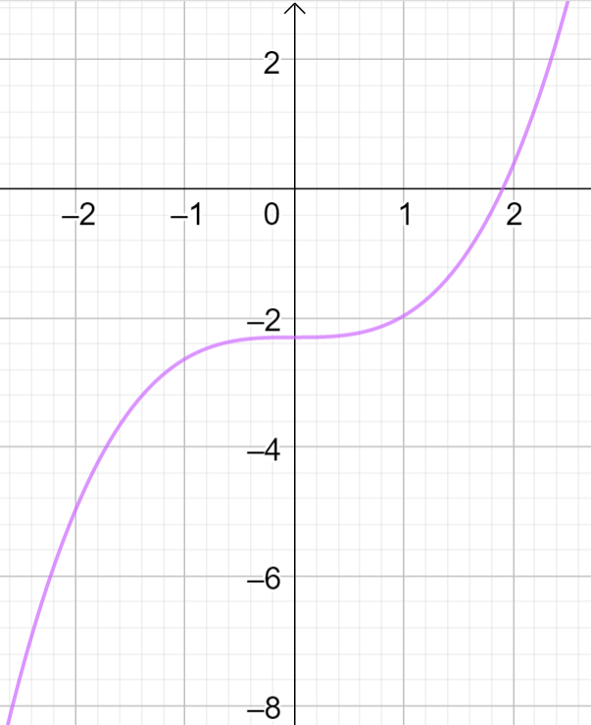
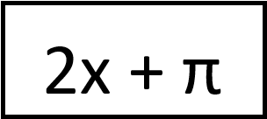
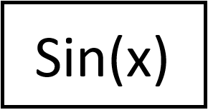
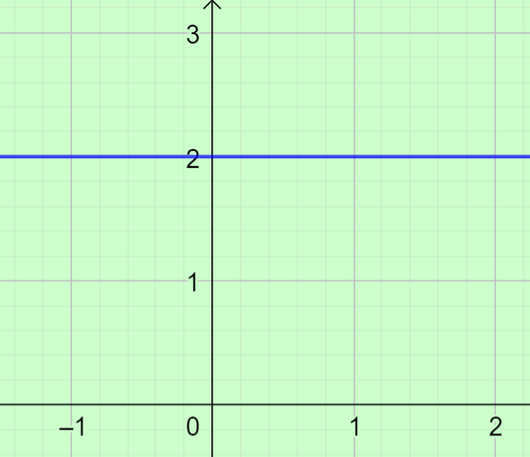
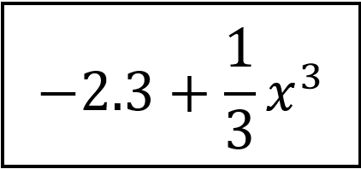
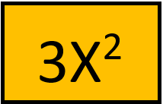
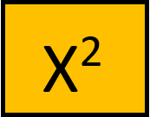
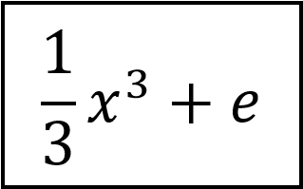
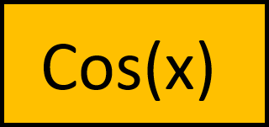
Breakout room1
Directions: Follow the matched example on the right and drag the boxes below to complete the columns.
Breakout room 1

Slide 2
Breakout room2
Directions: Follow the matched example on the right and drag the boxes below to complete the columns.
Breakout room 2

Slide 3
Breakout room3
Directions: Follow the matched example on the right and drag the boxes below to complete the columns.
Breakout room 3

Slide 4
Breakout room4
Directions: Follow the matched example on the right and drag the boxes below to complete the columns.
Breakout room 4

Slide 5
Breakout room5
Directions: Follow the matched example on the right and drag the boxes below to complete the columns.
Breakout room 5

Slide 6
Breakout room6
Directions: Follow the matched example on the right and drag the boxes below to complete the columns.
Breakout room 6

Slide 7
Breakout room7
Directions: Follow the matched example on the right and drag the boxes below to complete the columns.
Breakout room 7

Slide 8
Breakout room8
Directions: Follow the matched example on the right and drag the boxes below to complete the columns.
Breakout room 8

Slide 9
Breakout room9
Directions: Follow the matched example on the right and drag the boxes below to complete the columns.
Breakout room 9

Slide 10
Breakout room10
Directions: Follow the matched example on the right and drag the boxes below to complete the columns.
Breakout room 10

Slide 11
Breakout room11
Directions: Follow the matched example on the right and drag the boxes below to complete the columns.
Breakout room 11

Slide 12
Breakout room12
Directions: Follow the matched example on the right and drag the boxes below to complete the columns.
Breakout room 12

Slide 13
Breakout room13
Directions: Follow the matched example on the right and drag the boxes below to complete the columns.
Breakout room 13

Slide 14
Breakout room14
Directions: Follow the matched example on the right and drag the boxes below to complete the columns.
Breakout room 14

Slide 15
Breakout room15
Directions: Follow the matched example on the right and drag the boxes below to complete the columns.
Breakout room 15

Slide 16
Breakout room16
Directions: Follow the matched example on the right and drag the boxes below to complete the columns.
Breakout room 16

Slide 17
Breakout room17
Directions: Follow the matched example on the right and drag the boxes below to complete the columns.
Breakout room 17

Slide 18
Breakout room18
Directions: Follow the matched example on the right and drag the boxes below to complete the columns.
Breakout room 18

Slide 19
Breakout room19
Directions: Follow the matched example on the right and drag the boxes below to complete the columns.
Breakout room 19

Slide 20
Breakout room20
Directions: Follow the matched example on the right and drag the boxes below to complete the columns.
Breakout room 20

