Slide 1
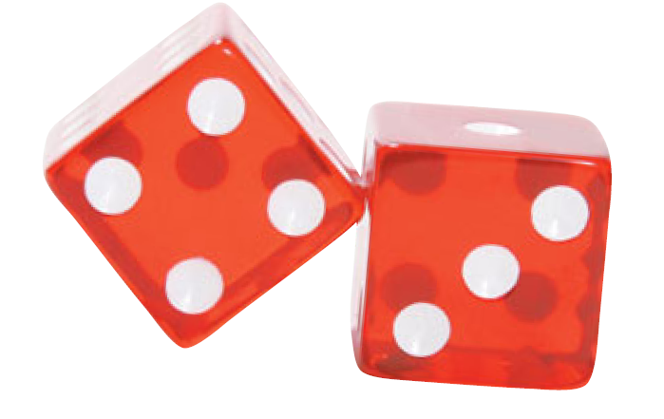
Expected Value and Fair Games

Slide 2
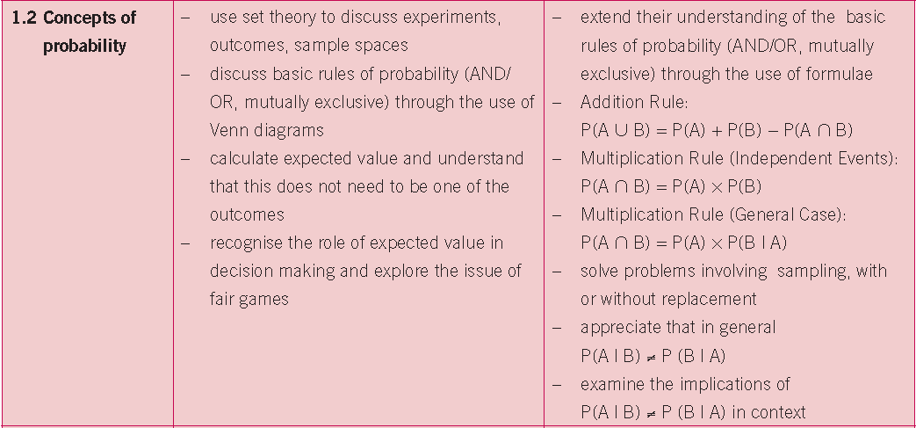
Syllabus
Prior Knowledge: Understanding of basic Probability theory

Slide 3
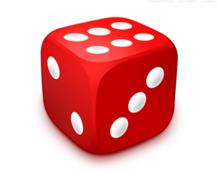
Numbers Up!
A funfair game called Numbers Up! involves
rolling a single die. Here are the rules:
You win the number that
appears on the die in €uro
€4 for a 4
€6 for a 6 etc

Slide 4
Activity 1
How much did you win?
2. Work out your average(mean) amount you won per
game having played the game 20 times.
3. When you have the value for the class mean, fill in
the table below:

Slide 5
Activity 1
4. Does your average differ from that of the class?
What could explain this?
5. What do you think the class average figure represents
in the context of the game?
6. Would you pay €3 to play this game? Give a reason for
your answer.
7. If you ran the Numbers Up! game at the funfair, how
much would you charge people to play it? Explain your
answer.
8. What do you think would be a fair price to pay
to play this game? Why?

Slide 6
A Fair Price?
If I roll a standard die many times what is the average score I can expect?

Slide 7
Probability Distribution Table
Score (X) | 1 | 2 | 3 | 4 | 5 | 6
Probability P(X) | 1/6 | 1/6 | 1/6 | 1/6 | 1/6 | 1/6
Numbers Up!

Slide 8
Probability Distribution Table
Score (X) | 1 | 2 | 3 | 4 | 5 | 6
Probability P(X) | $$\frac{1}{6}$$ | $$\frac{1}{6}$$ | $$\frac{1}{6}$$ | $$\frac{1}{6}$$ | $$\frac{1}{6}$$ | $$\frac{1}{6}$$
$$Mean=\frac{\sum{fx}}{\sum{f}} (JC)$$
$$=\frac{\sum{x.P(x)}}{\sum{P(x)}}$$
$$=\frac{\sum{x.P(x)}}{1}$$
Numbers Up!
=$\sum{x.P(x)}$

Slide 9
Expected Value
How much money a player can expect to win/lose in the long run on a particular bet
“The House Edge”/ Risk Analysis and
Insurance/ Economics (Decision Theory)
Mean: average of what HAS happened
Expected Value: average of WHAT IS GOING to happen

Slide 10
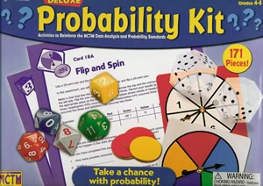
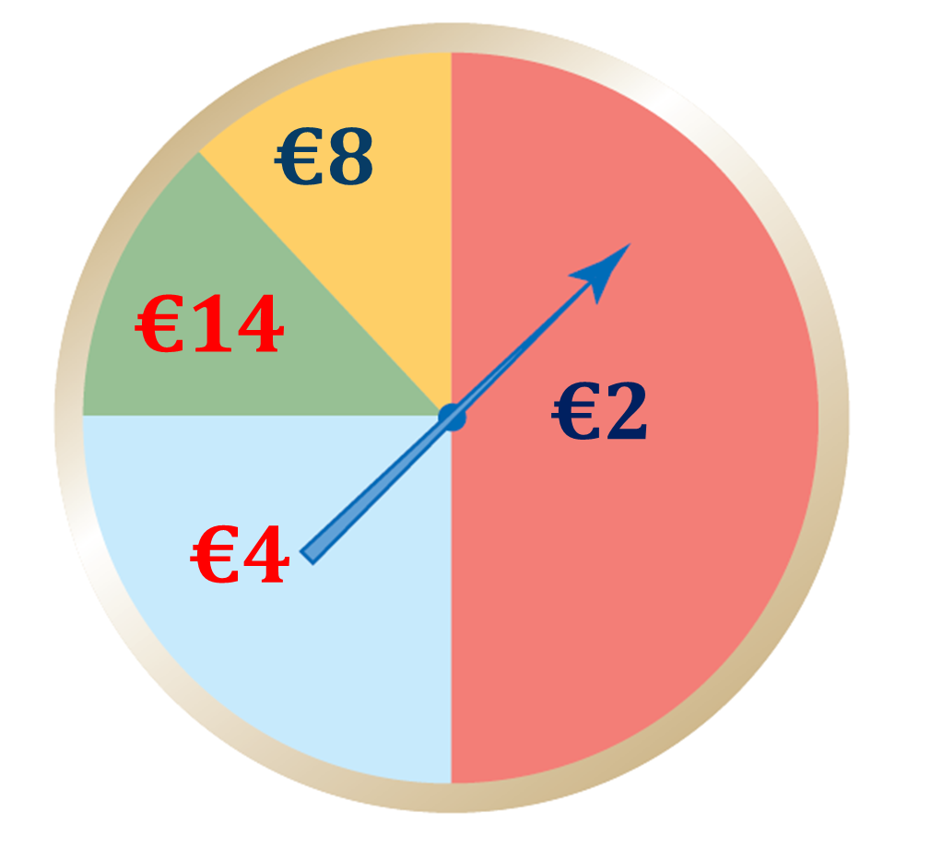
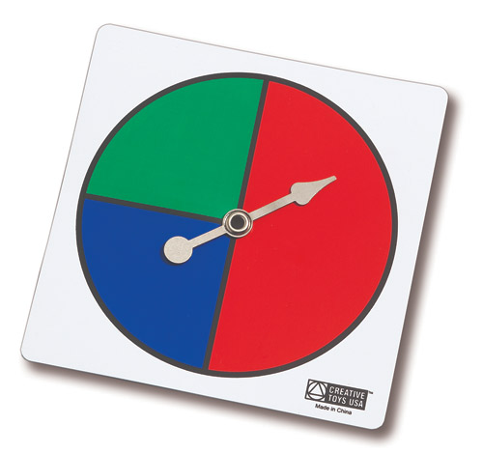
Teaching Idea

Slide 11
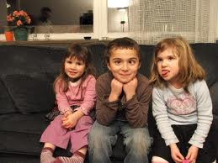
Mathematical Expectation
Suppose a couple decide to have three children.
How many boys can they expect to have?
Assume boys and girls are equally likely.

Slide 12
Sample Space
3rd
2nd
BBB
Start
B
B
G
G
B
B
G
G
B
G
B
G
B
G
1st
BBG
BGB
BGG
GBB
GBG
GGB
GGG

Slide 13
Mathematical Expectation
No of Boys | 0 | 1 | 2 | 3
Probability
No of Boys | 0 | 1 | 2 | 3
Probability | 1/8 | 3/8 | 3/8 | 1/8

Slide 14
Fair or Unfair?
€5 to play
€8
€2

Slide 15
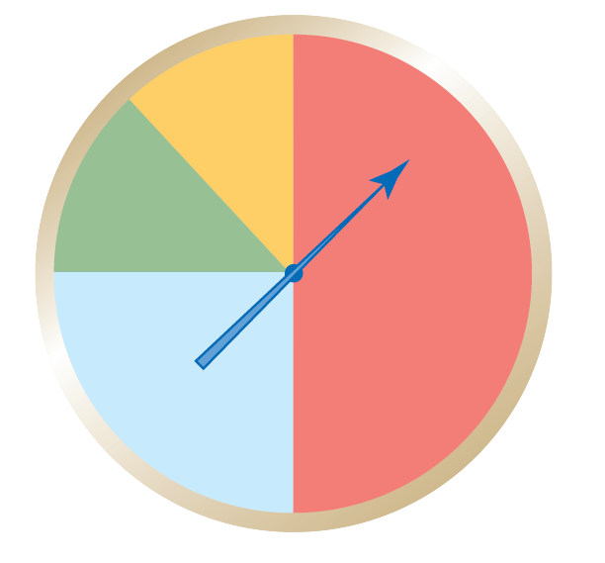
Fair or Unfair? Use Two Methods
€8
€14
€2
€4

Slide 16
Fair Games
Fair Game
A game is said to be fair if the expected value (after considering the cost) is 0. If this value is positive, the game is in your favour; and if this value is negative, the game is not in your favour.

