Slide 1
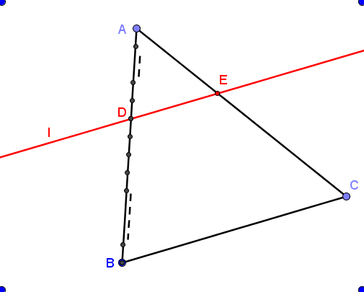
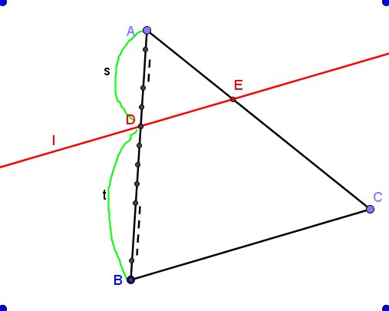
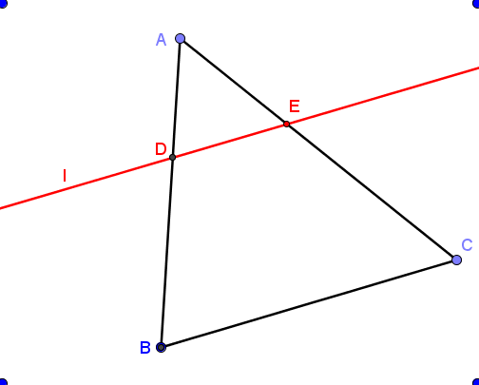
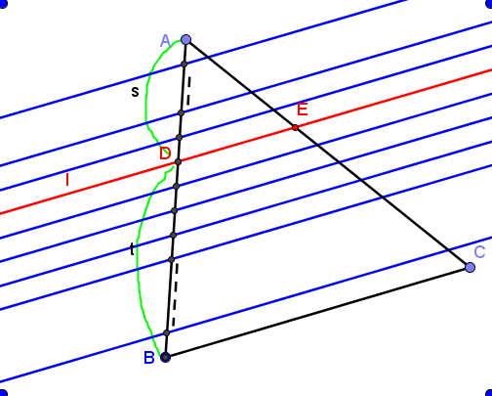
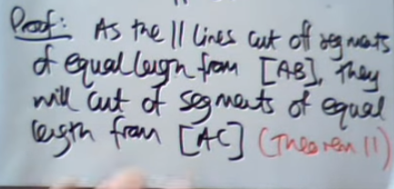
Theorem 12:
Diagram:
|AD|:|DB|= s:t$⇒\frac{|AD|}{|DB|}=\frac{s}{t}$
|AE|:|EC|= s:t$⇒\frac{|AE|}{|EC|}=\frac{s}{t}$
Given:  ABC, line l parallel to [BC], which cuts [AB] at D and [AC] at E, where $\frac{|AD|}{|DB|}=\frac{s}{t}$
To Prove: $\frac{|AE|}{|EC|}=\frac{s}{t}$
Construction : Mark off points along [AB] to form s+t equal segments so that s of these segments lie in [AD] and t of them lie in [DB].
Draw lines from these points parallel to line l, and intersecting [AC].
Proof: [AC] has been divided into s+t equal segments. (by Theorem 11) with s of them forming [AE] and t of them forming [EC]. (Axiom of Parallels].
Thus line l divides AC in the ratio s:t.
https://www.youtube.com/watch?v=RCBJXxdlcqs

