Slide 1
Multiplication of Complex Numbers
https://tinyurl.com/WS4task2-2
Argument$θ$= angle of complex number with the positive real axis
Modulus $r$ = distance from origin to complex number
What is the effect on the argument and modulus when $z1 = z2$?

Slide 2
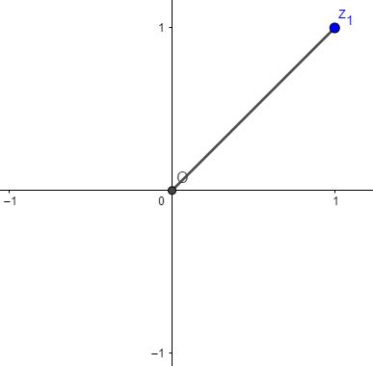
From Rectangular Form to Polar Form
Argument $θ$ = angle of complex number with the positive real axis
Modulus $r$ = distance from origin to complex number
Write $z = 1 + i$in Polar Form

Slide 3
From Rectangular Form to Polar Form $r(cosθ+i sinθ)$
Argument $θ$
$Tan θ = 1/1$
$θ=π/4$
Modulus $r$
$r=\sqrt{{\left(1\right)}^{2}+{\left(1\right)}^{2}}$
$r=\sqrt{2}$
From rectangular to polar form
$1+i=\sqrt{2}(cosπ/4+1 sinπ/4)$
$$θ$$
Write $z = 1 + i$in Polar Form

Slide 4
Multiplication of Complex Numbers
The effect of multiplying a complex number by itself:
De Moivre’s theorem: $zn = rn (\cos{nθ}+i\sin{nθ)}$
Multiplication | Argument (angle θ) | Modulus (r)
z x z = z² | Doubled | Squared
z x z x z = z³ | Tripled | Cubed
z x z x z x z = z⁴ | Multiplied by 4 | Multiplied by itself 4 times
z x z x z x z x z = z⁵ | Multiplied by 5 | Multiplied by itself 5 times
z^{n} | Multiplied by n | Multiplied by itself n times

Slide 5
De Moivre’s Theorem: $zn = rn (\cos{nθ}+i\sin{nθ)}$ Find ${\left(1+i\right)}^{10}$
From rectangular to polar form
$1+i=\sqrt{2}(cosπ/4+1 sinπ/4)$
${\left(1+i\right)}^{10}={\sqrt{2}}^{10}{\left(cosπ/4+i sinπ/4\right)}^{10}$
${\left(1+i\right)}^{10}={\sqrt{2}}^{10}\left(cos10\left(π/4\right)+i sin10\left(π/4\right)\right)$
${\left(1+i\right)}^{10}=32(\cos{{5π}/2+i\sin{{5π}/2)}}$
${\left(1+i\right)}^{10}=32(0+1i)$
${\left(1+i\right)}^{10}=0+32i$
$$θ$$
Find $z ={\left(1 + i\right)}^{10}$

